Slide 1
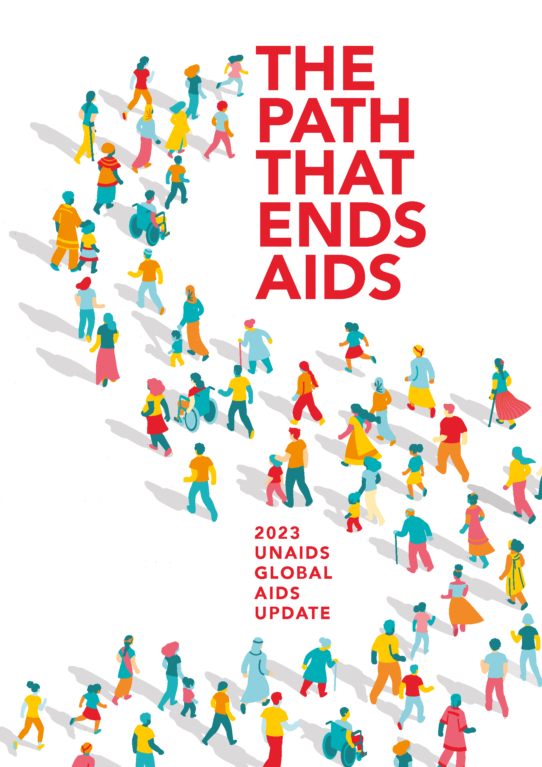
GLOBAL AIDS UPDATE | 2023
THE PATH THAT ENDS AIDS

Slide 2
I
EXECUTIVE SUMMARY
Global AIDS Update | 2022

Slide 3
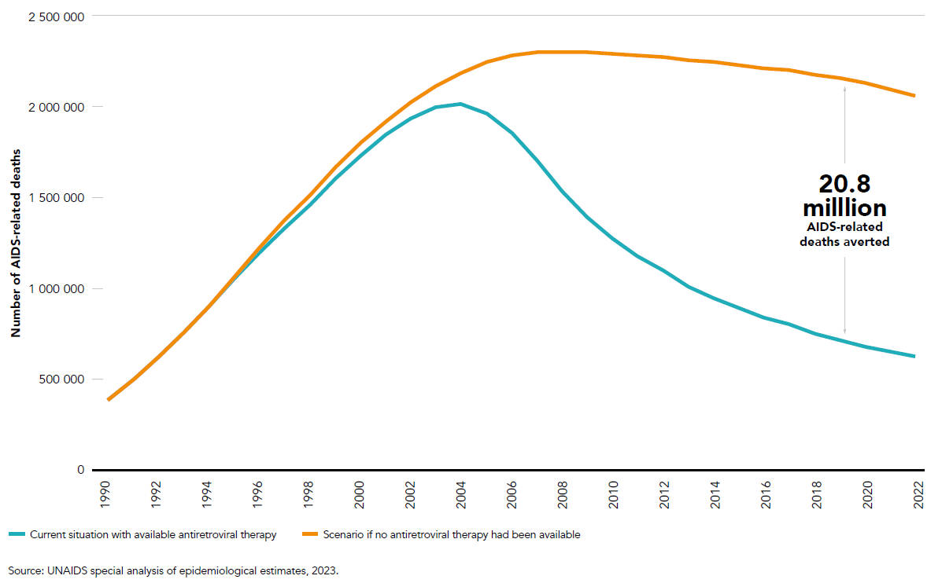
Number of AIDS-related deaths: current situation versus scenario without available antiretroviral therapy, 1990–2022

Slide 4
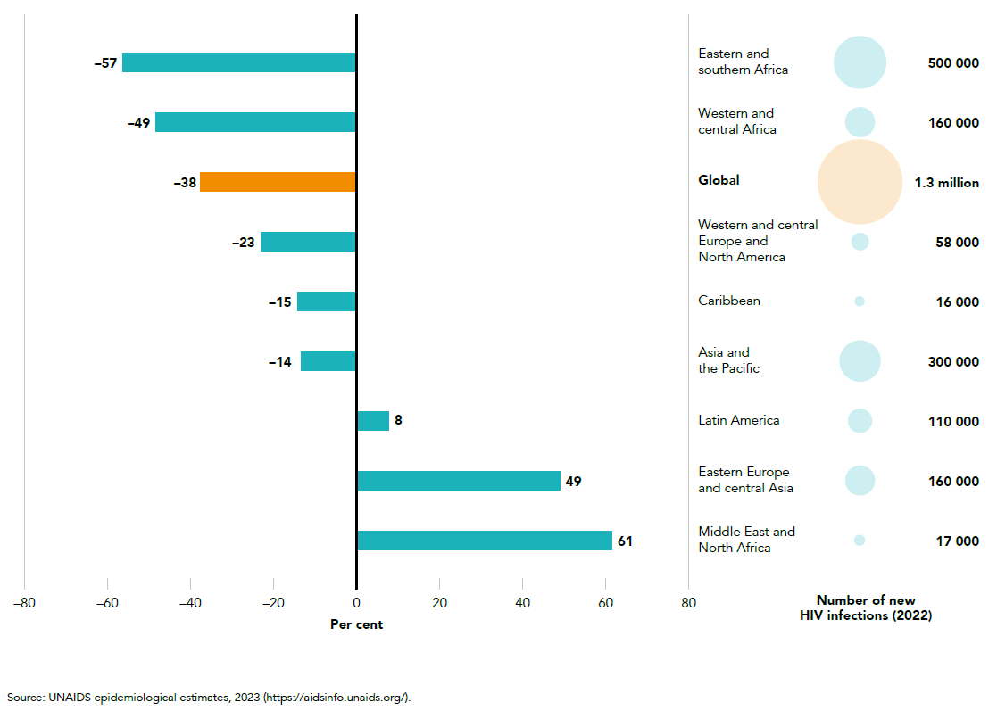
Change in number of new HIV infections, 2010–2022, and number of new HIV infections, 2022, global and by region

Slide 5
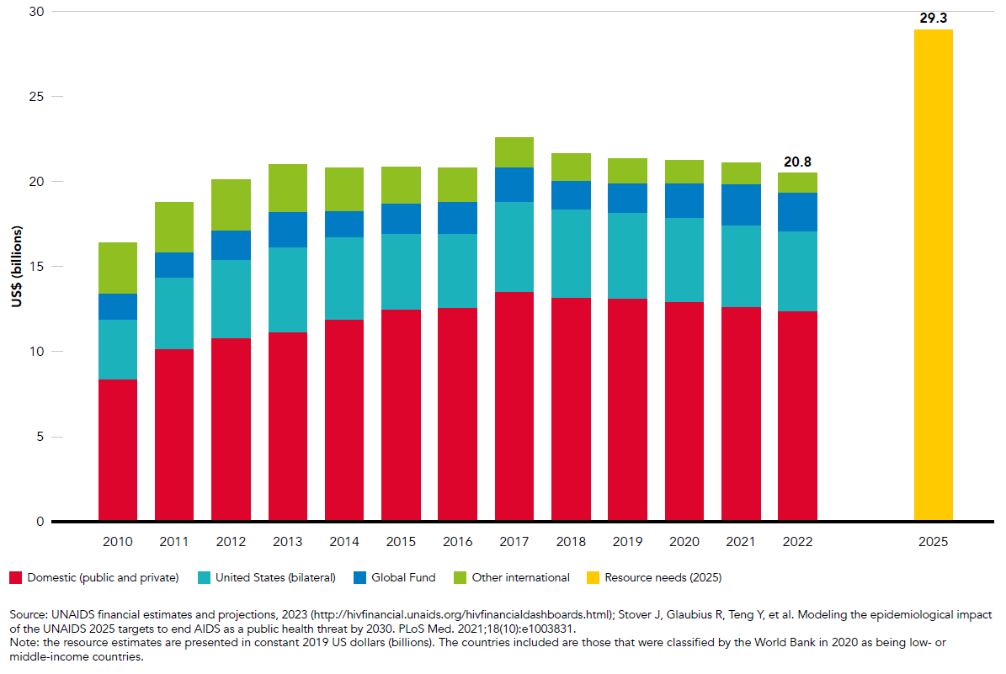
Resource availability for HIV in low- and middle-income countries by source, 2010–2022 and 2025 target

Slide 6
I
PATHWAYS TO SUCCESS IN THE HIV RESPONSE
Global AIDS Update | 2022

Slide 7
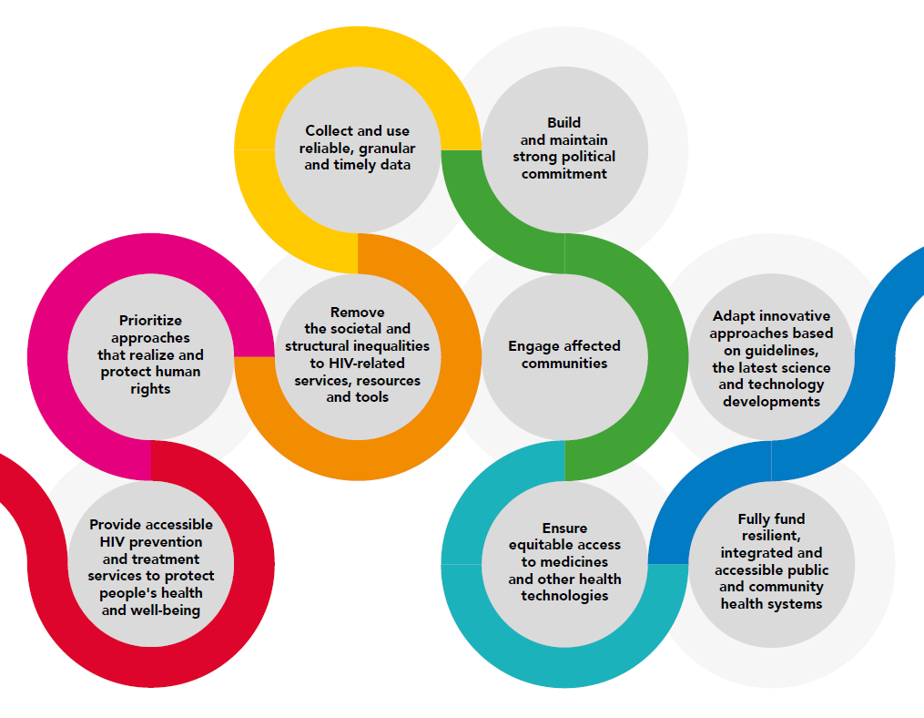
Building blocks for a successful HIV response

Slide 8
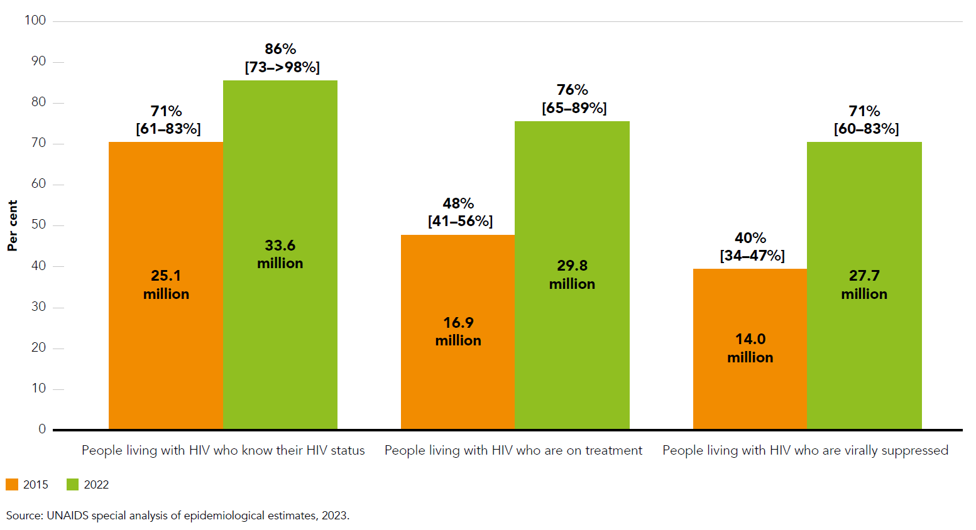
Percentage and number of people living with HIV who know their HIV status, are receiving antiretroviral therapy and are virally suppressed, global, 2015 and 2022

Slide 9
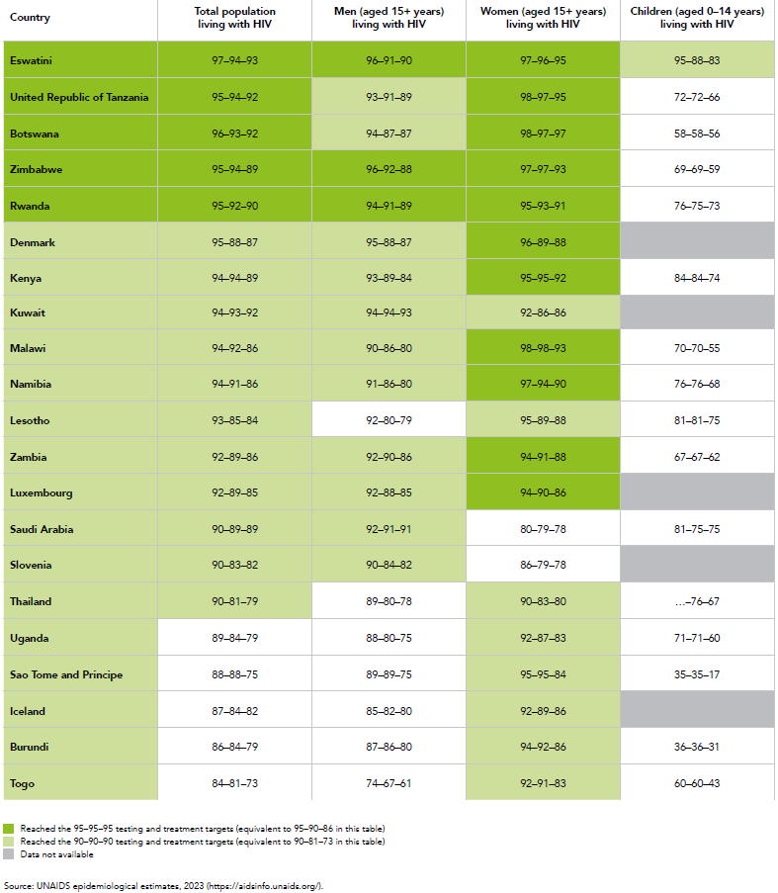
HIV testing and treatment cascade by age and sex, selected countries, 2022
Notes:
Note: achieving the 95–95–95 targets requires that 95% of people living with HIV know their HIV status (indicator 1); 95% of people who know their status are receiving antiretroviral therapy (indicator 2); and 95% of people on antiretroviral therapy have suppressed viral loads (indicator 3). In HIV testing and treatment cascade figures, indicators 2 and 3 are expressed as a percentage of all people living with HIV. Achieving the 95–95–95 targets thus translates to 95% of people living with HIV knowing their HIV status; 90% of people living with HIV receiving antiretroviral therapy; and 86% of people living with HIV having suppressed viral loads. Achieving the 90–90–90 targets translates to 90% of people living with HIV knowing their HIV status; 81% of people living with HIV receiving antiretroviral therapy; and 73% of people living with HIV having suppressed viral loads.
Note: all values in this table were rounded down to the nearest whole number. Countries have been assessed as reaching the 95–95–95 targets if coverage is ≥95.0% (for the 90–90–90 targets if coverage is ≥89.9%). Thus, coverage of 94.9% (or 90.0%) is not considered as reaching the target. Please see Annex 2 Methods for a description of how estimates of the testing and treatment targets are calculated.

Slide 10
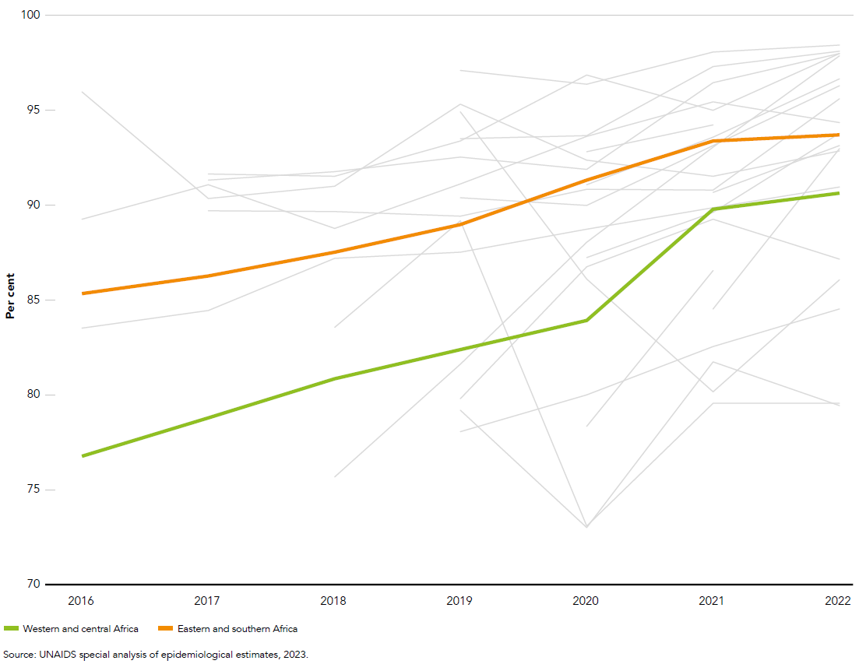
Percentage of adults (aged 15+ years) living with HIV on antiretroviral therapy with viral load suppression (<1000 copies/mL), western and central Africa and eastern and southern Africa, 2016–2022

Slide 11
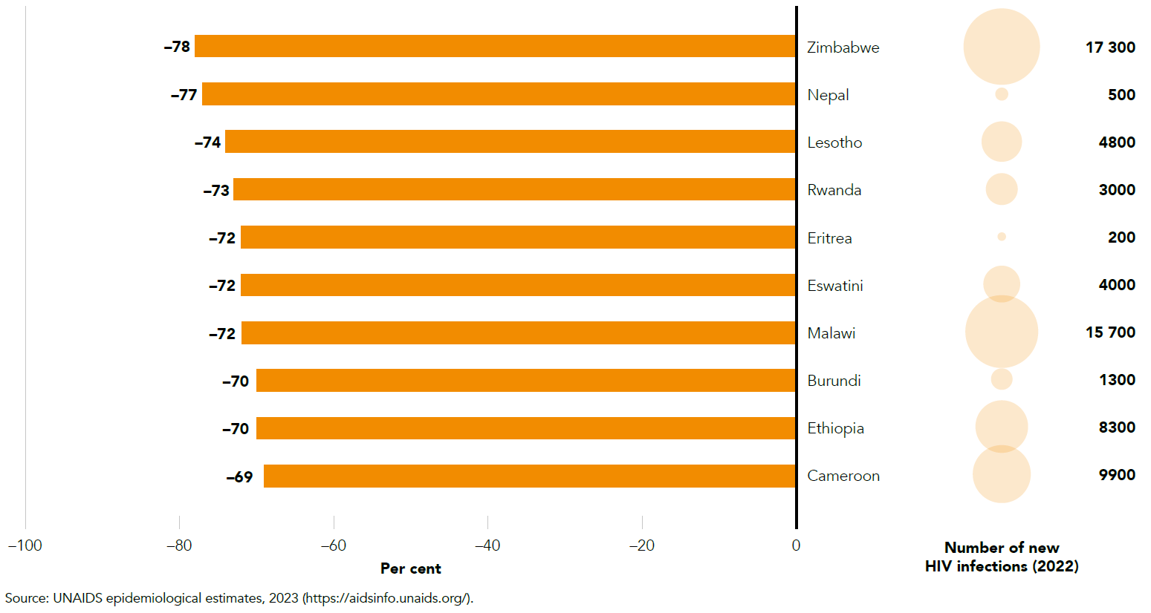
Change in number of new HIV infections, 2010–2022, and number of new HIV infections, 2022,
selected countries among those with the biggest declines in new HIV infections

Slide 12
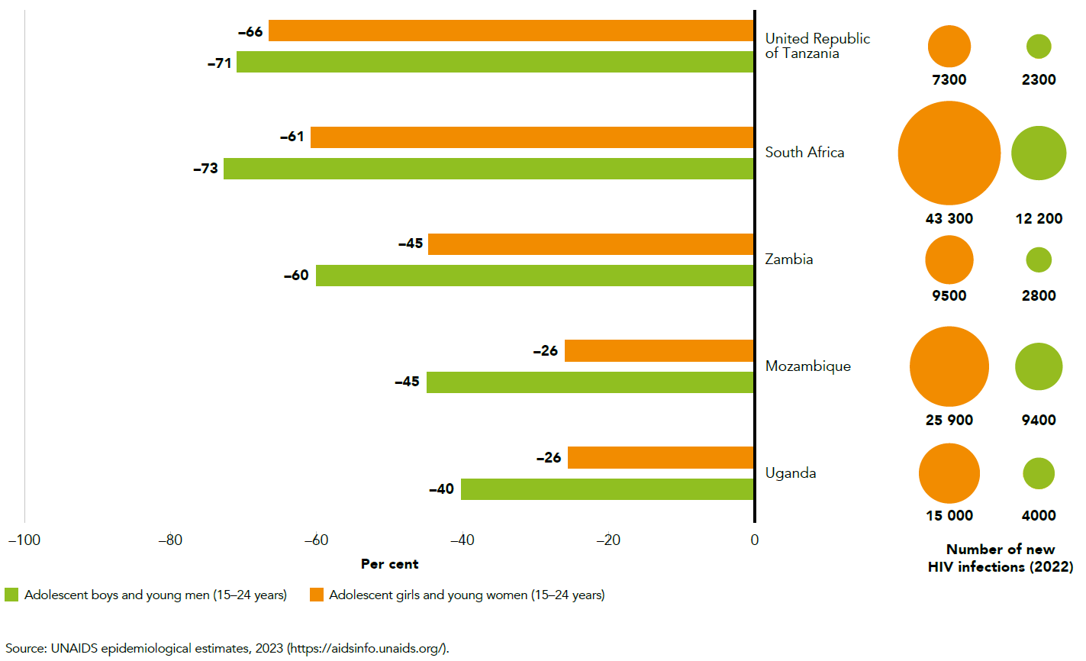
Change in number of new HIV infections, 2010–2022, and number of new HIV infections, 2022,
among adolescents and young people (aged 15–24 years), by sex, selected countries, eastern and southern Africa

Slide 13
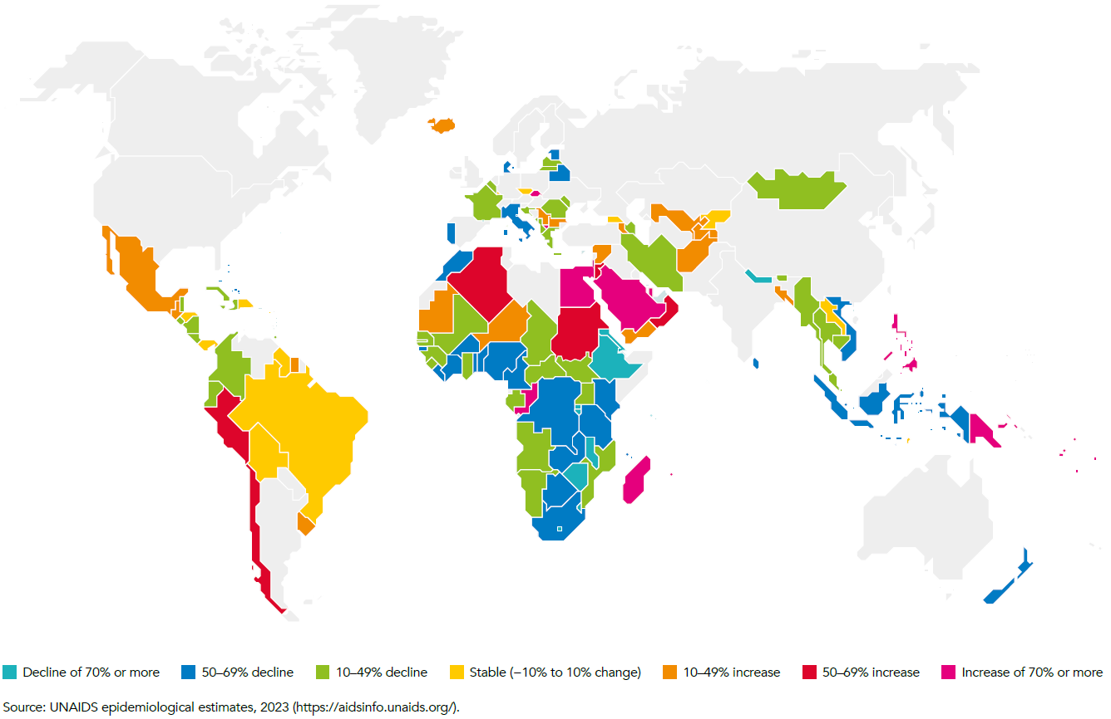
Change in number of new HIV infections, countries with available data, 2010–2022

Slide 14
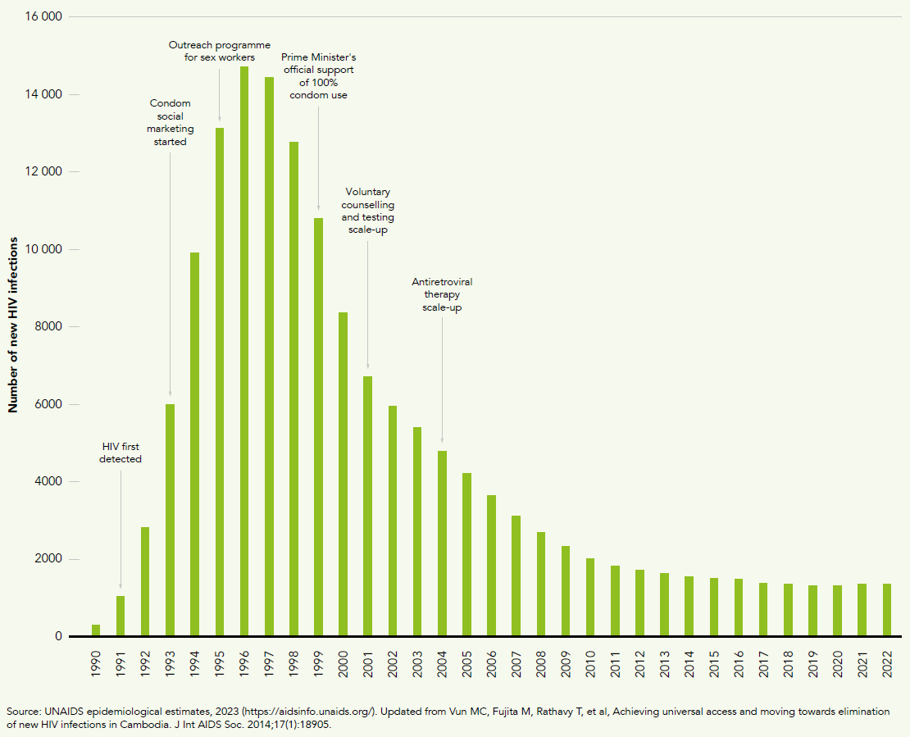
Numbers of new HIV infections and major programmatic improvements, Cambodia, 1990–2022

Slide 15
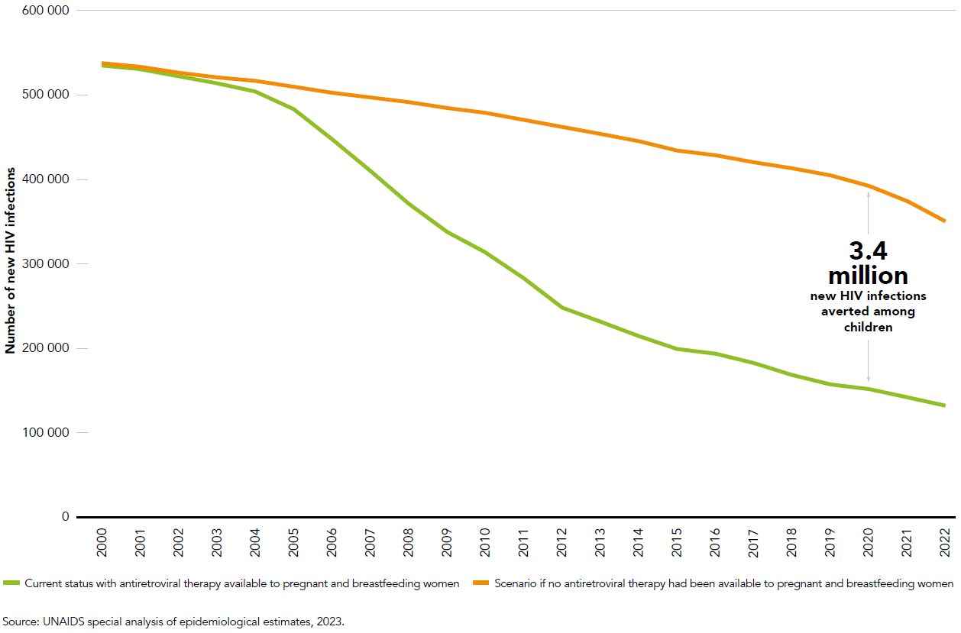
Number of new HIV infections among children (aged 0–14 years) versus scenario without antiretroviral therapy available to pregnant and breastfeeding women, global, 2000–2022

Slide 16
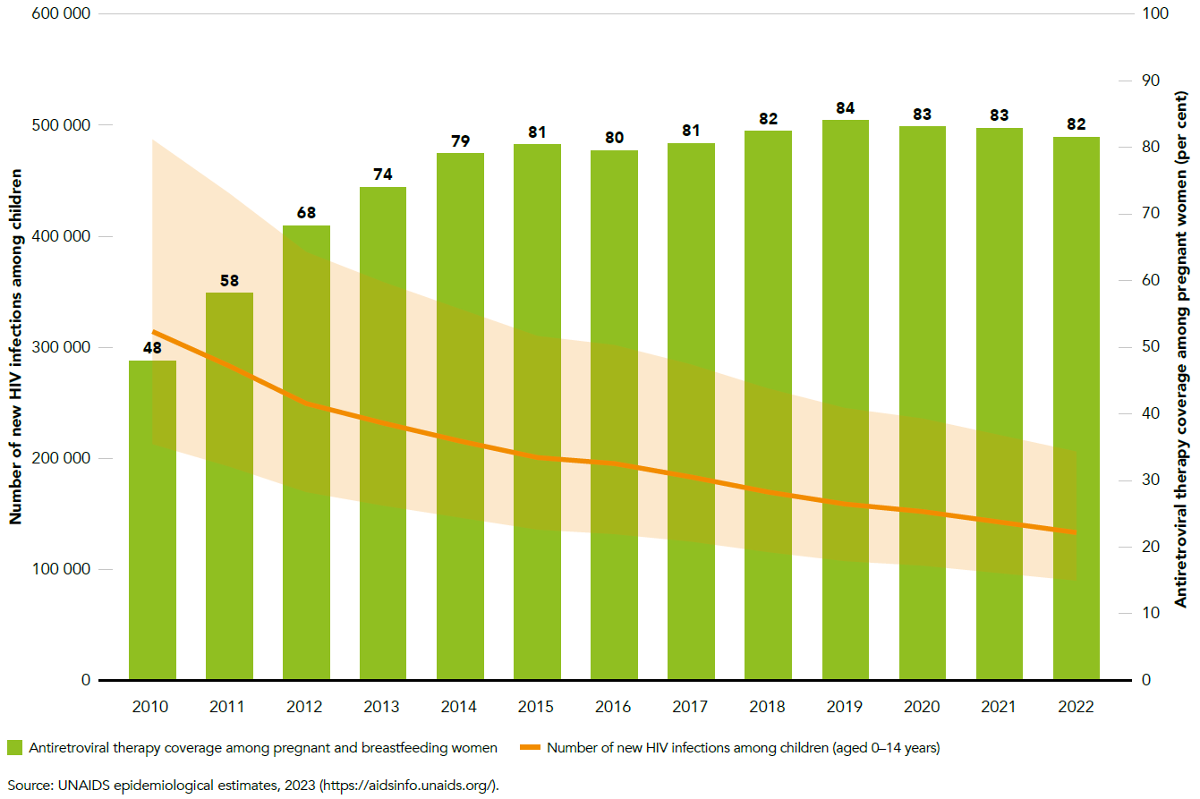
Numbers of new HIV infections among children (aged 0–14 years) and antiretroviral therapy coverage
among pregnant and breastfeeding women, global, 2010–2022

Slide 17
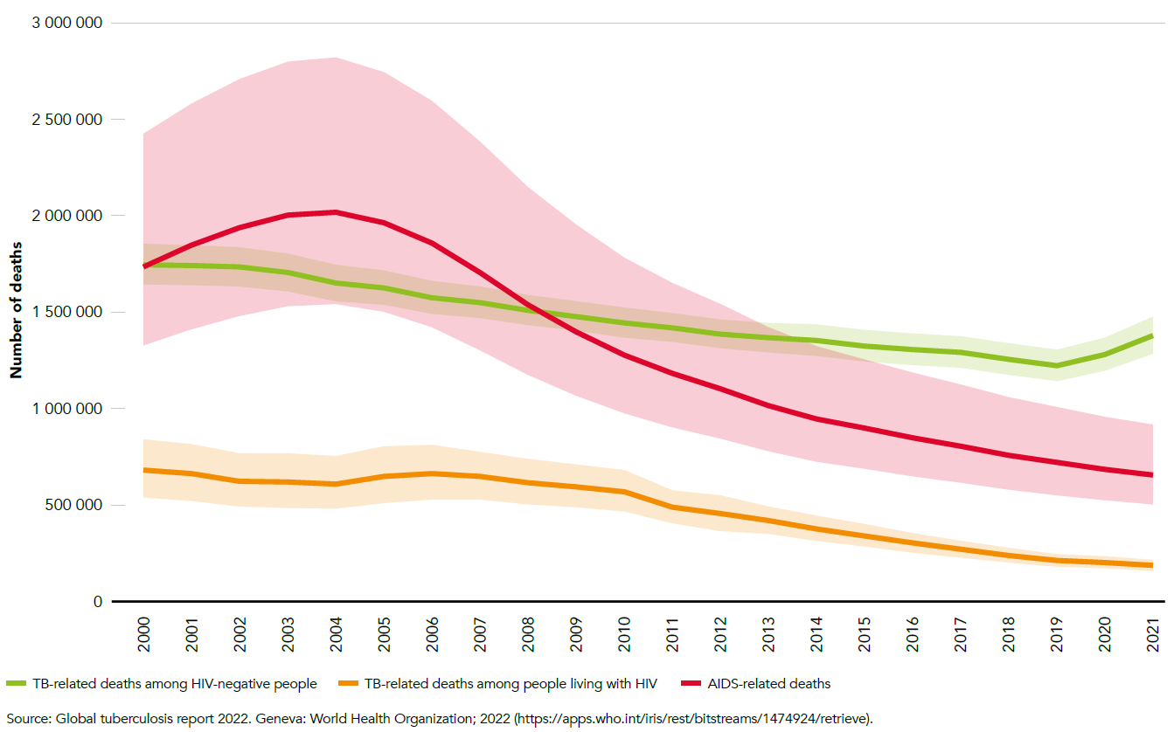
Numbers of TB-related deaths among people living with HIV and HIV-negative people, and AIDS-related deaths, global, 2000–2021

Slide 18
I
BREAKING DOWN BARRIERS: REMOVING THE OBSTACLES THAT HOLD BACK HIV RESPONSES
Global AIDS Update | 2022

Slide 19
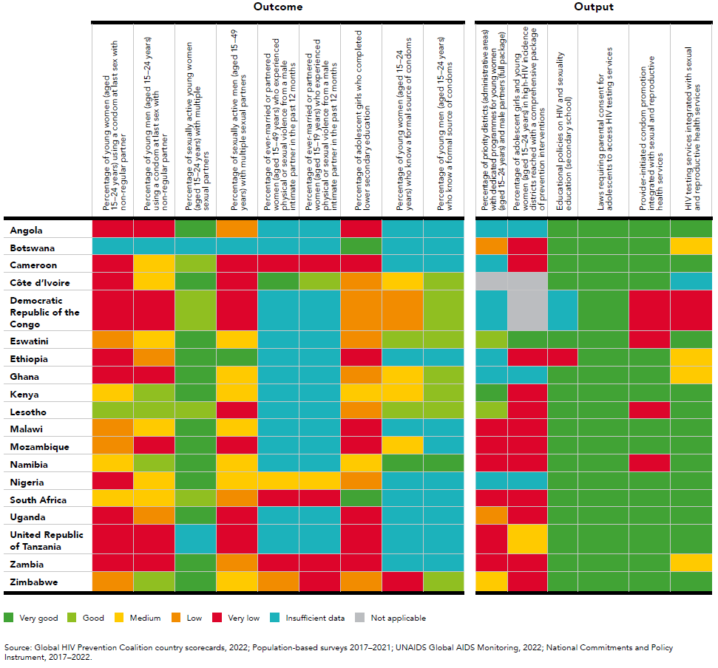
Scorecard for HIV prevention among adolescent girls and young women (aged 15–24 years), Global HIV
Prevention Coalition countries, 2021

Slide 20
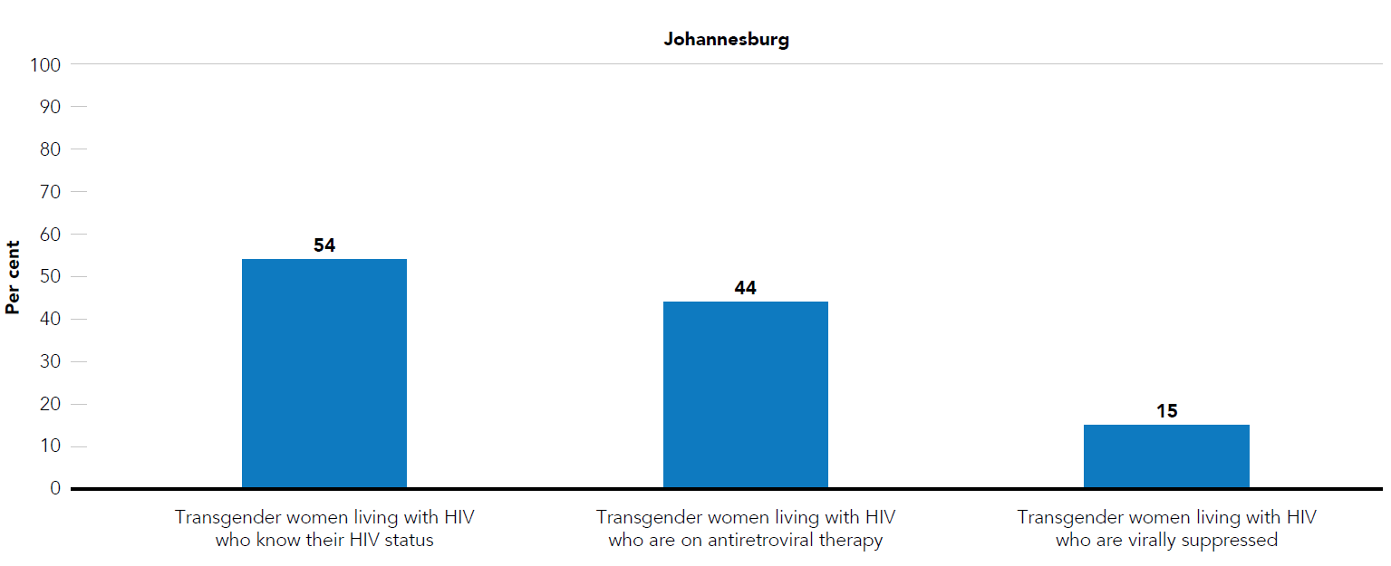
Testing and treatment cascade for transgender women living with HIV in three metropolitan areas in South Africa, 2018–2019

Slide 21
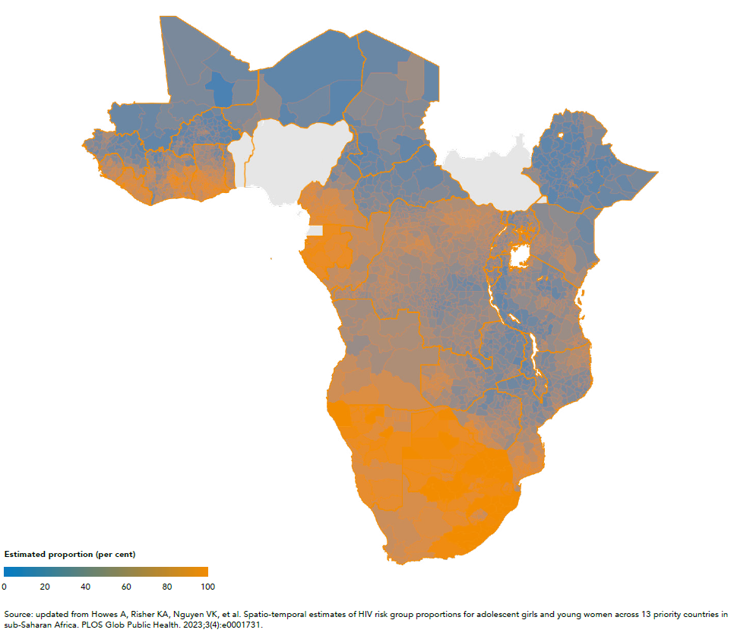
Spatial distribution of women (aged 20–24 years) with non-regular or multiple partners, 30 sub-Saharan African countries, 2022

Slide 22
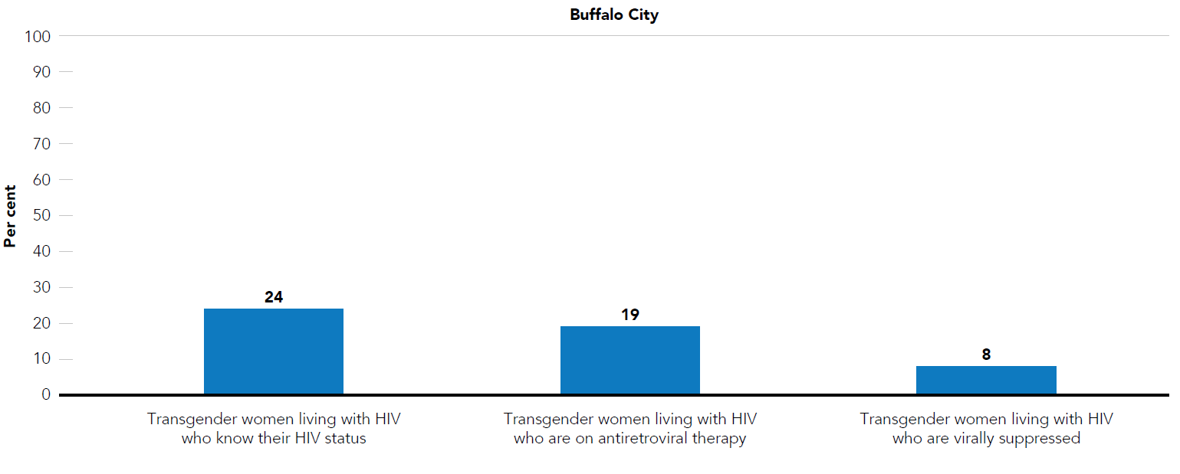
Testing and treatment cascade for transgender women living with HIV in three metropolitan areas in South Africa, 2018–2019

Slide 23
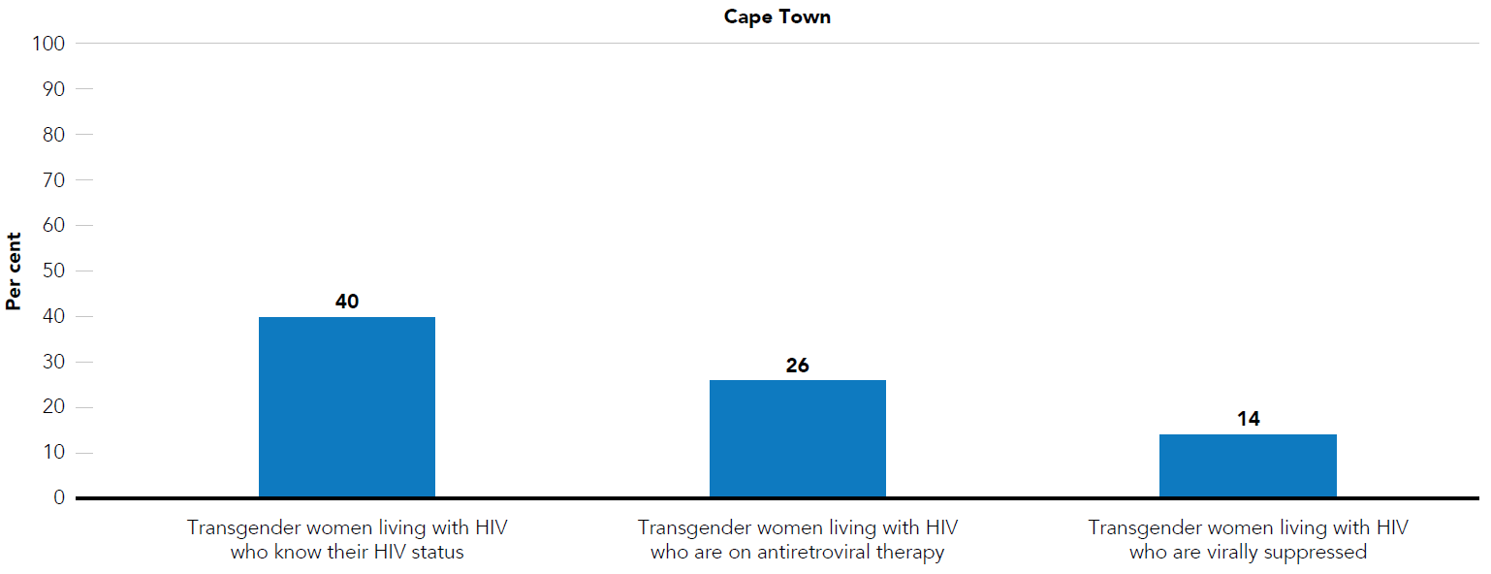
Testing and treatment cascade for transgender women living with HIV in three metropolitan areas in South Africa, 2018–2019

Slide 24
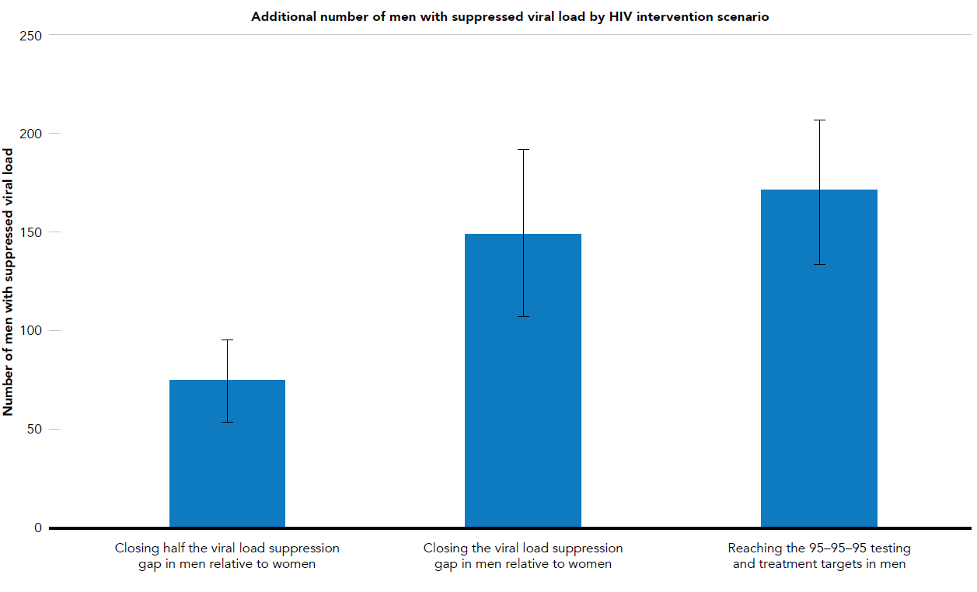
Modelling scenarios predicting the impact on HIV incidence in women of improved treatment coverage and outcomes in men, Rakai, Uganda

Slide 25
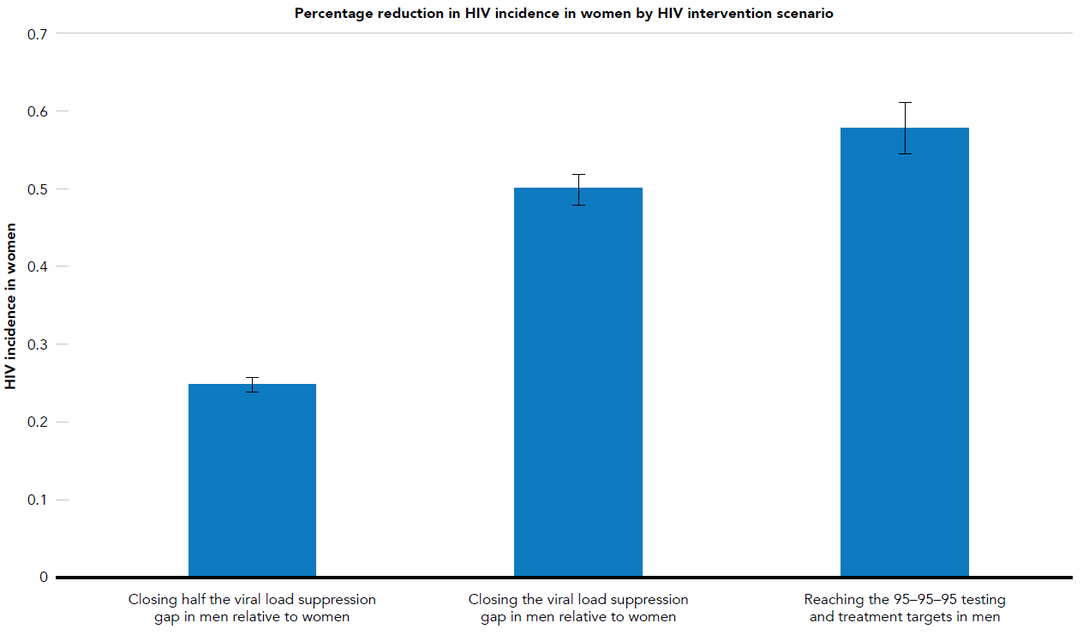
Modelling scenarios predicting the impact on HIV incidence in women of improved treatment coverage and outcomes in men, Rakai, Uganda

Slide 26
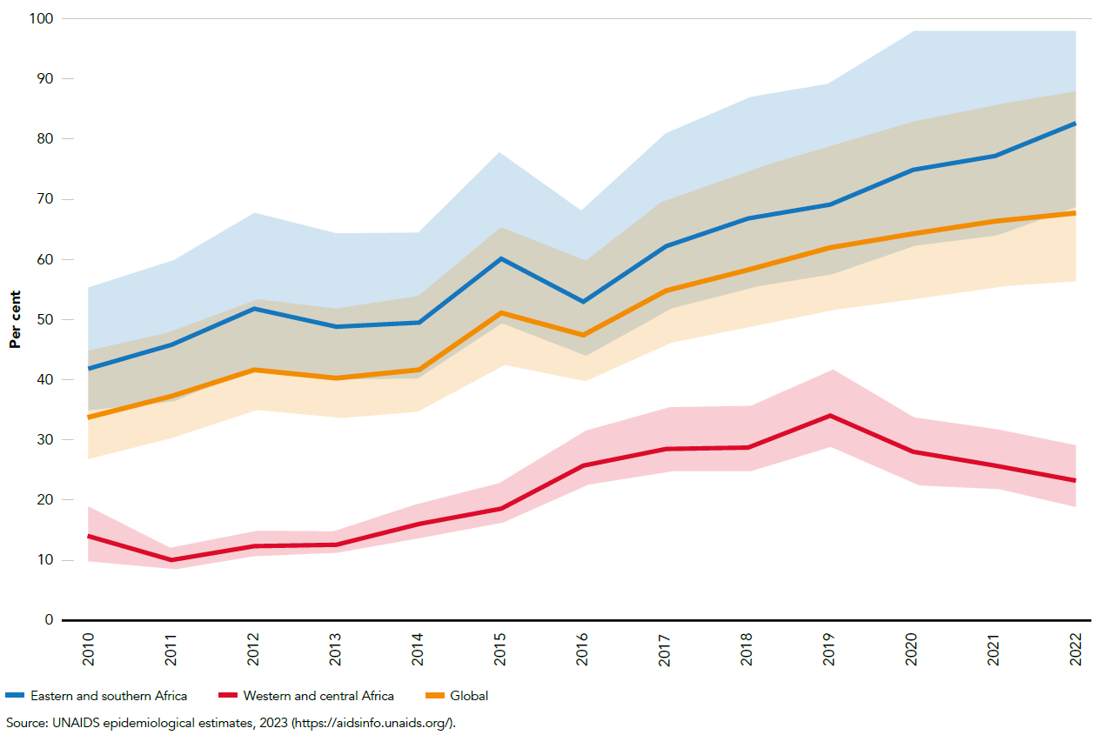
Percentage of children exposed to HIV who were tested for HIV by two months of age, global and selected regions, 2010–2022

Slide 27
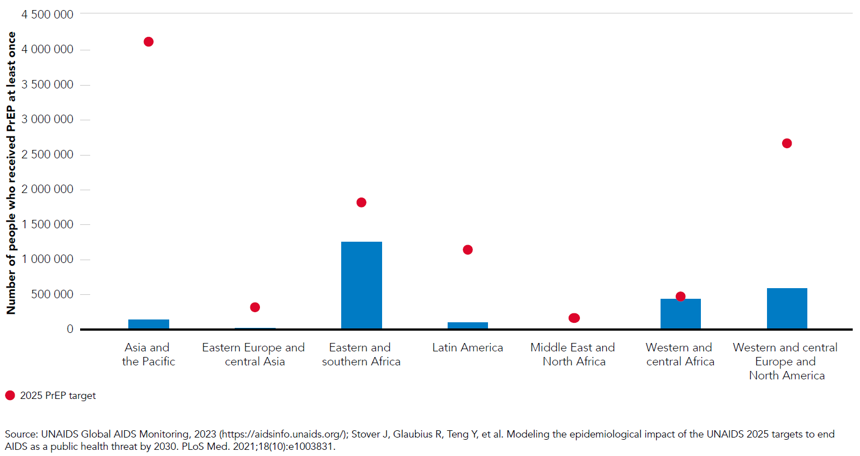
Number of people who received PrEP at least once during the reporting period, by region, 2022, and 2025 target

Slide 28
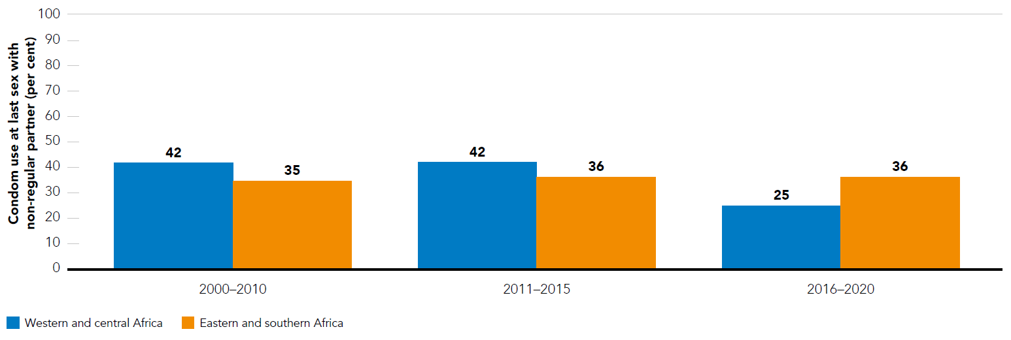
Consistent condom use by adolescent girls and young women (aged 15–24 years) at last sex with non-regular partner, eastern and southern Africa and western and central Africa, 2000–2020

Slide 29
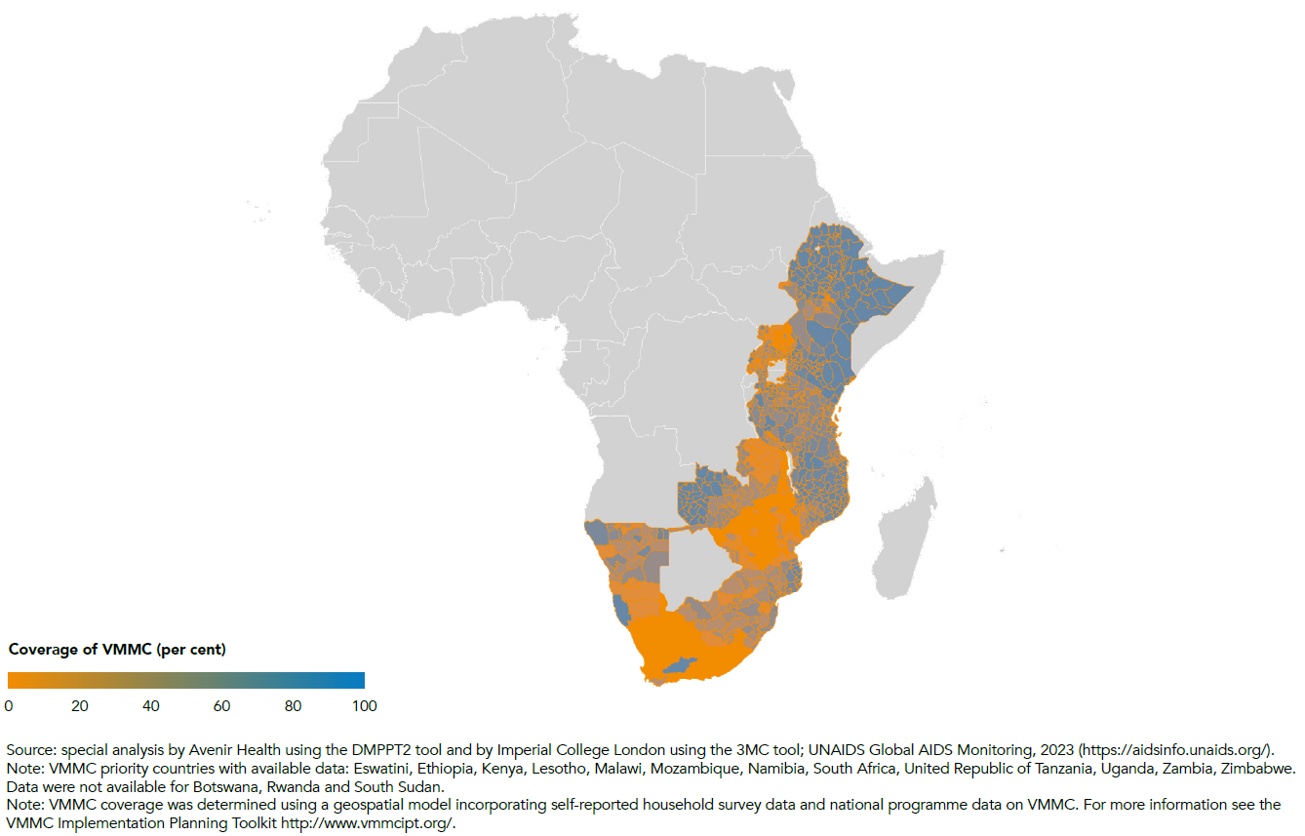
Coverage of VMMC among boys and men (aged 15–49 years), subnational level (administrative level 2), eastern and southern Africa, 2022

Slide 30
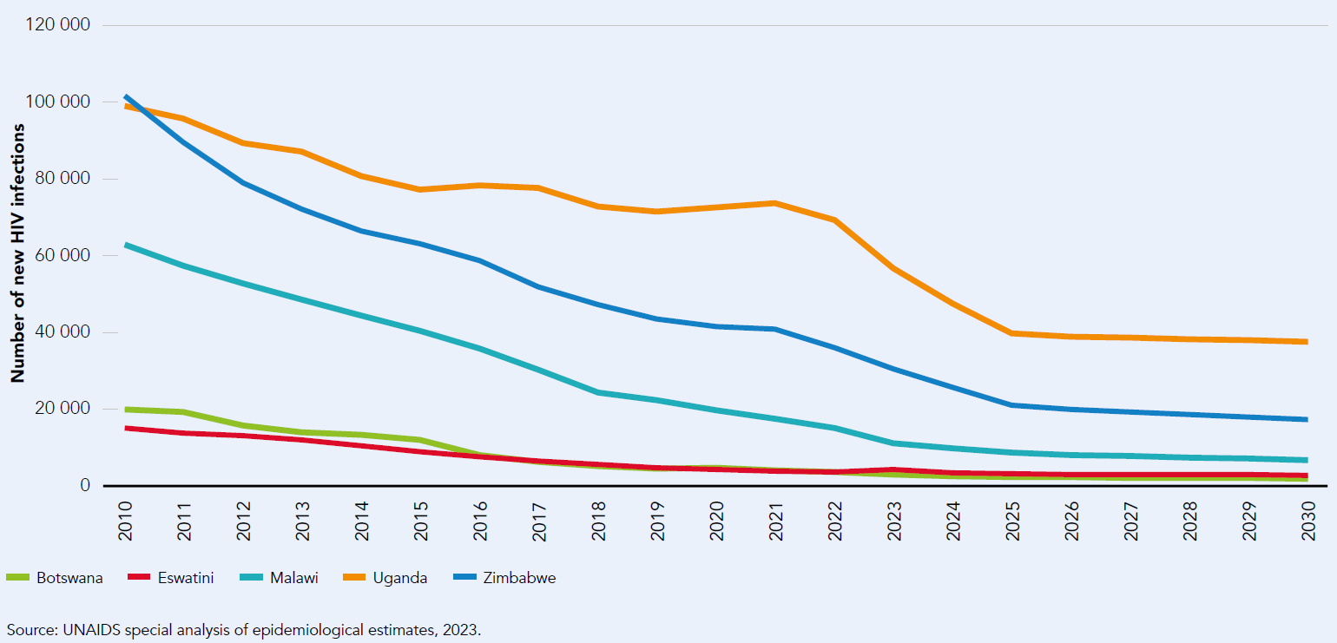
Number of new HIV infections, selected countries, eastern and southern Africa, 2010–2022 and projected number of new HIV infections without scale-up of HIV prevention efforts, 2023–2030

Slide 31
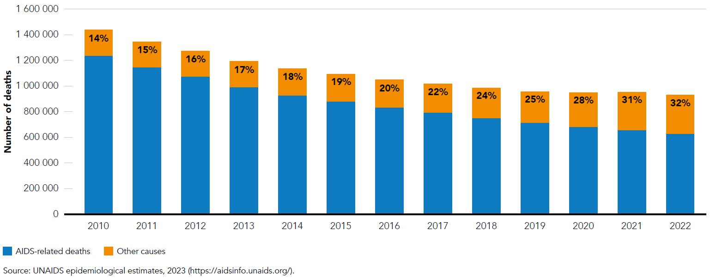
Deaths among people living with HIV, by cause, 2010–2022

Slide 32
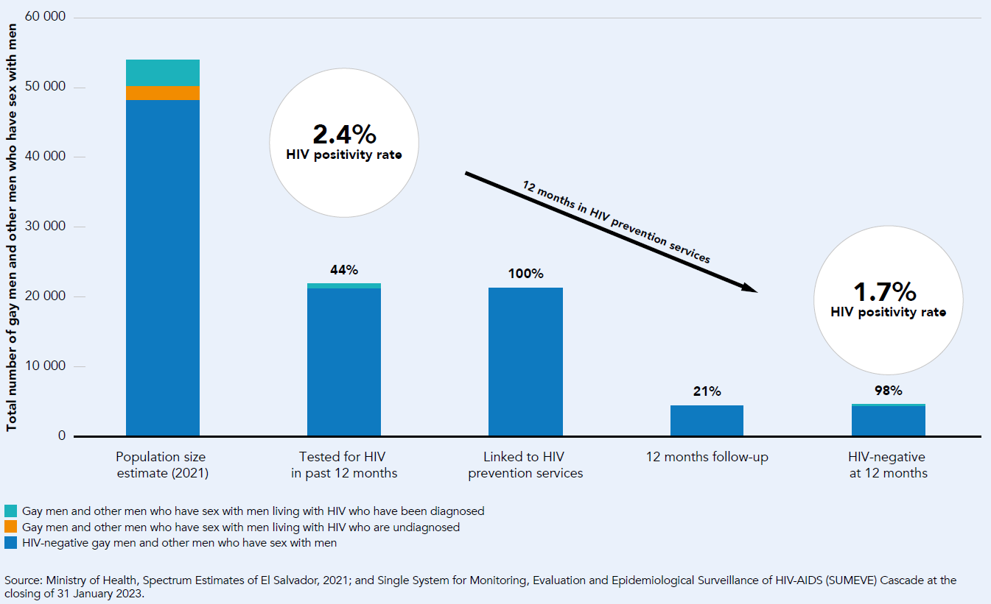
HIV prevention cascade for gay men and other men who have sex with men, El Salvador, 2021

Slide 33
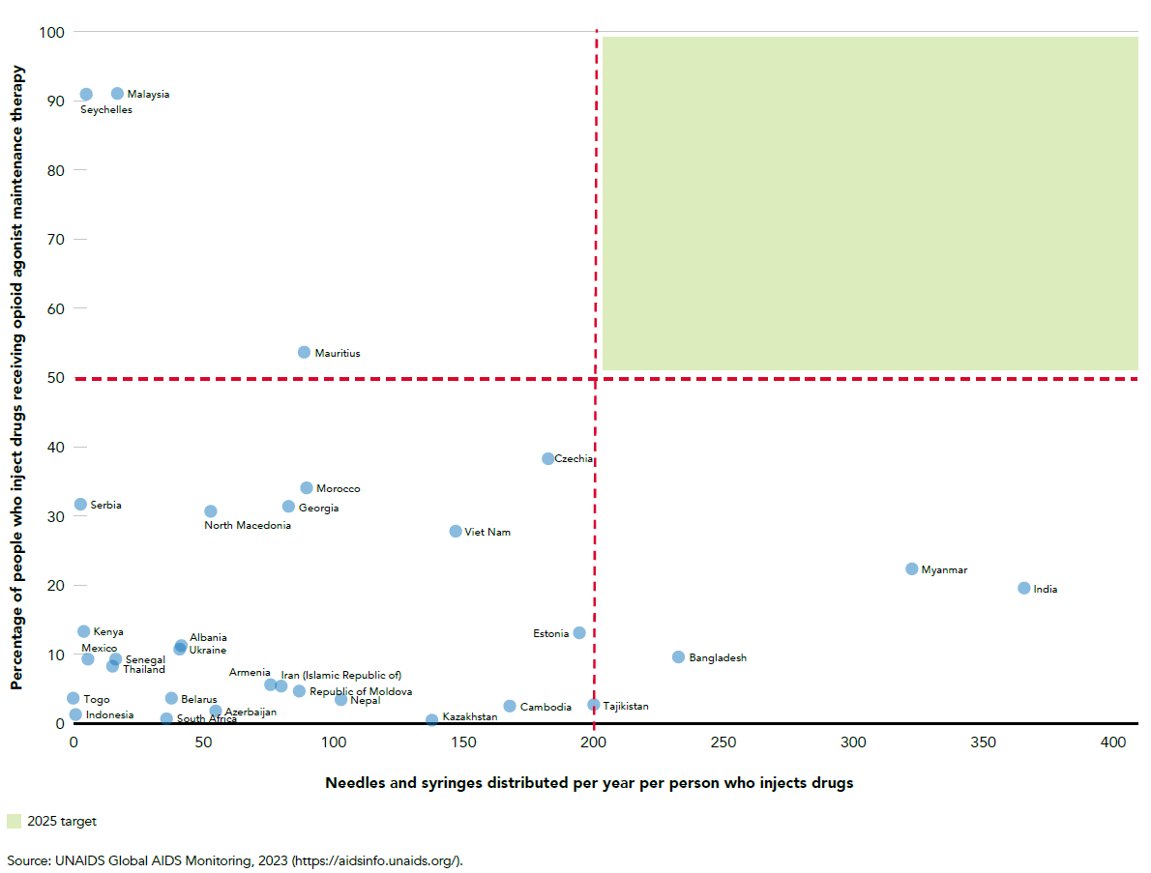
Coverage of needle–syringe programmes and opioid agonist maintenance treatment among people who inject drugs, and targets, countries with available data, 2018–2022

Slide 34
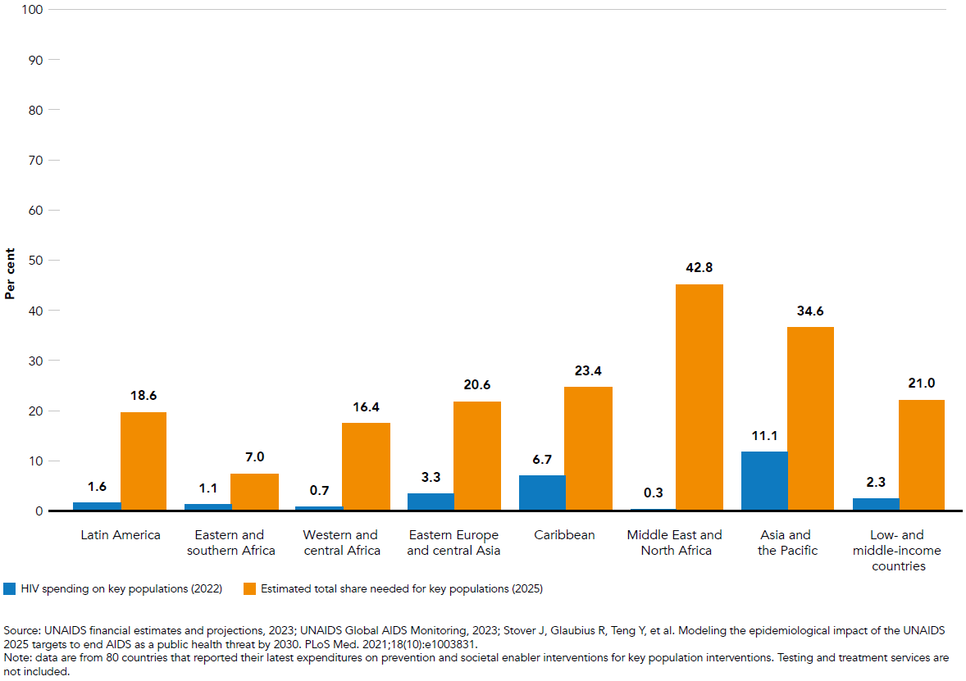
Percentage of total HIV spending spent on prevention and societal enablers for key populations, 2022, and projected share needed, 2025, low- and middle-income countries, by region

Slide 35
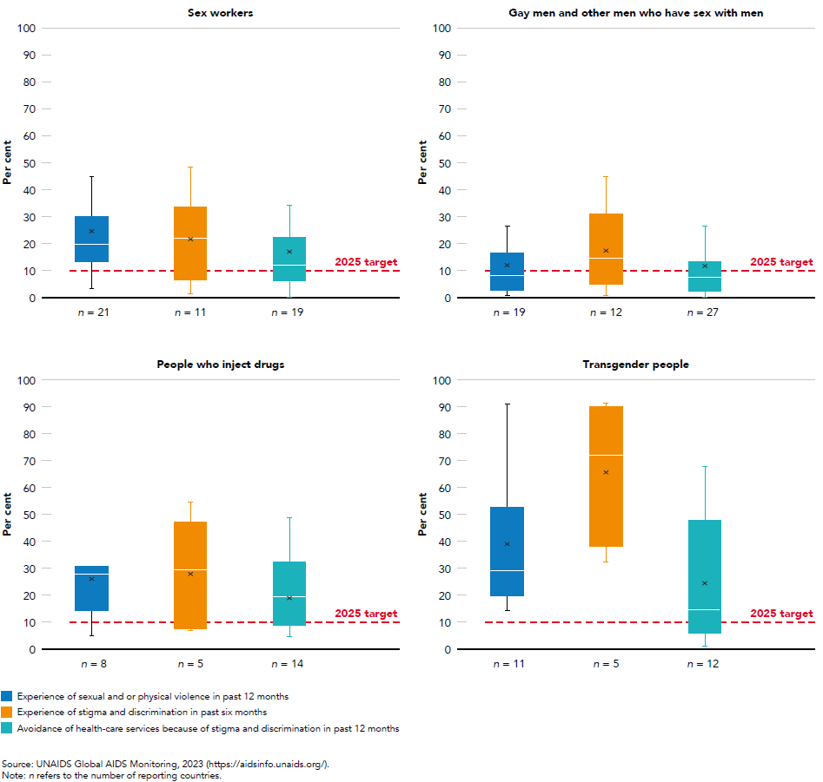
Experience of sexual and or physical violence, stigma and discrimination and avoidance of health-care services among key populations, countries with available data, 2018–2022

Slide 36
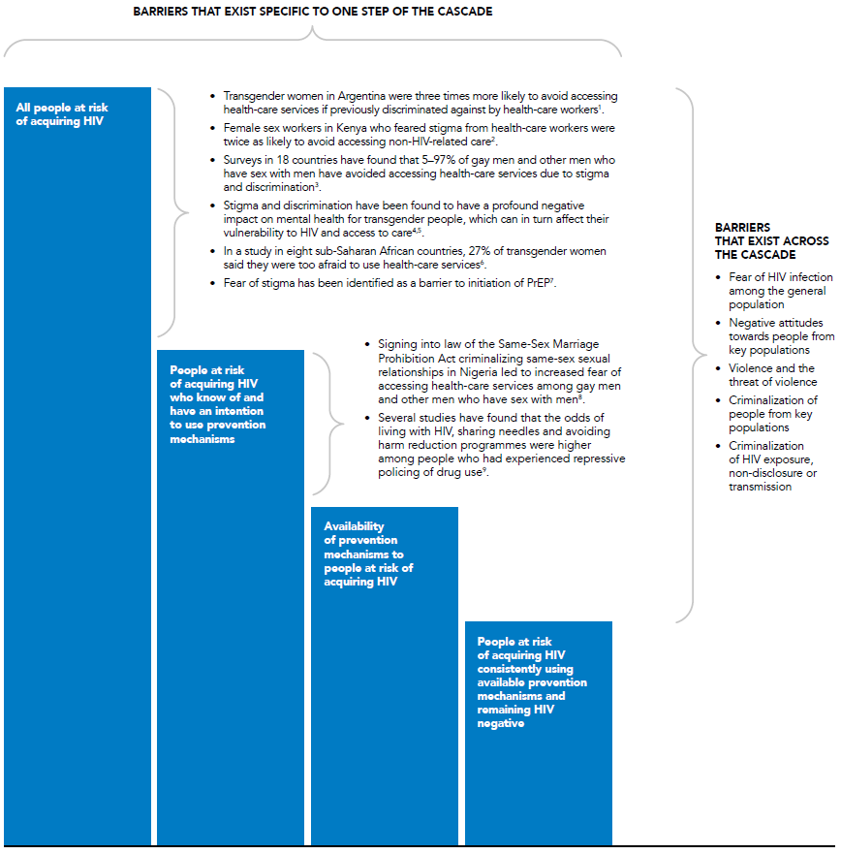
Evidence of the effects of stigma and discrimination on people’s ability to avoid acquiring HIV infection

Slide 37
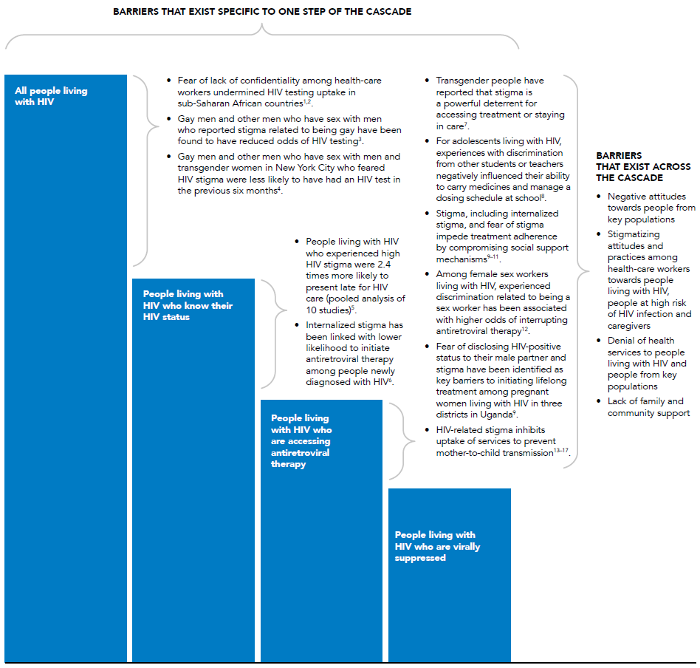
Evidence of the effects of stigma and discrimination on people’s ability to access and benefit from HIV testing and treatment services

Slide 38
I
OPPORTUNITIES FOR QUICKER PROGRESS TOWARDS ENDING AIDS
Global AIDS Update | 2022

Slide 39
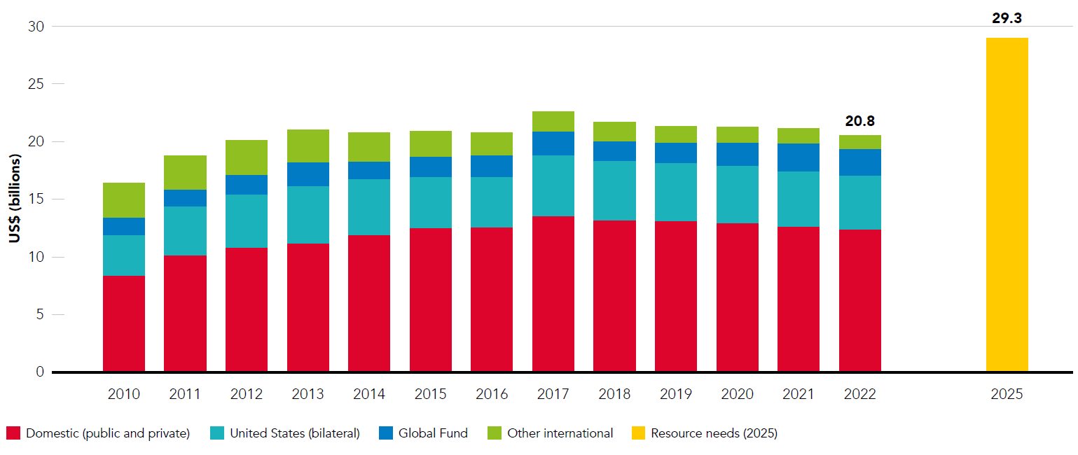
Resource availability for HIV in low- and middle-income countries by source of funding, 2010–2022 and 2025 target

Slide 40
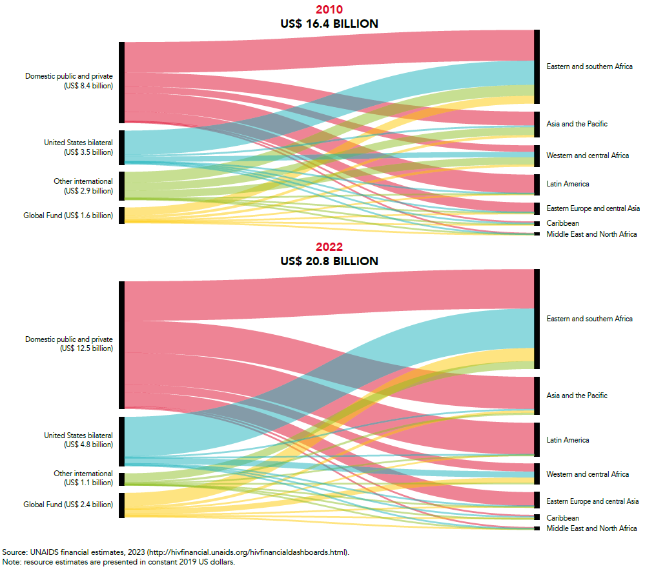
Domestic and international resources for HIV by source of funding, by region, 2010 and 2022

Slide 41
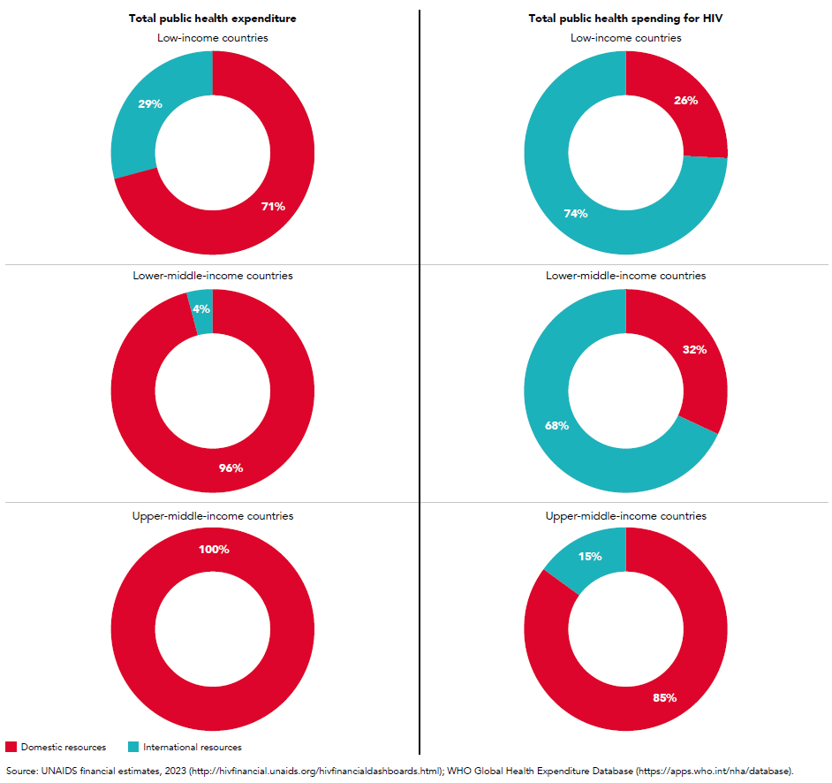
Percentage of public spending for health overall and for HIV, by source of funding and by country income classification, 2020

Slide 42
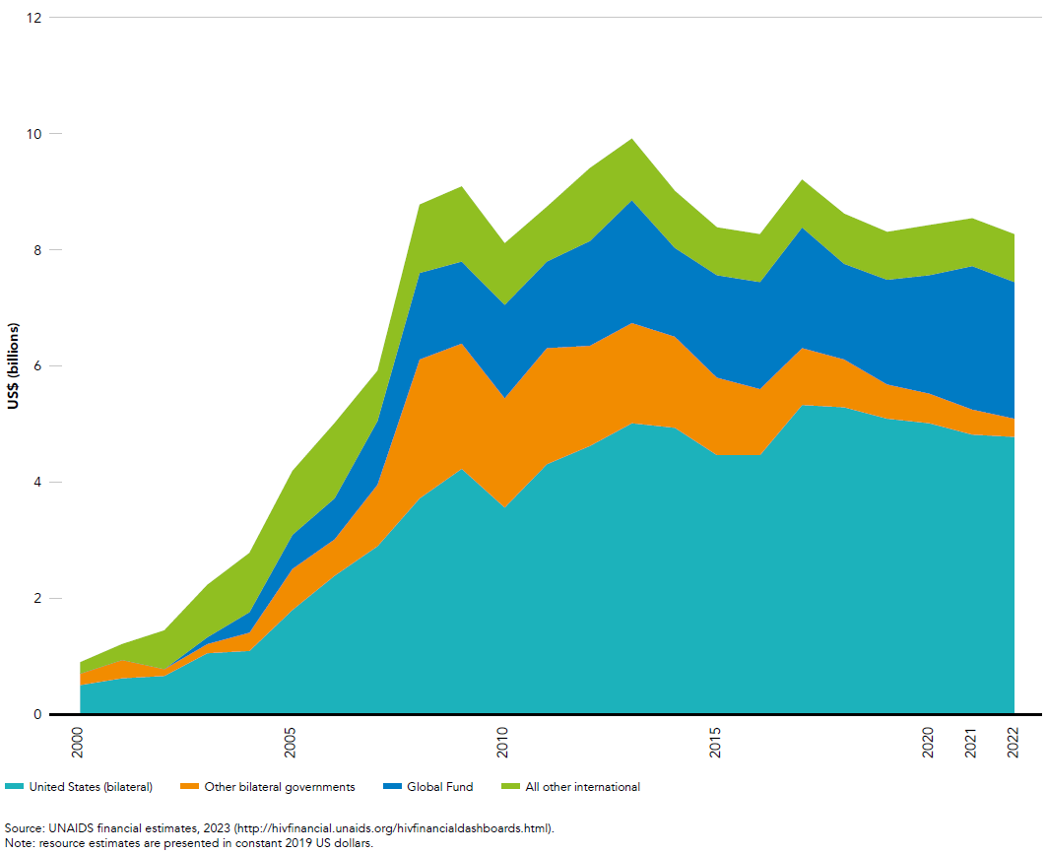
Resource availability for HIV in low- and middle-income countries by source of funding, 2000–2022

Slide 43
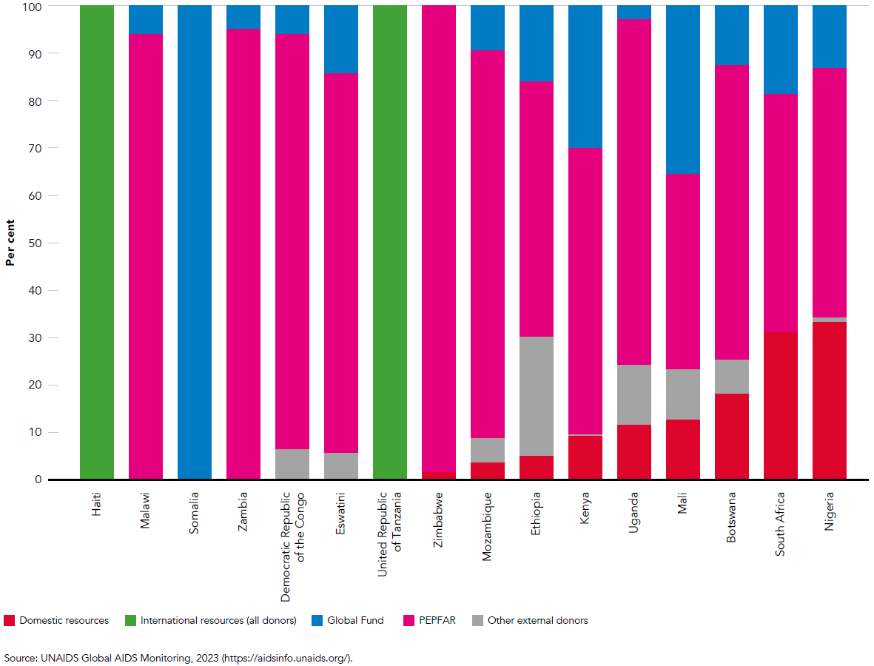
Percentage of funding for HIV prevention by source, selected countries with high burden of HIV, 2022

Slide 44
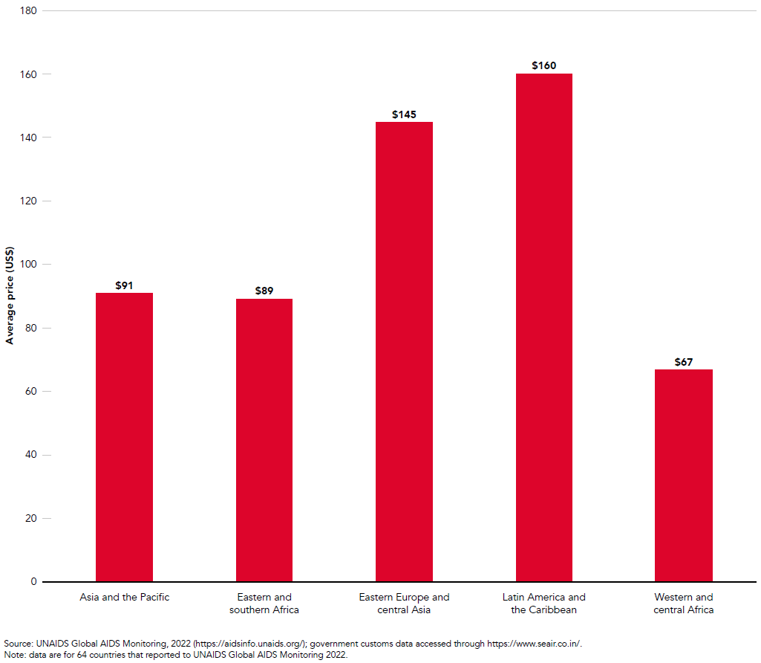
Average price (US$) per person-year for antiretroviral regimen (dolutegravir/lamivudine/tenofovir), by region, 2021

Slide 45
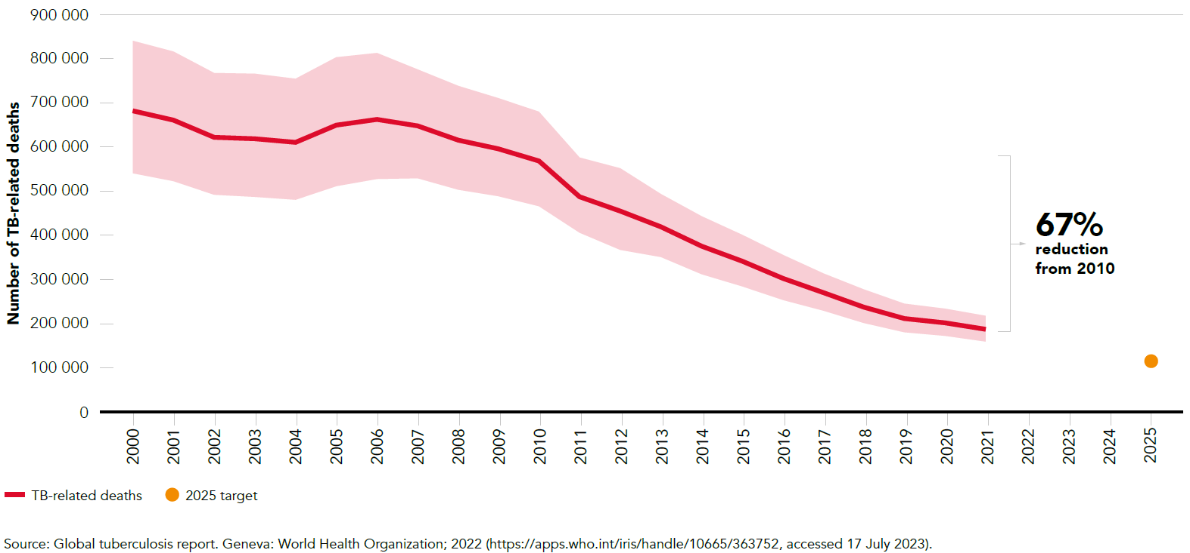
Number of TB-related deaths among people living with HIV, global, 2000–2021 and 2025 target

Slide 46
I
Asia and the Pacific
Global AIDS Update | 2022

Slide 47
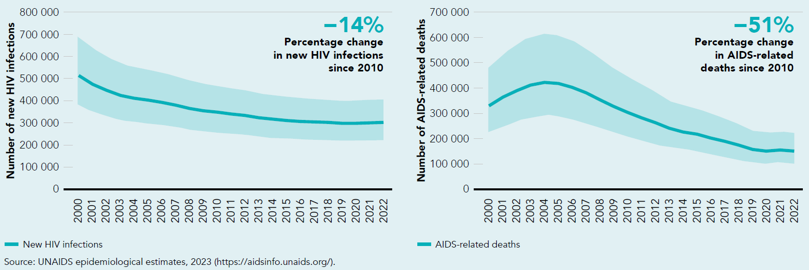
Numbers of annual new HIV infections and AIDS-related deaths, Asia and the Pacific, 2000–2022

Slide 48
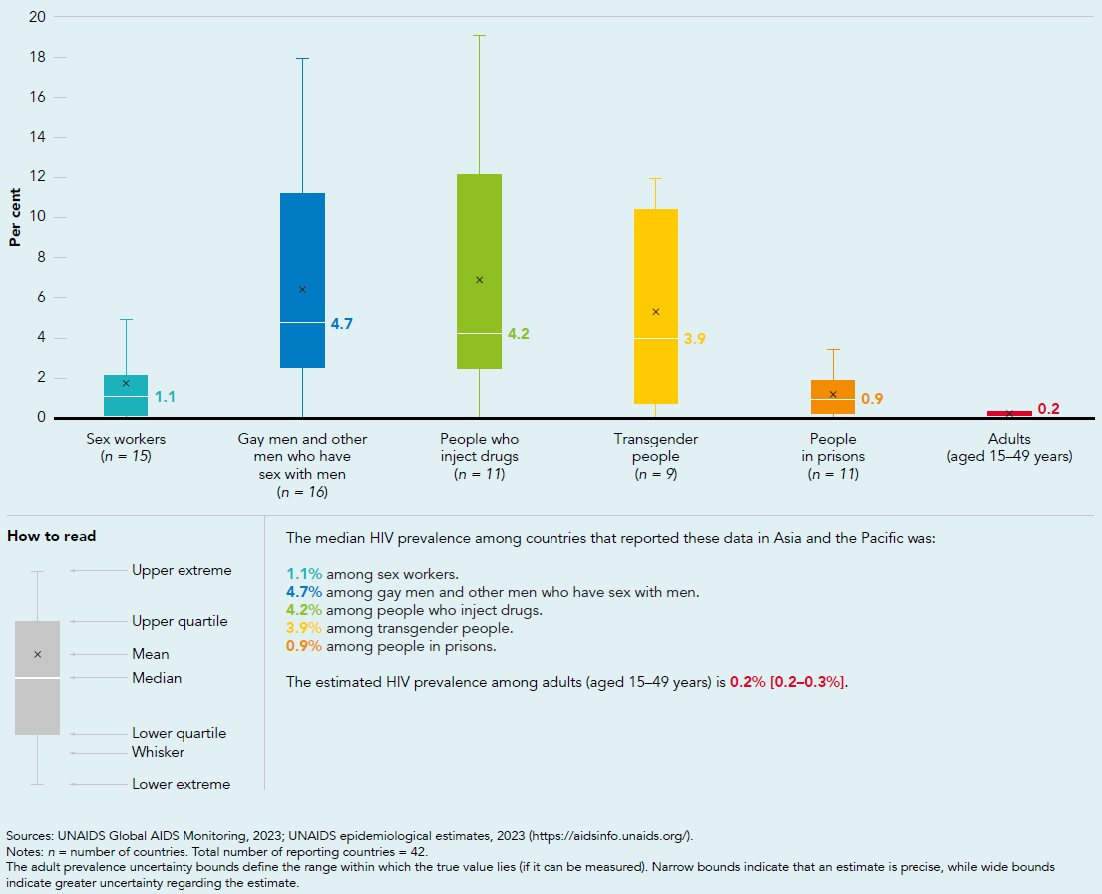
HIV prevalence among key populations compared with adults (aged 15–49 years), reporting countries in Asia and the Pacific, 2018–2022

Slide 49
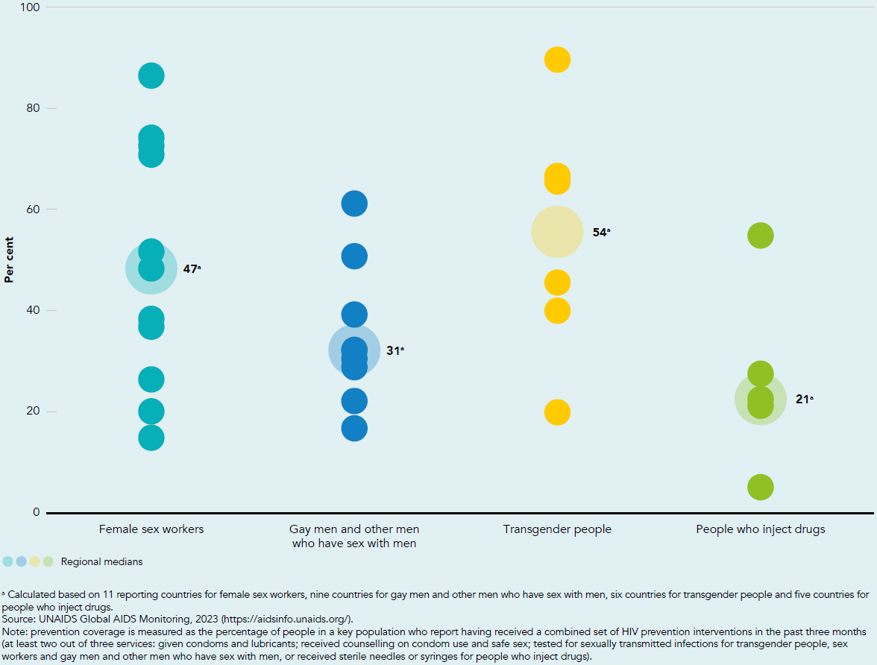
Coverage of HIV prevention interventions among key populations, select countries with available data, Asia and the Pacific, 2018–2022

Slide 50
I
Caribbean
Global AIDS Update | 2022

Slide 51
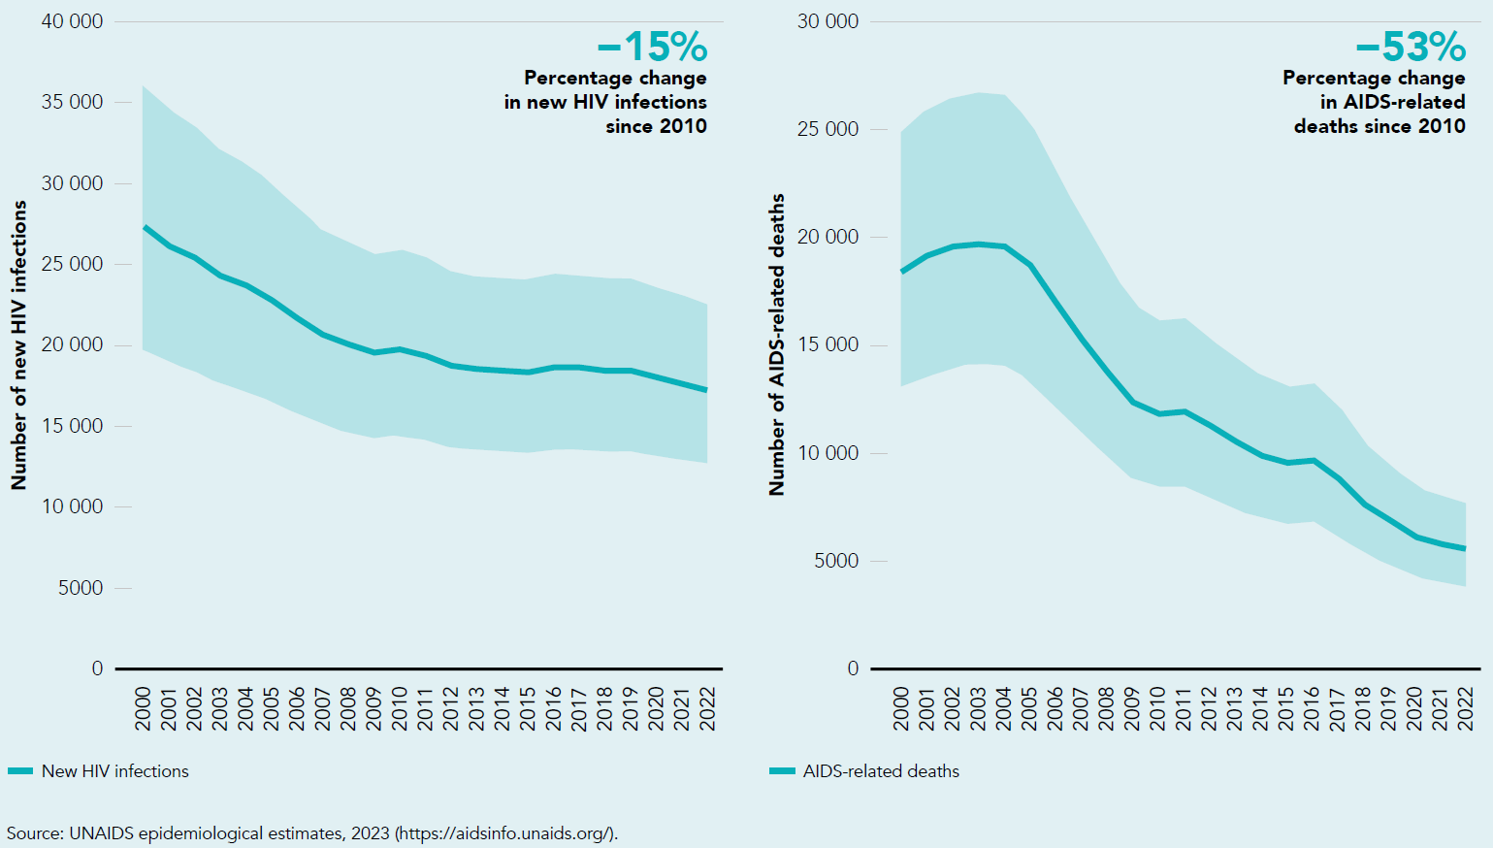
Numbers of new annual HIV infections and AIDS-related deaths, Caribbean, 2000–2022

Slide 52
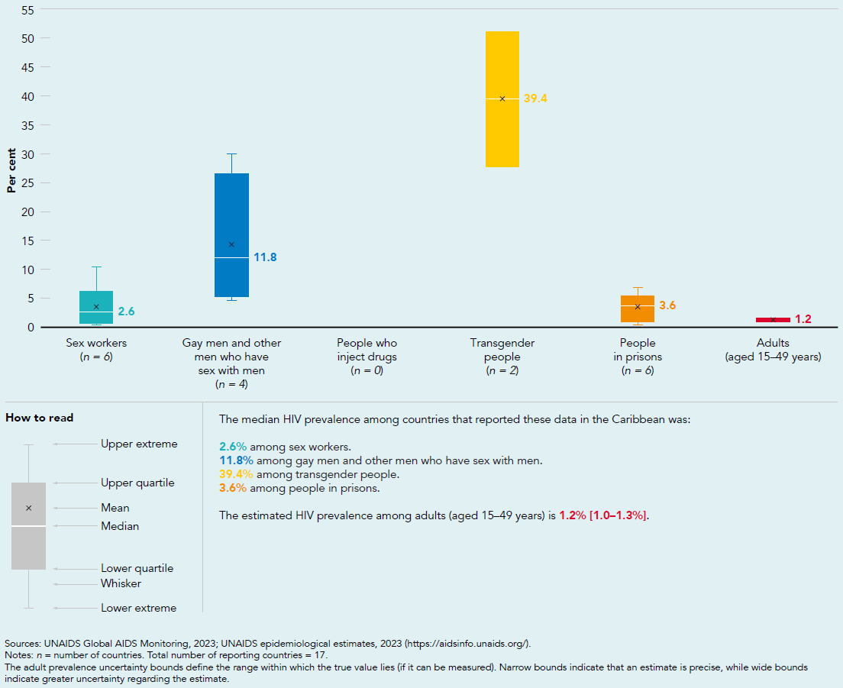
HIV prevalence among key populations compared with adults (aged 15–49 years), reporting countries in the Caribbean, 2018–2022

Slide 53
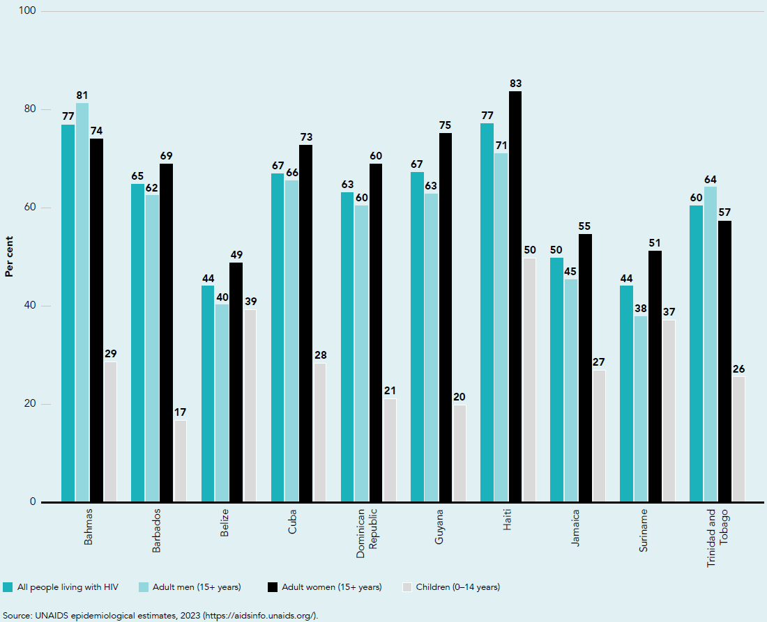
Antiretroviral coverage by age and sex, selected countries, Caribbean, 2022

Slide 54
I
Eastern and southern Africa
Global AIDS Update | 2022

Slide 55
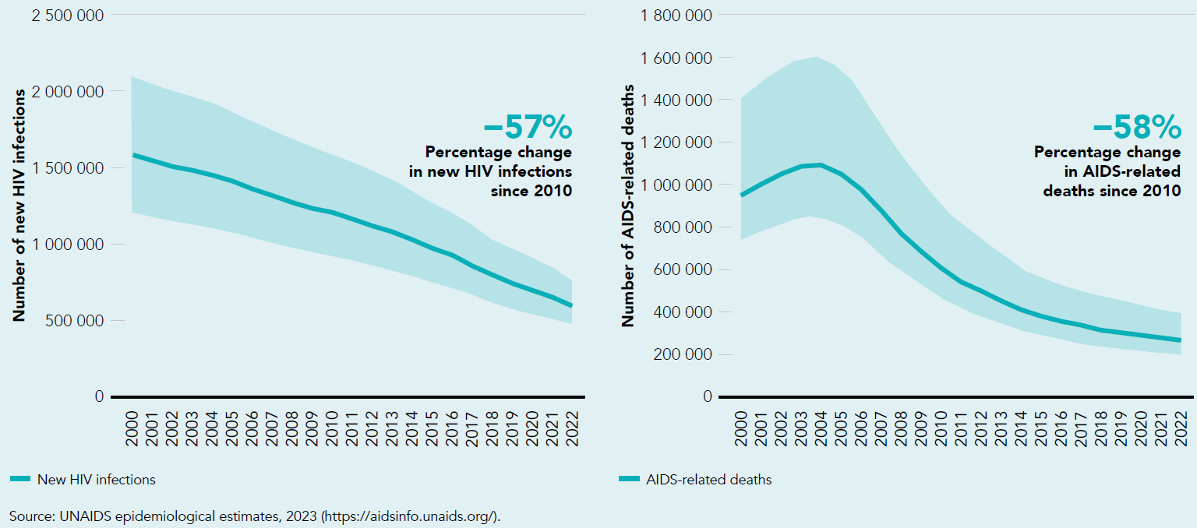
Numbers of new annual HIV infections and AIDS-related deaths, eastern and southern Africa, 2000–2022

Slide 56
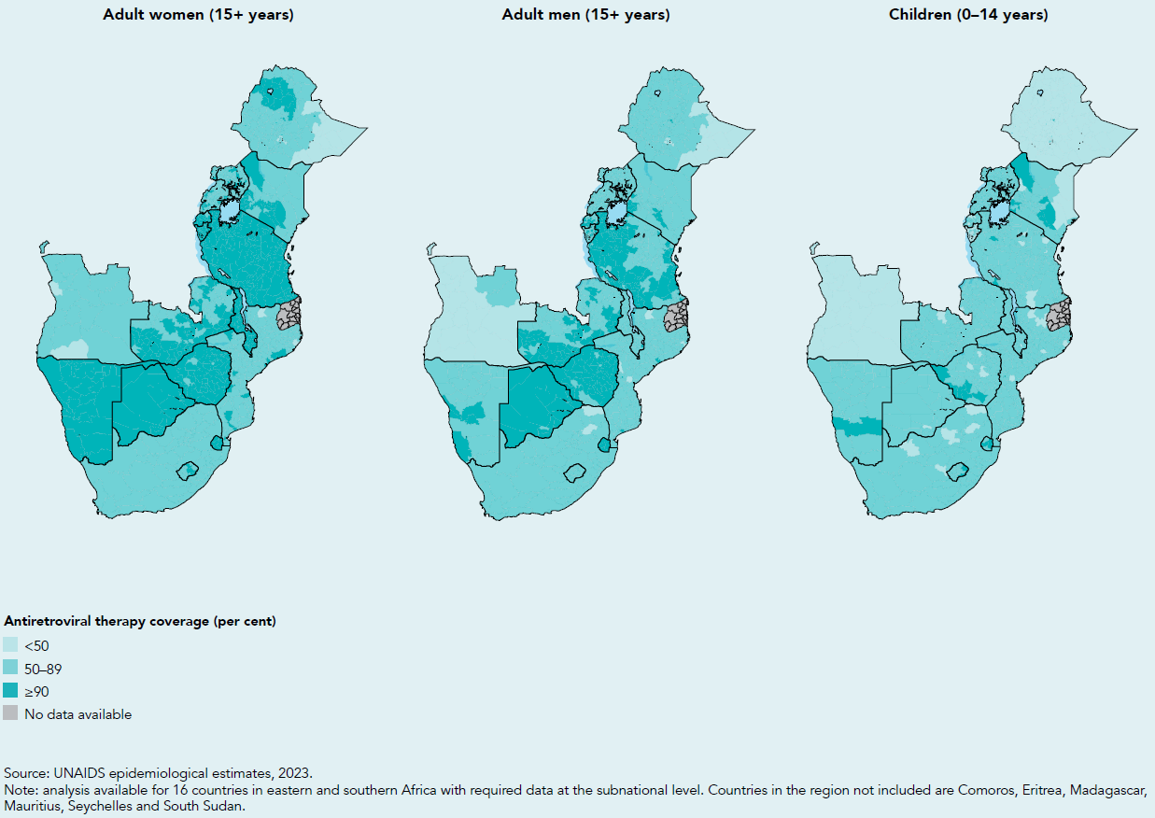
Antiretroviral treatment coverage among children (0–14 years), adult men and adult women (aged 15+ years), subnational levels, eastern and southern Africa, 2022

Slide 57
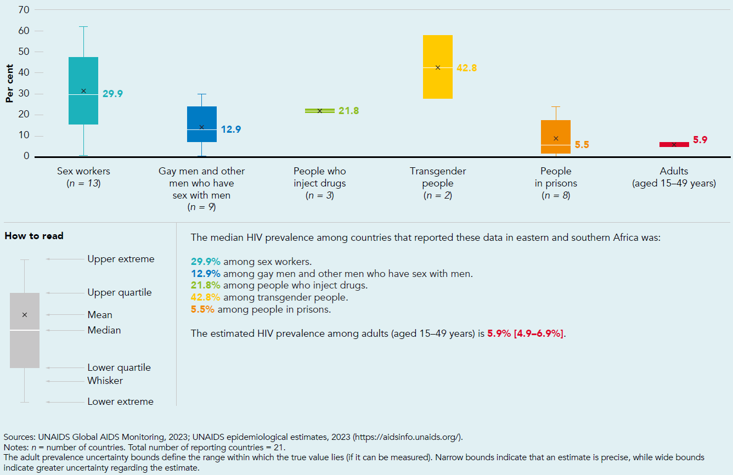
HIV prevalence among key populations compared with adults (aged 15–49 years), reporting countries in eastern and southern Africa, 2018–2022

Slide 58
I
Eastern Europe and central Asia
Global AIDS Update | 2022

Slide 59
Numbers of new annual HIV infections and AIDS-related deaths, eastern Europe and central Asia, 2000–2022

Slide 60
HIV prevalence among key populations compared with adults (aged 15–49 years), reporting countries in eastern Europe and central Asia, 2018–2022

Slide 61
Countries with discriminatory and punitive laws, eastern Europe and central Asia, 2023

Slide 62
I
Latin America
Global AIDS Update | 2022

Slide 63
Numbers of annual new HIV infections and AIDS-related deaths, Latin America, 2000–2022

Slide 64
HIV prevalence among key populations compared with adults (aged 15–49 years), reporting countries in Latin America, 2018–2022

Slide 65
Countries with PrEP in national guidelines by type of distribution, Latin America, 2022

Slide 66
I
Middle East and North Africa
Global AIDS Update | 2022

Slide 67
Number of annual new HIV infections and AIDS-related deaths, Middle East and North Africa, 2000–2022

Slide 68
HIV testing and treatment cascade, by age and sex, Middle East and North Africa, 2022

Slide 69
HIV prevalence among key populations compared with adults (aged 15–49 years), reporting countries in Middle East and North Africa, 2018–2022

Slide 70
I
Western and central Africa
Global AIDS Update | 2022

Slide 71
Numbers of annual new HIV infections and AIDS-related deaths, western and central Africa, 2000–2022

Slide 72
HIV testing and treatment cascade, by age and sex, western and central Africa, 2022

Slide 73
HIV prevalence among key populations compared with adults (aged 15–49 years), reporting countries in western and central Africa, 2018–2022

Slide 74
I
Western and central Europe and North America
Global AIDS Update | 2022

Slide 75
Numbers of new annual HIV infections and AIDS-related deaths, western and central Europe and North America, 2000–2022

Slide 76
HIV prevalence among key populations compared with adults (aged 15–49 years), reporting countries in western and central Europe and North America, 2018–2022

Slide 77
Adoption of WHO recommendations on oral PrEP in national guidelines, western and central Europe and North America, 2023

Slide 78
I
Annex 1: Progress towards the 2025 targets
Global AIDS Update | 2022

Slide 79
Number of new HIV infections, global, 1990–2022, and 2025 target

Slide 80
Number of AIDS-related deaths, global, 1990–2022, and 2025 target

Slide 81
Progress towards the 95–95–95 testing, treatment and viral load suppression targets, global, 2015 and 2022

Slide 82
Countries with discriminatory and punitive laws, global, 2023

Slide 83
Percentage of men and women aged 15–49 years with discriminatory attitudes towards people living with HIV, countries with available data, 2018–2022

Slide 84
Resource availability for HIV in low- and middle-income countries by source of funding, 2010–2022 and 2025 target

Slide 85
I
Annex 2: Methods
Global AIDS Update | 2022

Slide 86
Incidence models used for national HIV estimates collated in the Spectrum software and UNAIDS 2023 estimation round

Slide 87
Comparison of 2022 and 2023 UNAIDS estimates: people living with HIV, AIDS-related deaths and new HIV infections, global, 1990–2022

Slide 88
Data available for constructing UNAIDS measures of progress against the 95–95–95 targets, 2015–2022

Slide 89
Proportion of estimated people living with HIV for whom knowledge of status was imputed, and proportion of estimated people on treatment for whom viral suppression was imputed, 2015–2022

Slide 90
Countries using the Naomi model to generate subnational estimates

