Slide 2
AIDS, Crises and the Power to Transform
Executive summary
Foreword by Executive Director
Chapter 1 – Where are we now?
Chapter 2 –Services that save the lives of people living with HIV
Chapter 3 – HIV prevention is in jeopardy
Chapter 4 – Communities, financing and new ways forward to 2030
8 regional summaries (online only)
Methods Annex (online only)
Other products:
Factsheet
Slide-deck
Key messages
10 country stories of resilience
Social media kit
Source: AIDSinfo | UNAIDS
Notes:
- One of a kind shift in HIV financing. Not just the US but all other donors as well.

Slide 3
EXECUTIVE SUMMARY

Slide 4
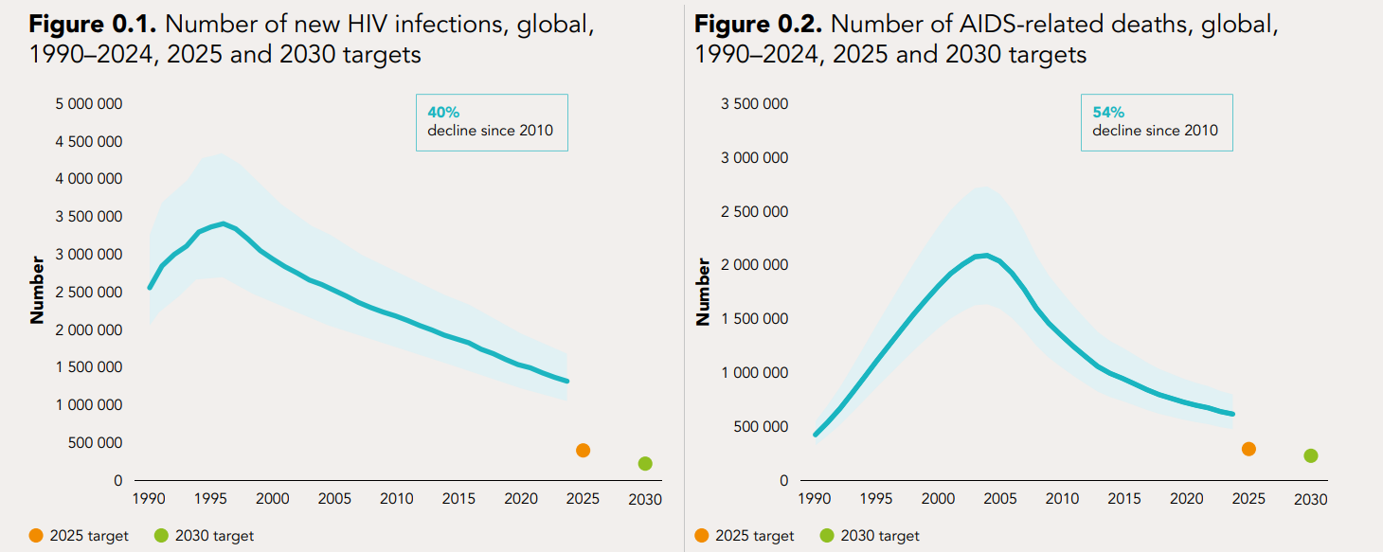
In 2024, the world had made significant progress in the response to HIV—but this is now in jeopardy
Insert Text
Source: UNAIDS epidemiological estimates 2025 (https://aidsinfo.unaids.org/).

Slide 5
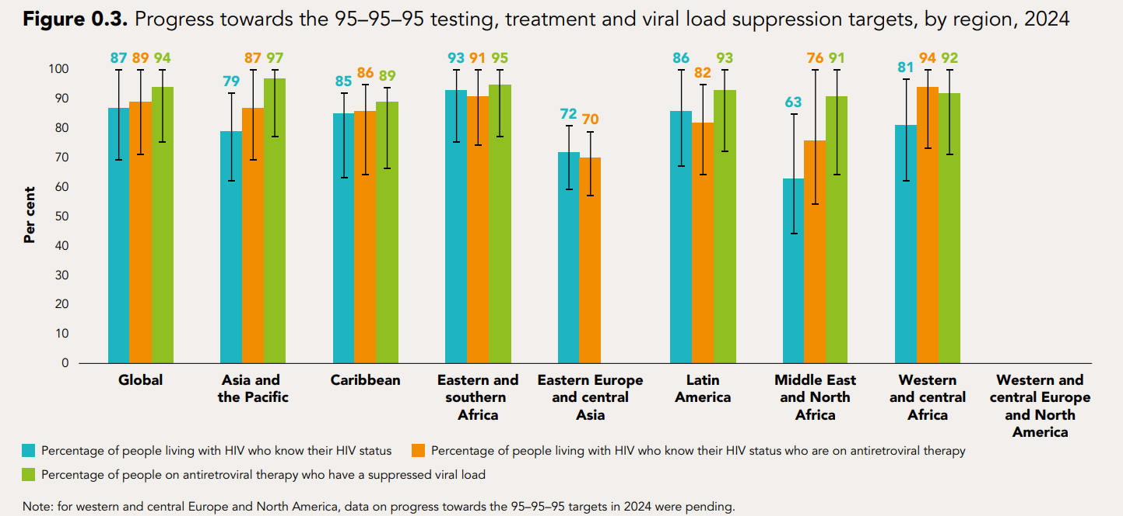
Some regions are very close to achieving the 95–95–95 targets
Insert Text
Source: UNAIDS epidemiological estimates 2025 (https://aidsinfo.unaids.org/).

Slide 6
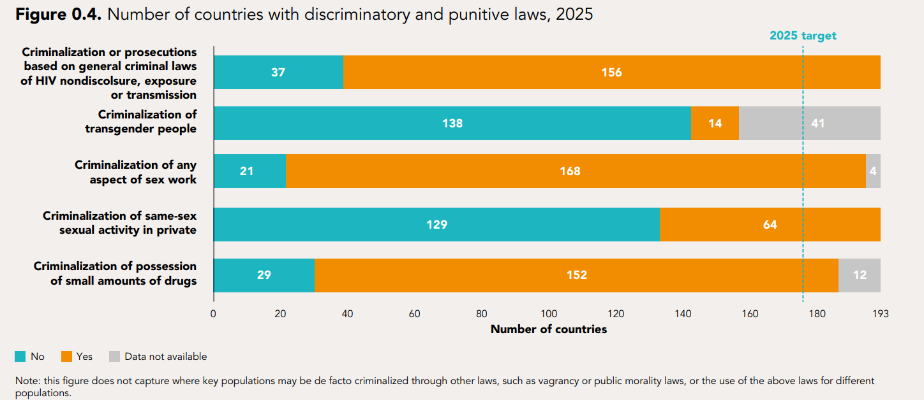
The number of countries with criminalizing laws was rising in 2024
Insert Text
Source: National Commitments and Policy Instrument, 2017–2024 (http://lawsandpolicies.unaids.org/), supplemented by additional sources (see references in regional factsheets and http://lawsandpolicies.unaids.org/).

Slide 7
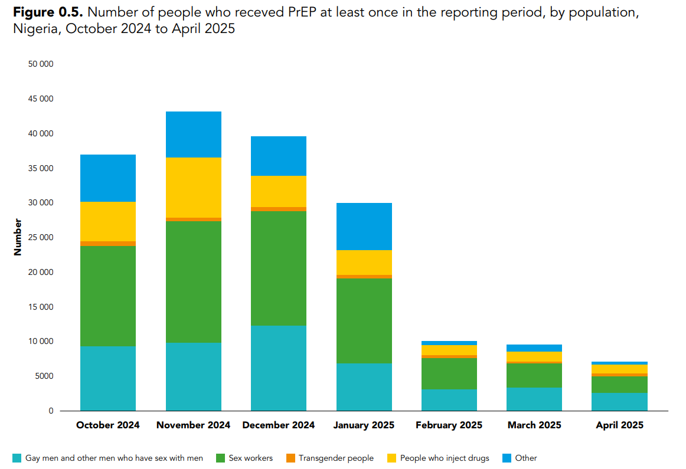
Access to PrEP in Nigeria
Insert Text
Source: country-reported data through the monthly Global AIDS Monitoring platform (https://hivservicestracking.unaids.org/).

Slide 8
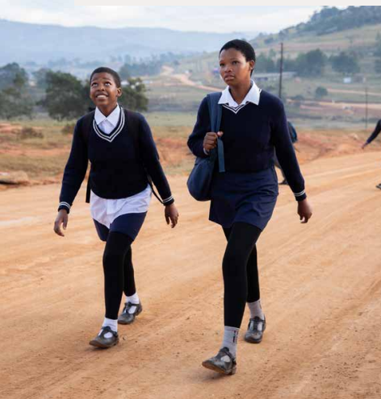
WHERE ARE WE NOW?

Slide 9
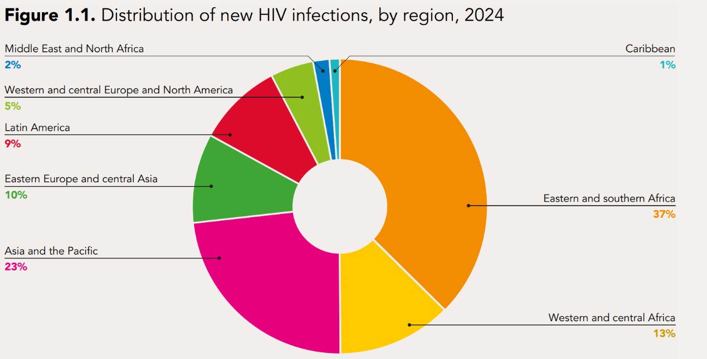
Half of all new HIV infections are in sub-Saharan Africa
40.8 million people living with HIV in 2024
1.3 million newly acquired HIV in 2024
120,000 new infections among children
50% of new infections in sub-Saharan Africa
Source: UNAIDS epidemiological estimates 2025 (https://aidsinfo.unaids.org/).

Slide 10
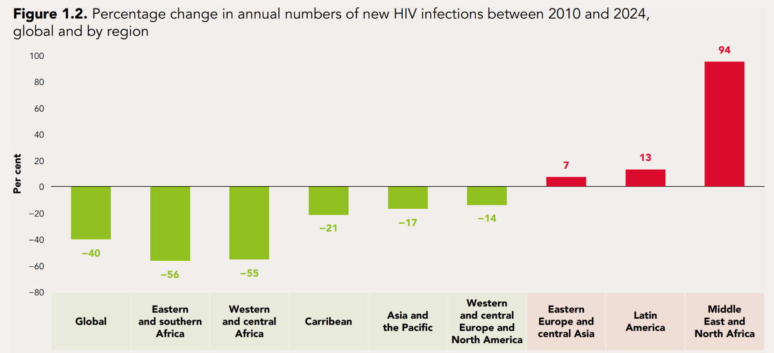
Progress in reducing new HIV infections is uneven
40% fewer new infections in 2024 compared to 2010
Progress insufficient to reach the 2025 and 2030 goal
Varying rates of decline across regions
55% decline in new infections in sub-Saharan Africa
Source: UNAIDS epidemiological estimates 2025 (https://aidsinfo.unaids.org/).

Slide 11
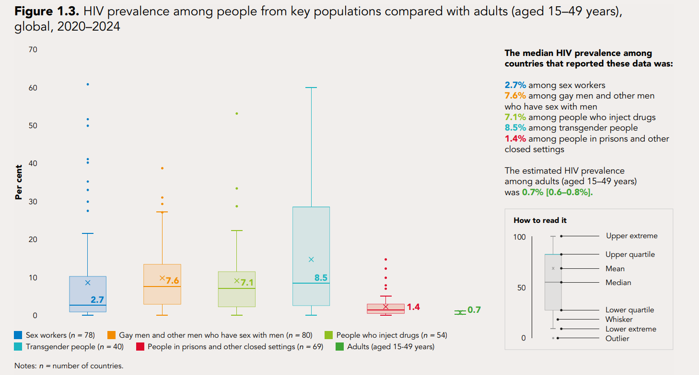
Key populations continue to be more affected by HIV globally
Insert Text
Source: Global AIDS Monitoring 2021–2025 (https://aidsinfo.unaids.org/); UNAIDS epidemiological estimates 2025 (https://aidsinfo.unaids.org/).

Slide 12
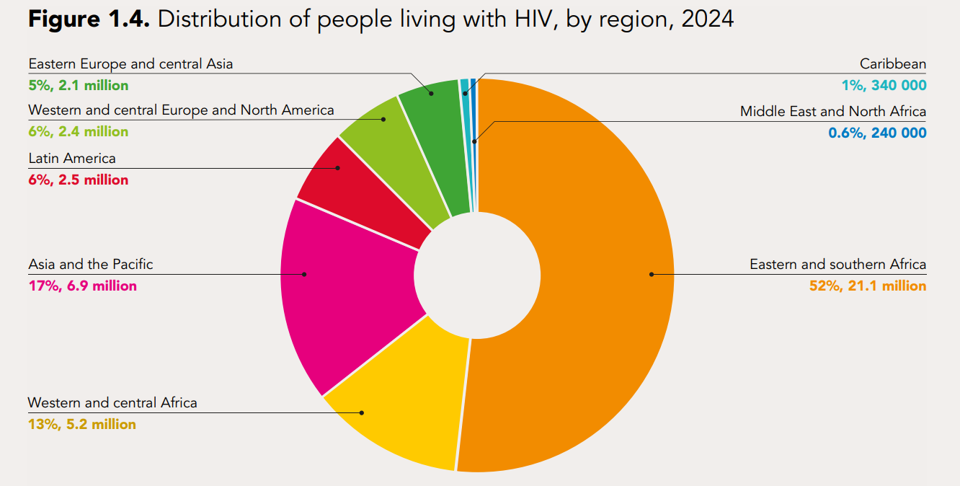
Two-thirds of people living with HIV are in sub-Saharan Africa
Insert Text
Source: UNAIDS epidemiological estimates 2025 (https://aidsinfo.unaids.org/)

Slide 13
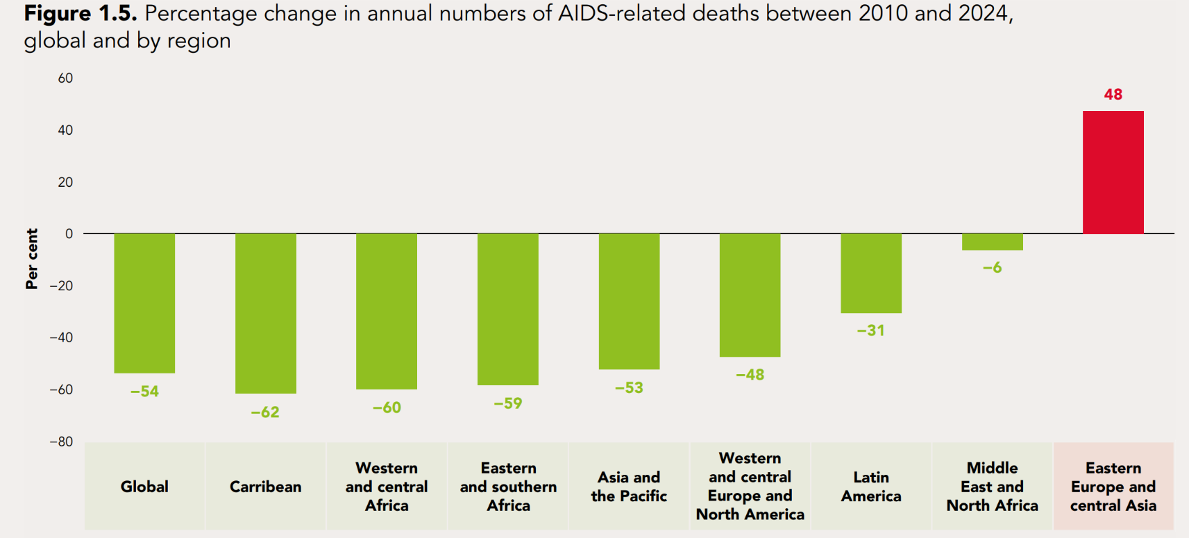
Numbers of AIDS-related deaths have decreased steeply in most regions
630,000 AIDS-related deaths in 2024
  75,000 among children
50% reduction in AIDS-related deaths between 2010 and 2024
60% decline in sub-Saharan Africa
Significant decline a result of widespread availability of ART
Source: UNAIDS epidemiological estimates 2025 (https://aidsinfo.unaids.org/).

Slide 14
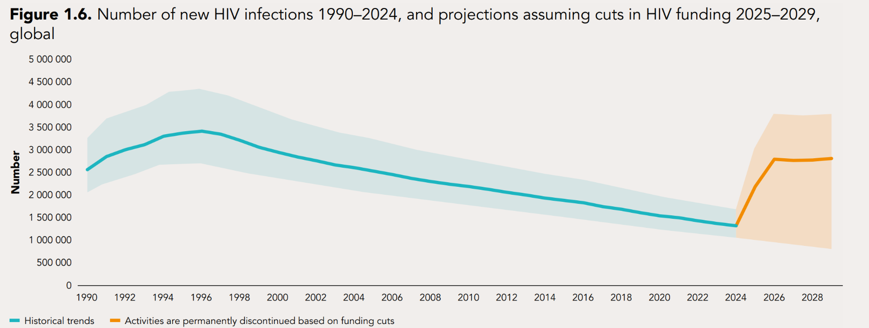
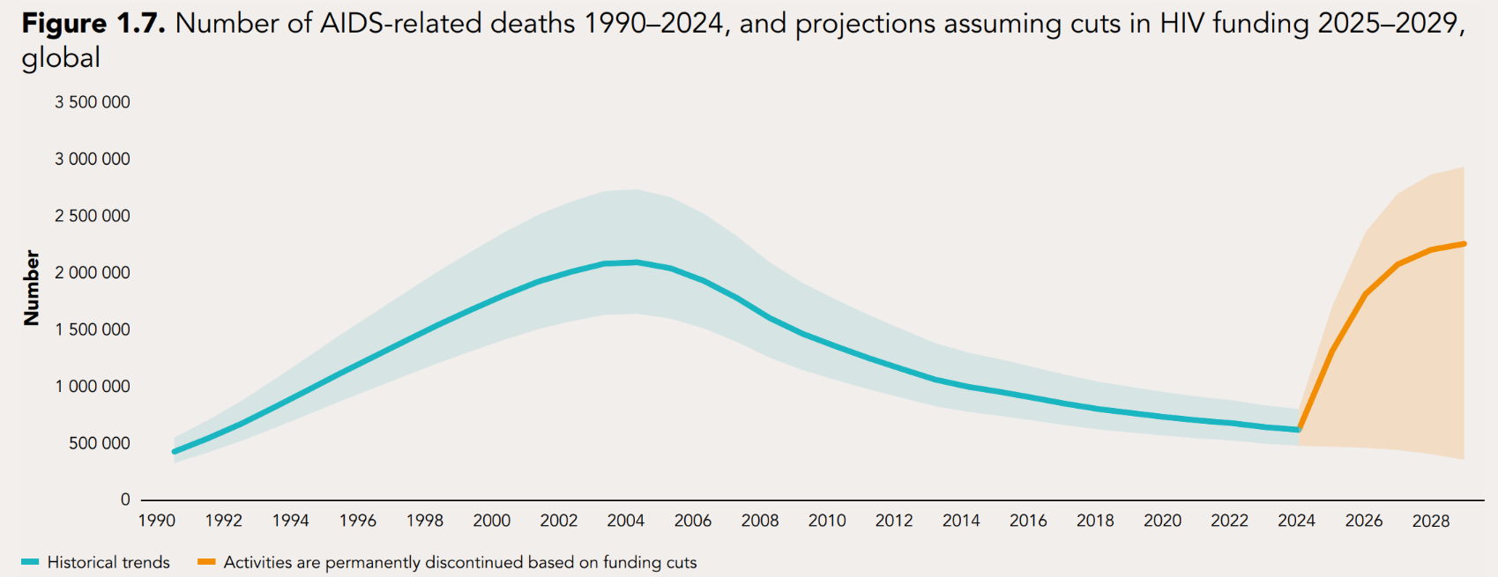
The recent funding restrictions could potentially put us back to levels not seen
since the early 2000s
Impact of funding cuts likely to be severe
Modelling predicts significant increase by 2029 in new HIV infections and AIDS-related deaths, if HIV prevention and treatment support by PEPFAR is halted
Source: UNAIDS epidemiological estimates 2025 (https://aidsinfo.unaids.org/).

Slide 15
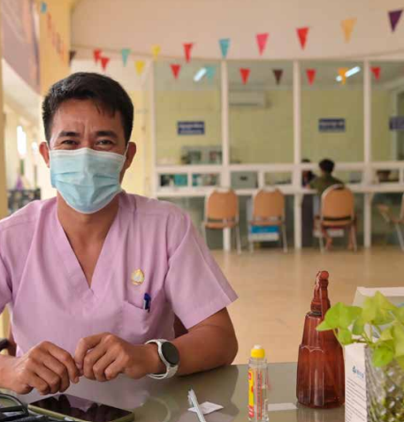
SERVICES
THAT SAVE
THE LIVES OF
PEOPLE LIVING
WITH HIV

Slide 16
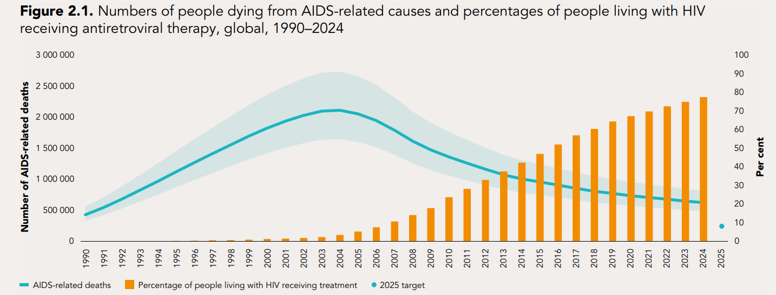
Rising HIV treatment coverage has led to a steep decline in the number of
AIDS-related deaths
Insert Text
Source: UNAIDS epidemiological estimates 2025 (https://aidsinfo.unaids.org/).

Slide 17
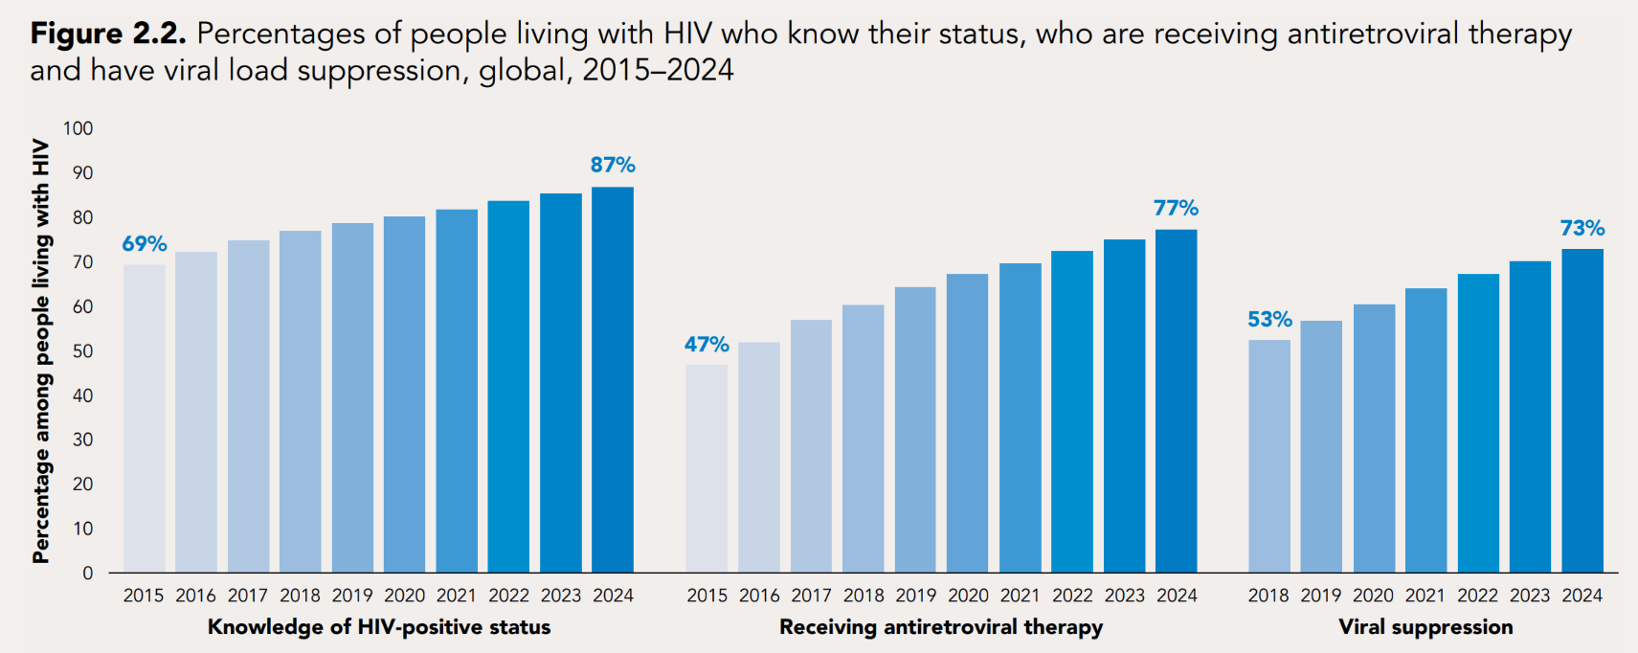
Testing, treatment coverage and viral suppression among people living with HIV
continued to rise in 2024
31.6 million people on ART globally in 2024
Eastern and Southern Africa close to achieving 95-95-95
In sub-Saharan Africa, provision of ART resulted in life expectancy increasing from 56.5 years in 2010 to 62.3 in 2024
Source: UNAIDS estimates 2025.

Slide 18
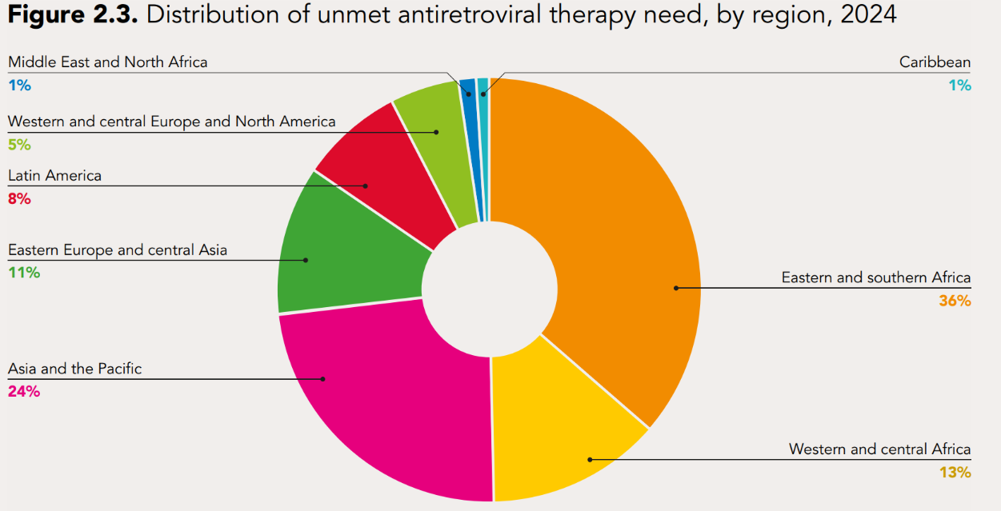
More than half of the unmet HIV treatment need is in two regions
9.2 million people not getting treatment in 2024
Half of unmet need in sub-Saharan Africa
Source: UNAIDS estimates 2025.

Slide 19
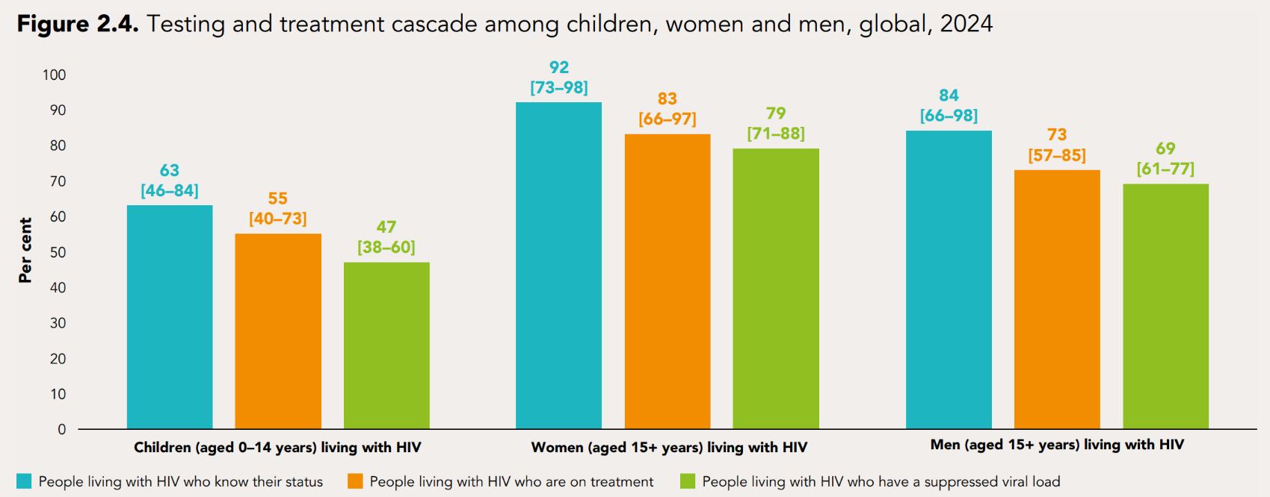
Many children and men living with HIV are missed along the treatment cascade
Disparities in treatment programmes across regions, between men, women, age groups and key populations
620,000 children living with HIV not receiving treatment
Source: UNAIDS estimates 2025.

Slide 20
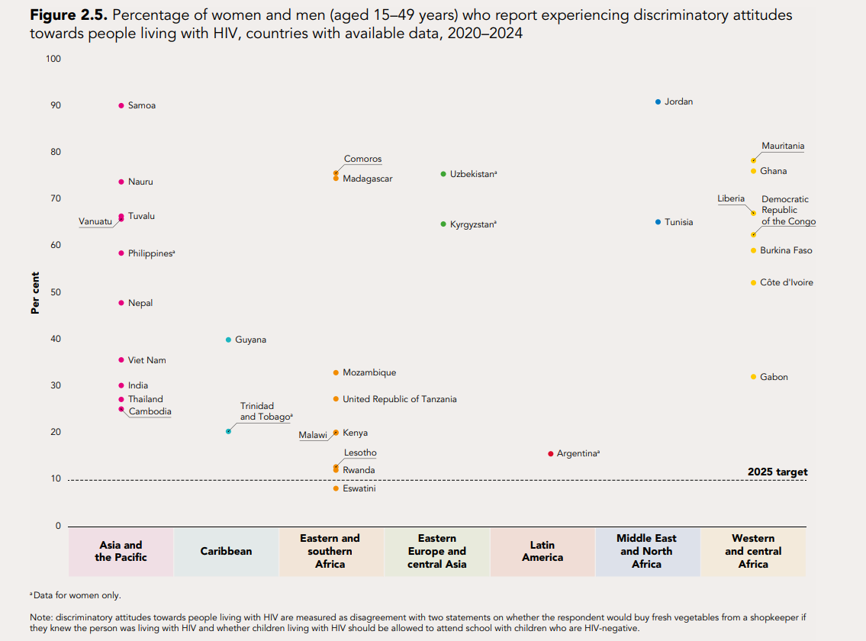
HIV-related stigma and discrimination are still unacceptably high
Insert Text
Source: population-based surveys, 2020–2024.

Slide 21
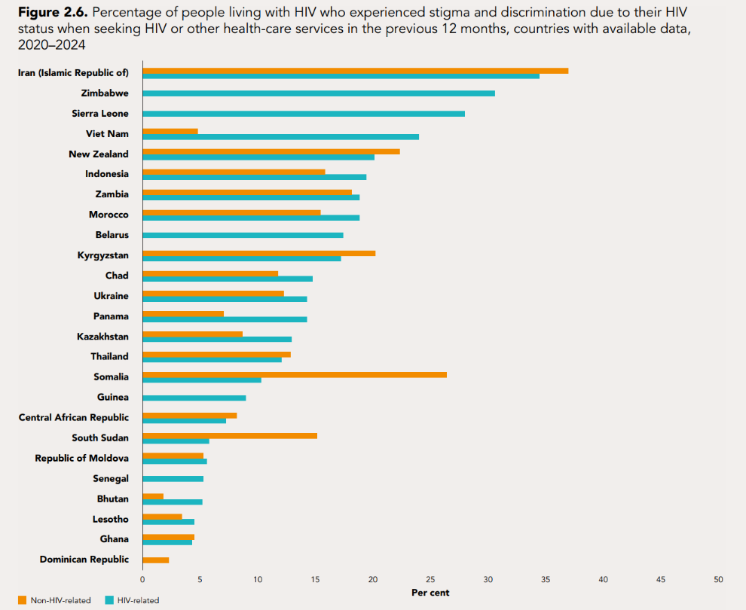
People living with HIV routinely exposed to stigma, discrimination and violence
Treatment coverage substantially lower among key populations
Barriers such as stigma and discrimination, harassment and violence can prevent access to HIV testing and treatment services
Source:: People living with HIV Stigma Index 2.0, 2020–2024.

Slide 22
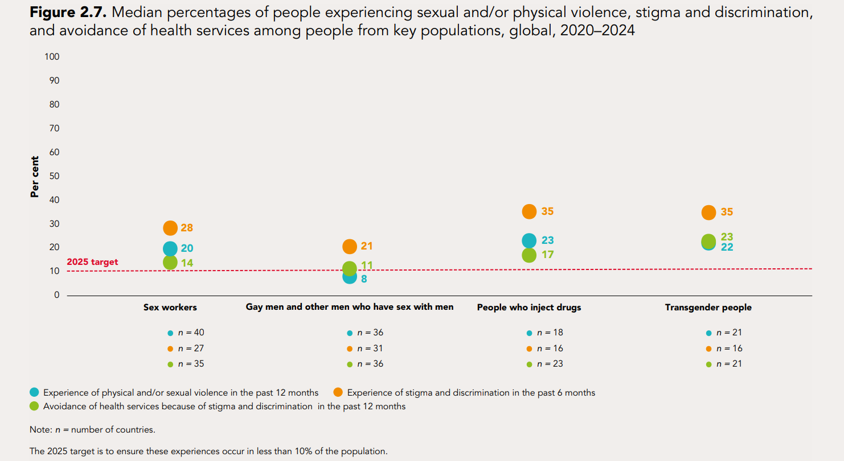
People living with HIV are routinely exposed to stigma and discrimination
Insert Text
Source: Global AIDS Monitoring 2021–2025 (https://aidsinfo.unaids.org/).

Slide 23
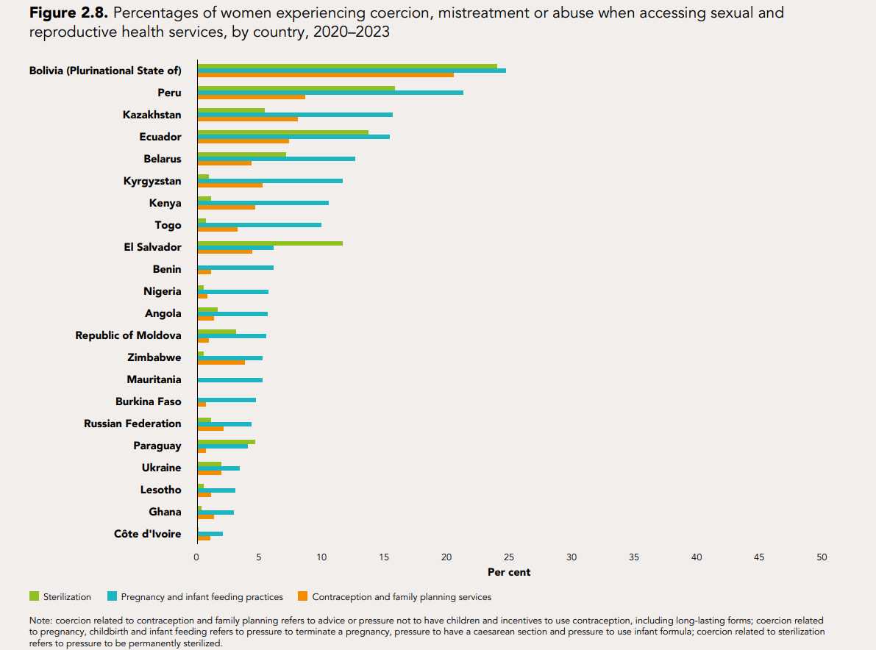
Women living with HIV still experience abuse and mistreatment when using
sexual and reproductive health services
Insert Text
Source: People Living with HIV Stigma Index 2.0 studies 2020–2023; Confronting coercion: a global scan of coercion, mistreatment and abuse experienced by women living with HIV in reproductive and sexual health services. International Community of Women Living with HIV; 2024.

Slide 24
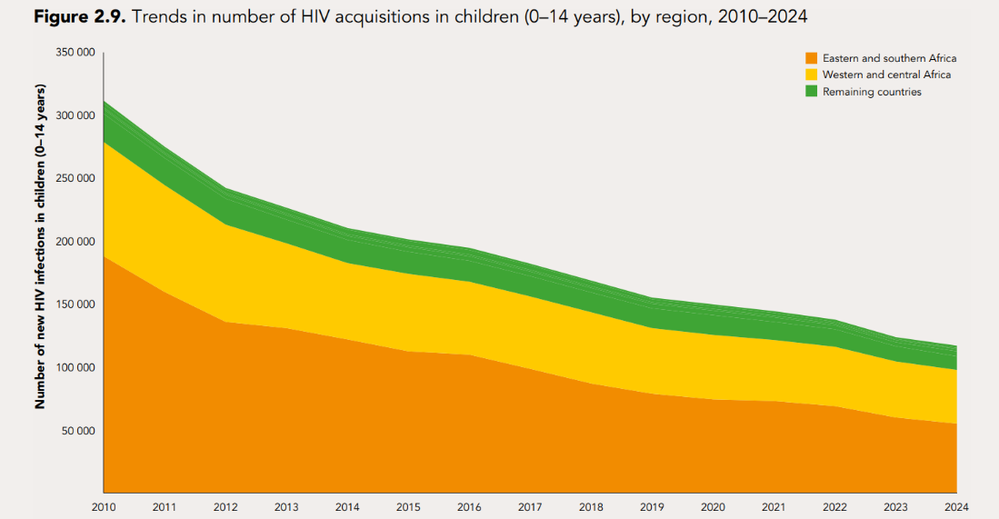
The decline in new pediatric HIV infections is slowing down
62% drop in new child infections since 2010
18 countries & territories certified as having halted vertical transmission
4.4 million child infections averted between 2000 and 2024
Rate of decline has slowed, and will be difficult to address if funding losses are not recovered
Source: UNAIDS epidemiological estimates 2025 (https://aidsinfo.unaids.org/).

Slide 25
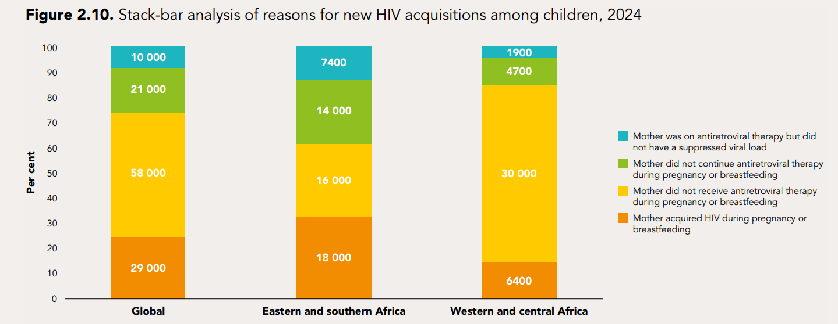
The main reasons for vertical transmission of HIV differ between regions
Insert Text
Source: UNAIDS epidemiological estimates 2025 (https://aidsinfo.unaids.org/).

Slide 26
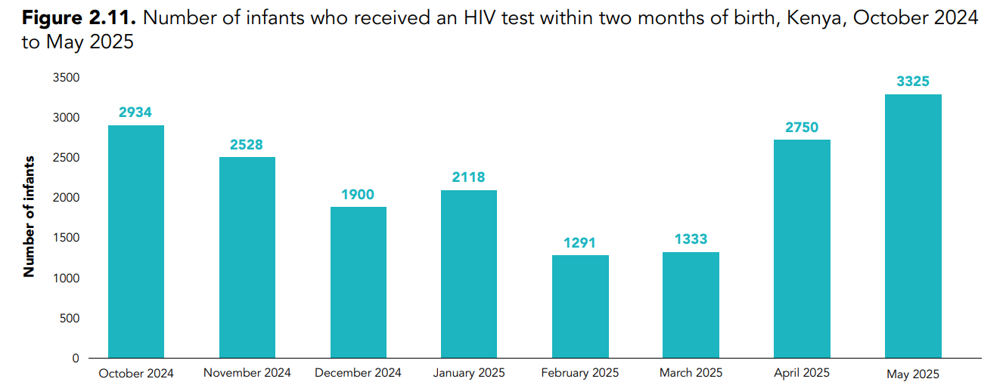
Diagnosis of more children who have acquired HIV
Insert Text
Source: country-reported data through the monthly Global AIDS Monitoring platform (https://hivservicestracking.unaids.org/)

Slide 27
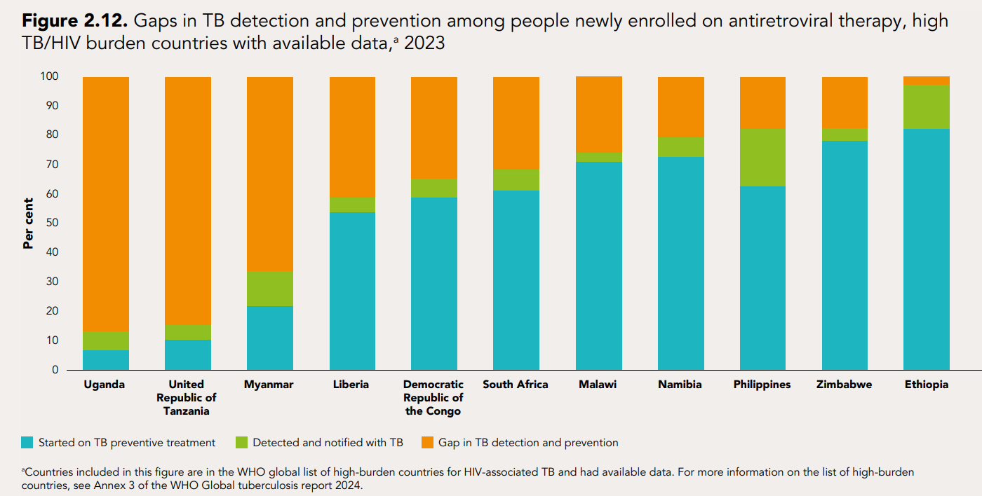
Some countries have opportunities to close gaps in preventing or detecting TB
among people living with HIV
Insert Text
Source: Global AIDS Monitoring 2024; Global tuberculosis report 2024. Geneva: World Health Organization; 2024.

Slide 28
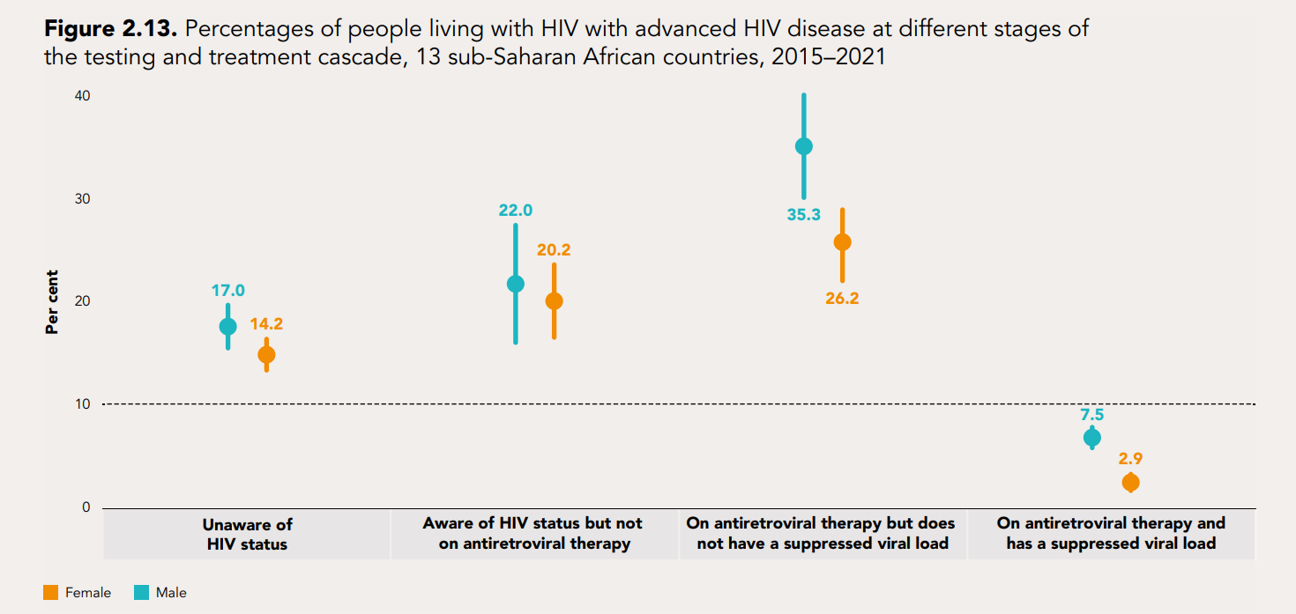
The prevalence of advanced HIV disease is surprisingly high among people on
antiretroviral therapy, and especially among men
Insert text
Source: Stelzle D, Rangaraj A, Jarvis JN, et al. Prevalence of advanced HIV disease in sub-Saharan Africa: a multi-country analysis of nationally representative household surveys. Lancet Glob Health. 2025;13(3):e437–e446 (https://doi.org/10.1016/S2214-109X(24)00538-2).

Slide 29
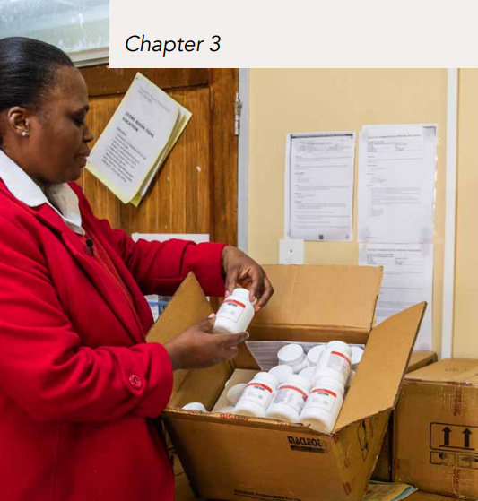
HIV
PREVENTION
IS IN
JEOPARDY

Slide 30
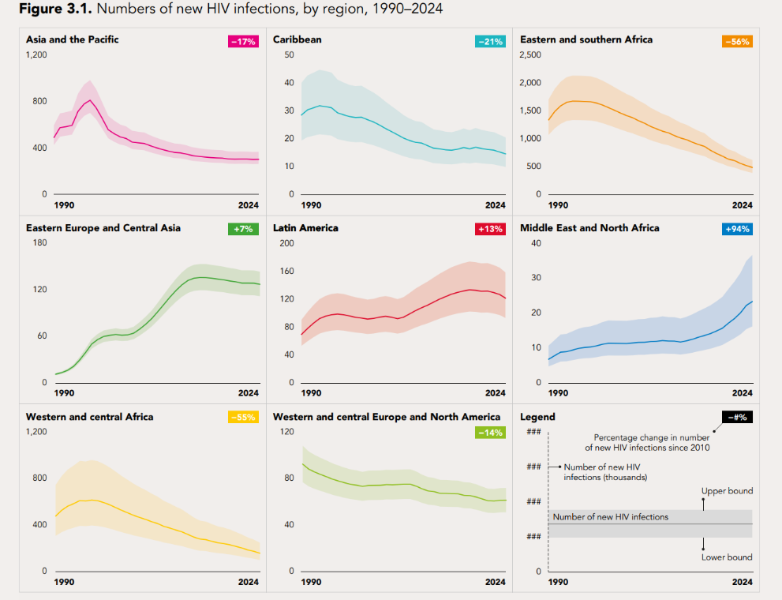
The impact of HIV prevention on reducing new HIV infections is mixed
Source: UNAIDS epidemiological estimates, 2025 (https://aidsinfo.unaids.org/).

Slide 31
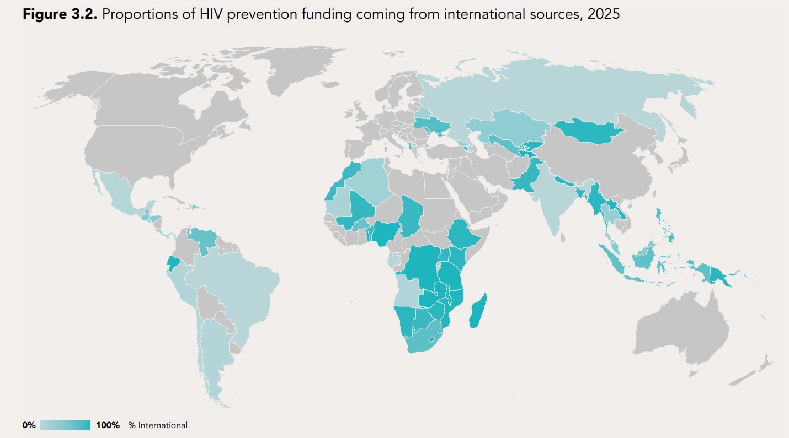
HIV prevention in many countries has relied heavily on donor funding
Only 18 countries finance >25% of HIV prevention domestically
Source: UNAIDS financial estimates using latest available prevention funding data from Global AIDS Monitoring, National AIDS Spending Assessments, PEPFAR Panaroma spotlight, Global Fund.

Slide 32
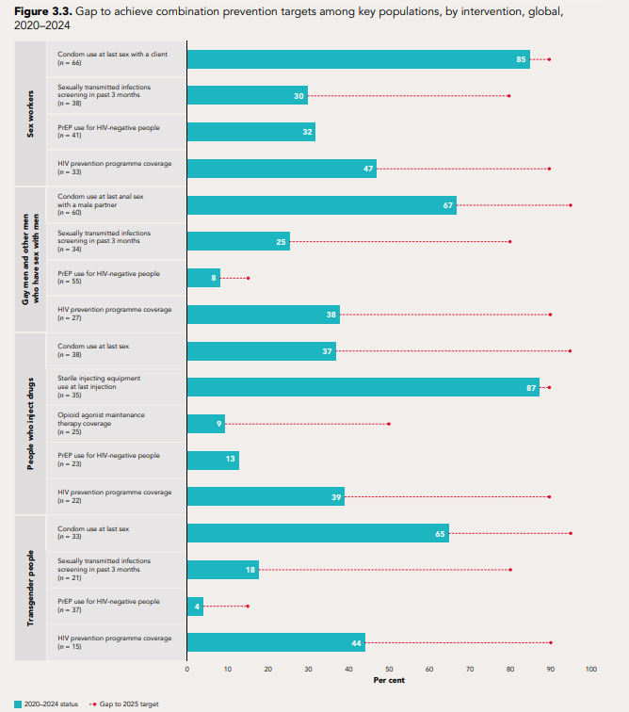
Combination prevention services are not reaching the most vulnerable people
Source: Global AIDS Monitoring 2021–2025 (https://aidsinfo.unaids.org/); UNAIDS special analysis 2025.

Slide 33
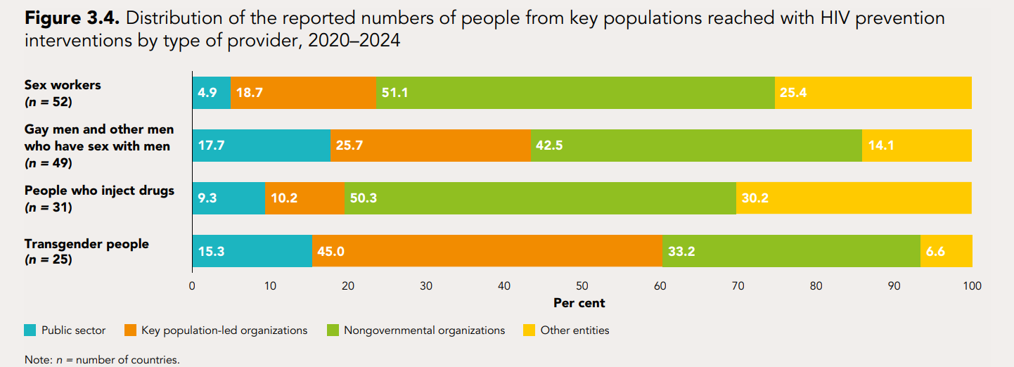
People from key populations depend on community-led and other
nongovernmental organizations for HIV prevention services that are free of stigma and discrimination
Insert Text
Source: Global AIDS Monitoring 2021–2025 (https://aidsinfo.unaids.org/).

Slide 34
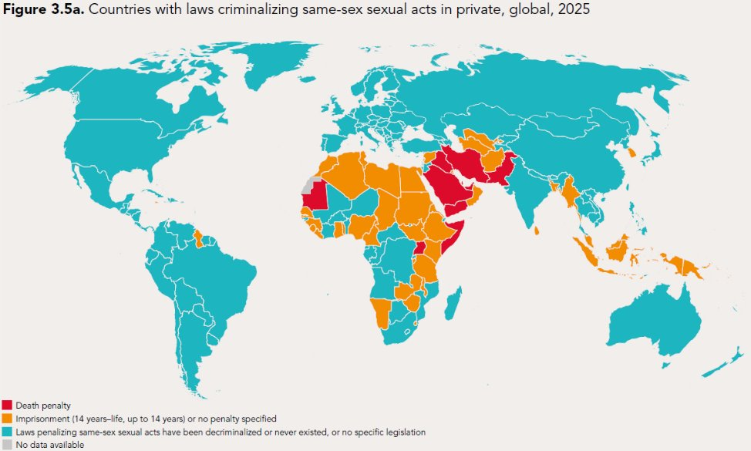
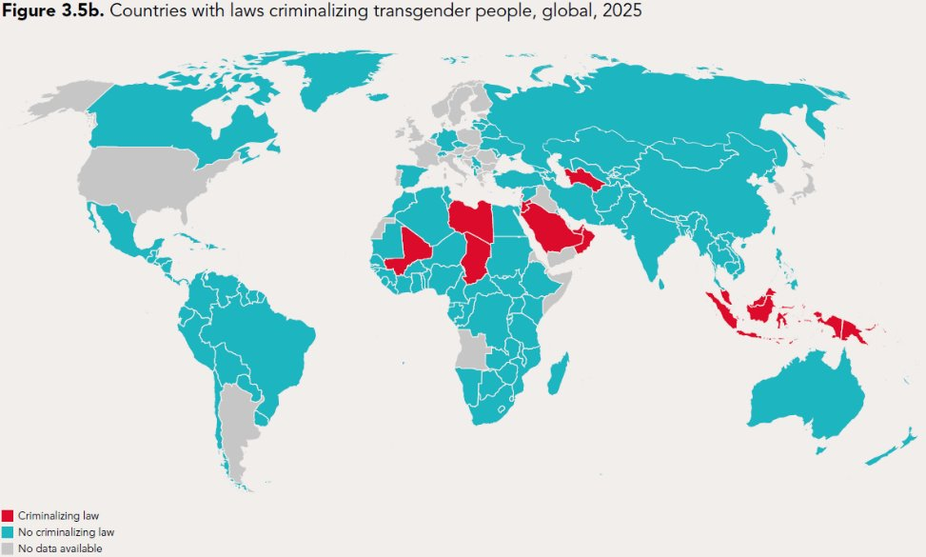
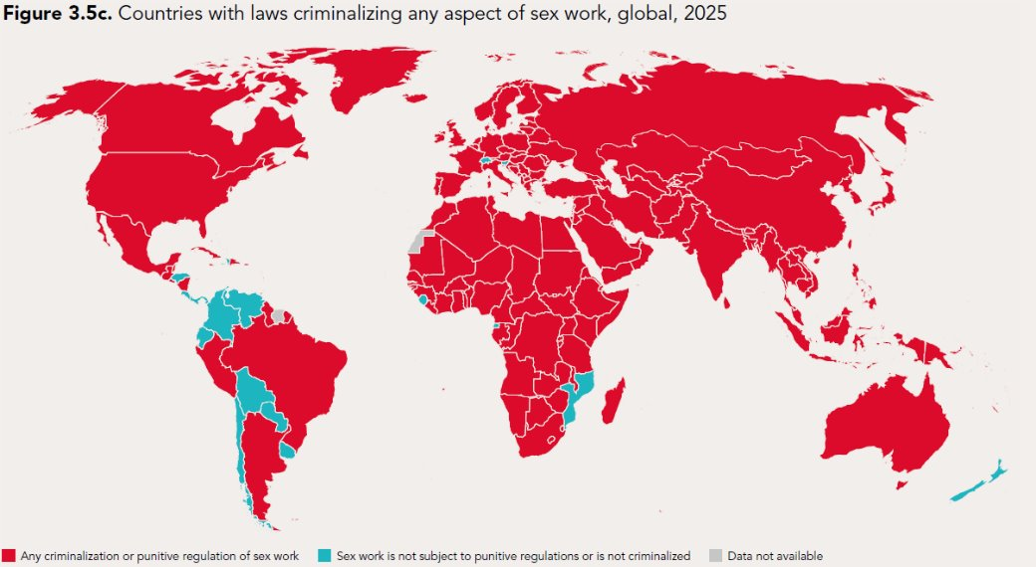
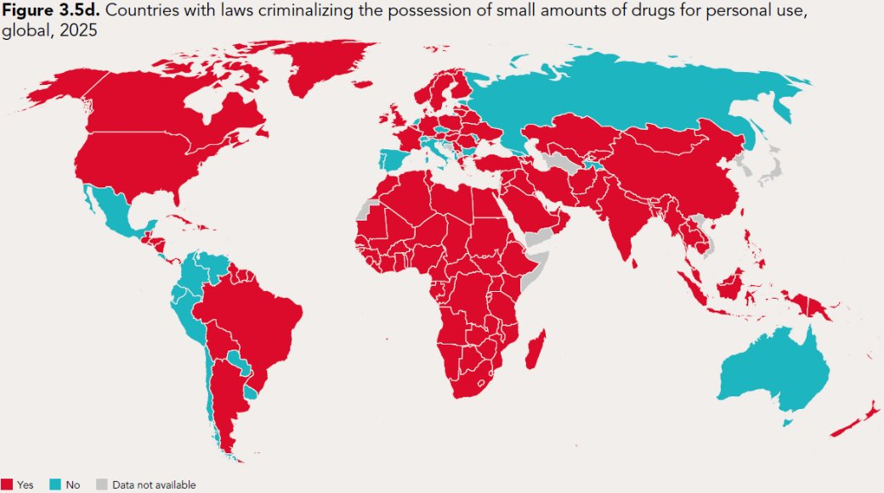
Almost all countries have punitive laws that criminalize at least one key population
Countries criminalizing same-sex sexual activity and gender expression have increased
Source: National Commitments and Policy Instrument, 2017–2024 (http://lawsandpolicies.unaids.org/), supplemented by additional sources (see references in http://lawsandpolicies.unaids.org/).

Slide 35
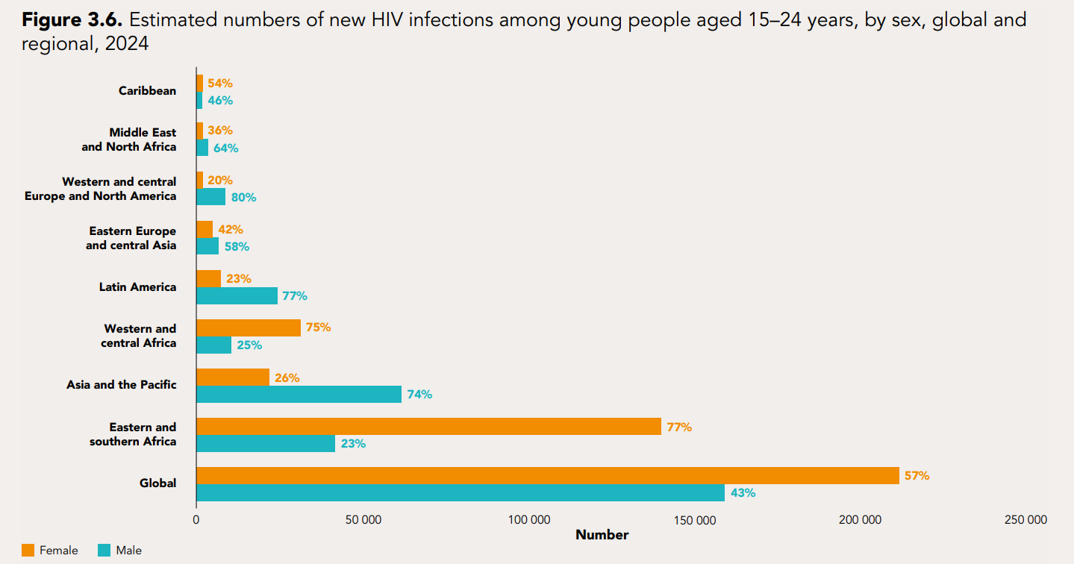
Adolescent girls and young women are still at much higher risk of acquiring HIV in
sub-Saharan Africa, but adolescent boys and young men are at higher risk elsewhere
Insert Text
Source: UNAIDS epidemiological estimates 2025 (https://aidsinfo.unaids.org/).

Slide 36
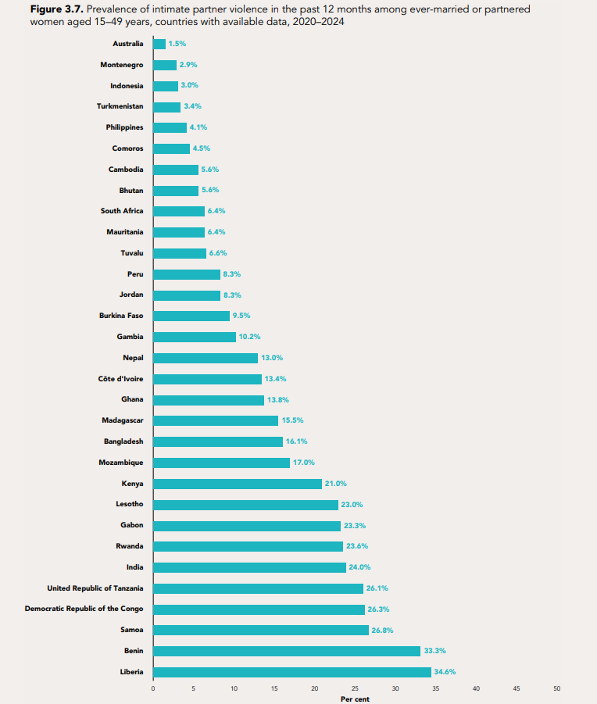
Intimate partner violence is very common in some countries
Insert Text
Source: population-based surveys, 2020–2024; 2021–2024 EU survey on gender-based violence against women and other forms of inter-personal violence (EU-GBV).

Slide 37
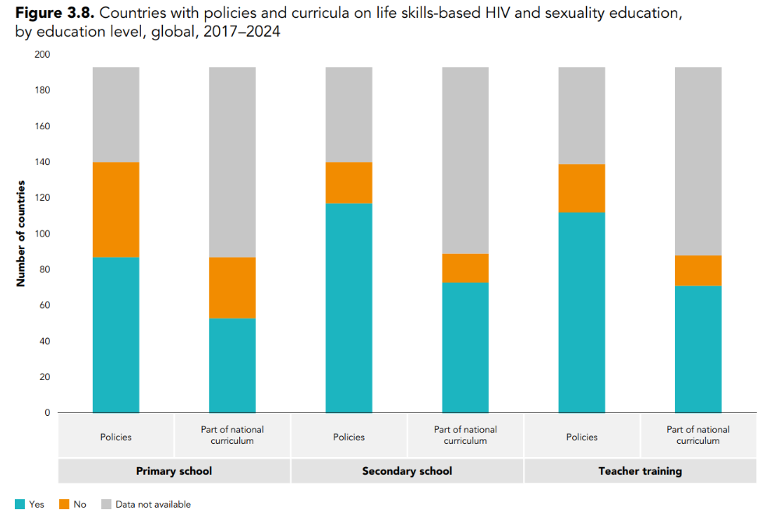
Inclusion of sexuality education in national curricula to prevent HIV remains
alarmingly low
Insert Text
Source: National Commitments and Policy Instrument, 2017–2024 (http://lawsandpolicies.unaids.org/)

Slide 38
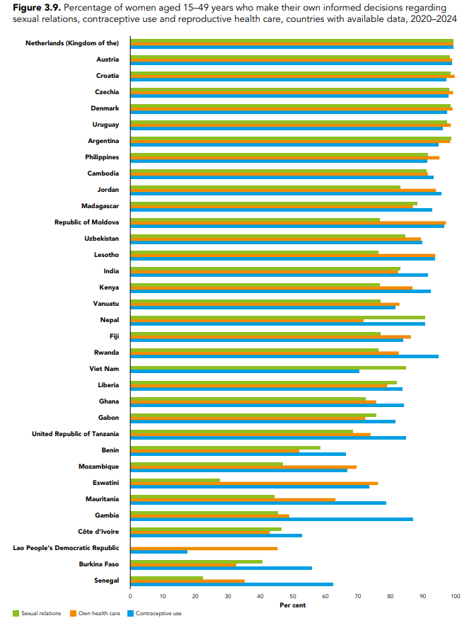
Adolescent girls and young women in many countries lack autonomy over their
sexual lives and health
Insert Text
Source: population-based surveys, 2020–2024; SDG indicator database. New York: United Nations (https://unstats.un.org/sdgs/dataportal/database).

Slide 39
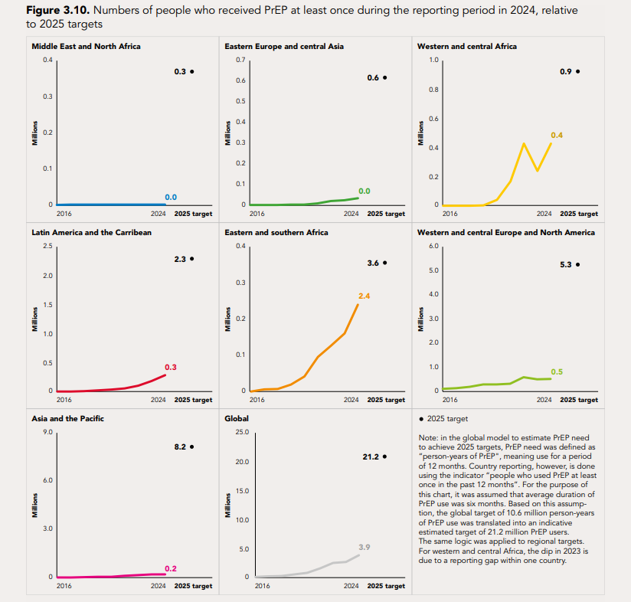
The prevention potential of PrEP is not being used to the full
3.9M people used PrEP at least once in 2024; the majority used oral PrEP
Source: Global AIDS Monitoring 2025 (https://aidsinfo.unaids.org/)

Slide 40
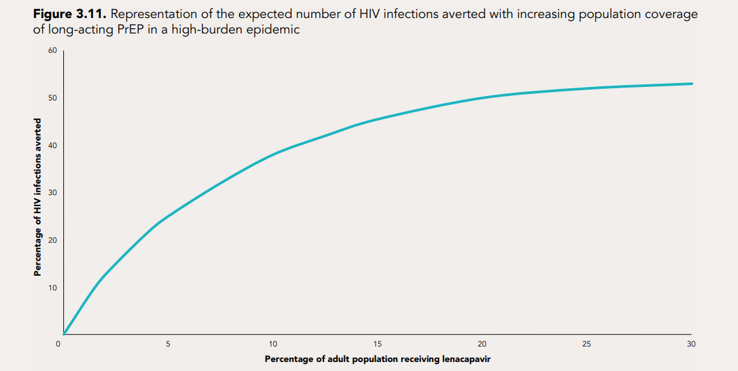
If well-targeted, long-acting PrEP can be cost efficient
Insert Text
Source: Summary of the consultation on the projected impact and cost-effectiveness of lenacapavir as pre-exposure prophylaxis (PrEP). London: Joint United Nations Programme on HIV/AIDS and Gates Foundation 2025. Figure based on analysis by Wu L, Kaftan D, Wittenauer R, et al. Health impact, budget impact, and price threshold for cost-effectiveness of lenacapavir for HIV pre-exposure prophylaxis in eastern and southern Africa: a modelling analysis. Lancet HIV. 2024;11(11):e765–e773 (https://doi.org/10.1016/S2352-3018(24)00239-X)

Slide 41
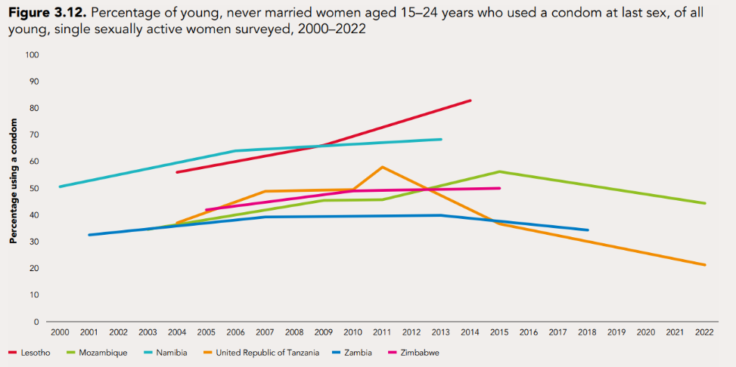
Condom use is decreasing among young women in some countries with high HIV
prevalence
Condom procurement, distribution and use are far below need
Source: Demographic and Health Surveys.

Slide 42
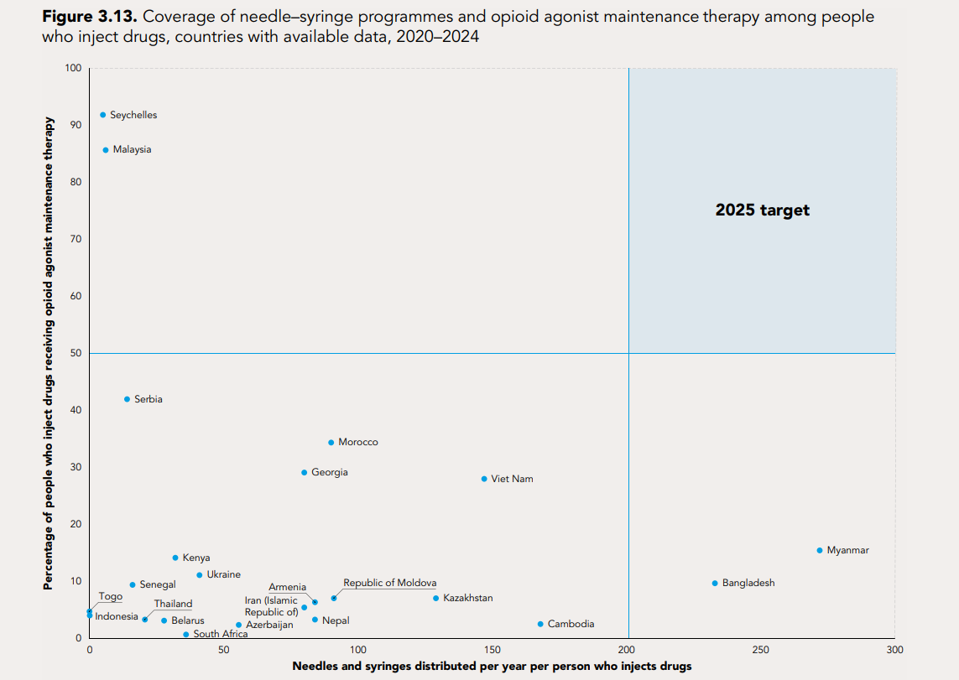
Very few countries are on track to reach the main 2025 harm reduction targets
Insert Text
Source: UNAIDS Global AIDS Monitoring 2021–2025 (https://aidsinfo.unaids.org/)

Slide 43

COMMUNITY-LED ORGANIZATIONS PERFORM
LIFESAVING WORK

Slide 44
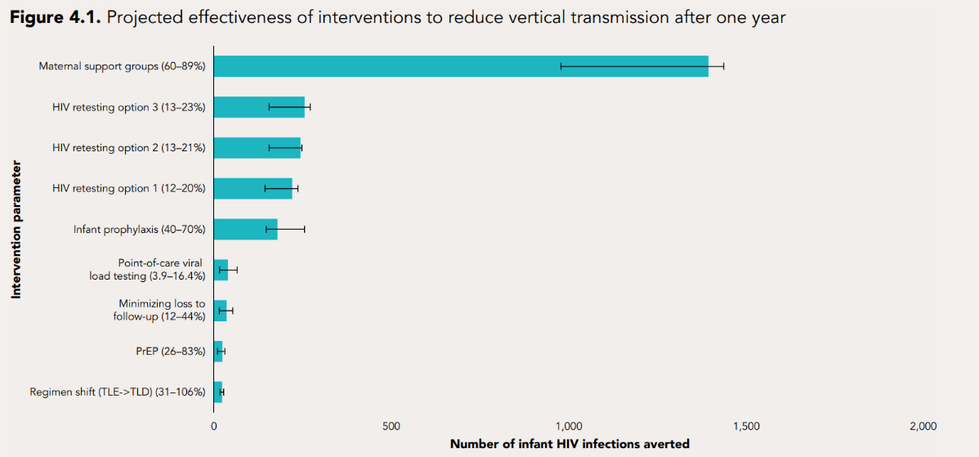
Maternal support programmes are highly effective
What we need now is the will to scale what works.
Source: Chevalier, J. M., Hansen, M. A., Coskun, E., Sy, K. T. L., Drakes, J., Dowling, S., ... & Nichols, B. E. (2024). Cost-effectiveness of intervention combinations towards the elimination of vertical transmission of HIV in limited-resource settings: a mathematical modelling study. The Lancet Global Health, 12(3), e457-e466.
Notes:
Note: This is a univariate sensitivity analysis of intervention effectiveness measure parameters representing the expected number of infant HIV infections averted after 1 year. The range for each parameter estimate is shown in parentheses. LTFU=loss to follow-up. POCVL=point-of-care viral load. PrEP=pre-exposure prophylaxis. TLD=tenofovir, lamivudine, and dolutegravir. TLE=tenofovir, lamivudine, and efavirenz. HIV retesting option 1: HIV retesting during late antenatal care, delivery, or 6 weeks postpartum. Option 2: HIV retesting during late antenatal care, delivery, or 6 weeks postpartum, with an additional test at 14 weeks postpartum. Option 3: HIV retesting during late antenatal care, delivery, or 6 weeks postpartum and additional retesting every 3 months during breastfeeding.

Slide 45
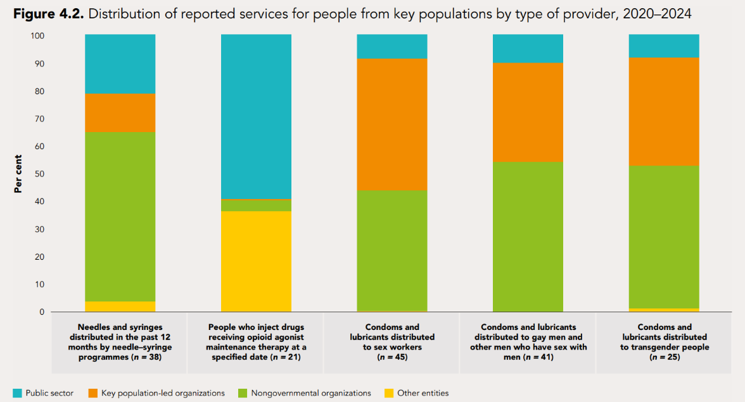
Large majorities of people from key populations rely on nongovernmental
organizations, including those run by people from key populations, for differentiated HIV prevention services
Funding cuts are putting these lifelines at risk
Source: Global AIDS Monitoring 2021–2025 (https://aidsinfo.unaids.org/)

Slide 46
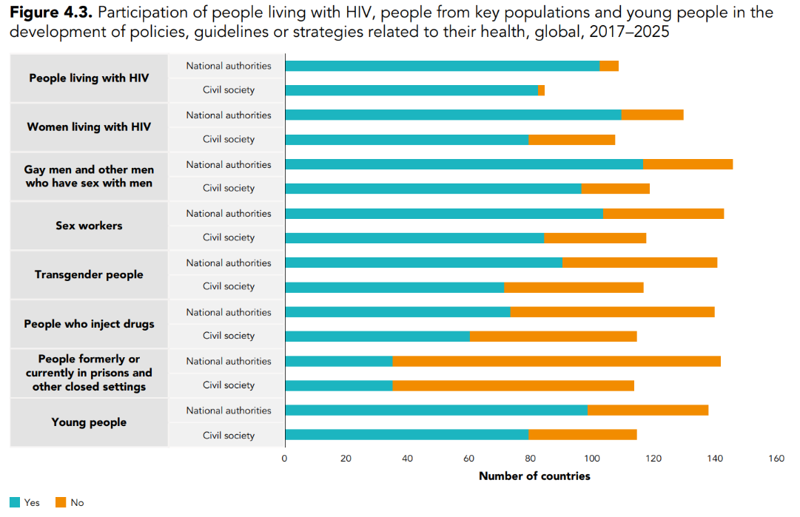
Participation in HIV policy-making varies widely across key populations
In the face of financial constraints, it is more important than ever that communities have a seat at the table
Source: National Commitments and Policy Instrument, 2017–2025 (http://lawsandpolicies.unaids.org/)

Slide 47
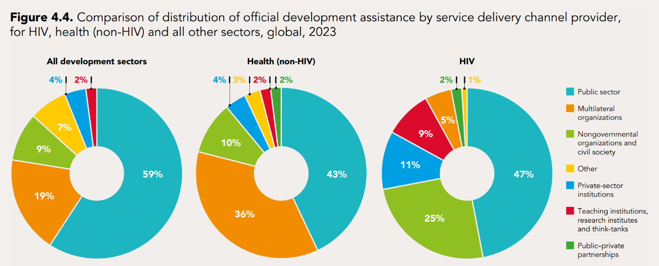
Civil society organizations were receiving a significant share of official development
assistance for HIV
Cuts in funding development assistance are having a huge impact on community-led organizations and other non-govermental organizations.
Source: UNAIDS financial estimates using data from the OECD creditor reporting system.

Slide 48
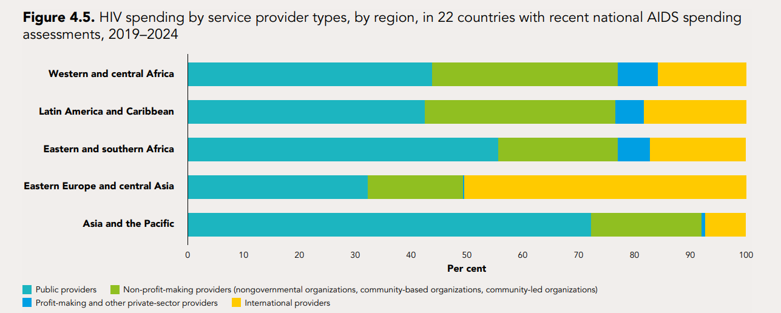
Nongovernmental organizations are highly vulnerable to funding cuts
Insert Text
Source: UNAIDS-supported national AIDS spending assessments, covering the period 2019–2024.

Slide 49
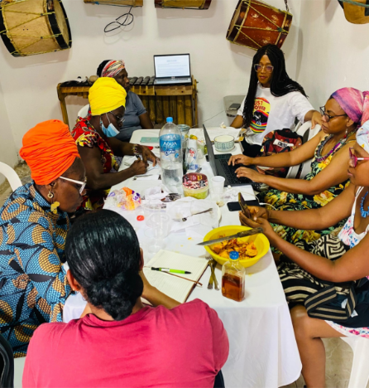
A FINANCING SHOCK AND WAYS TO SUSTAIN AND BOOST HIV RESPONSES

Slide 50
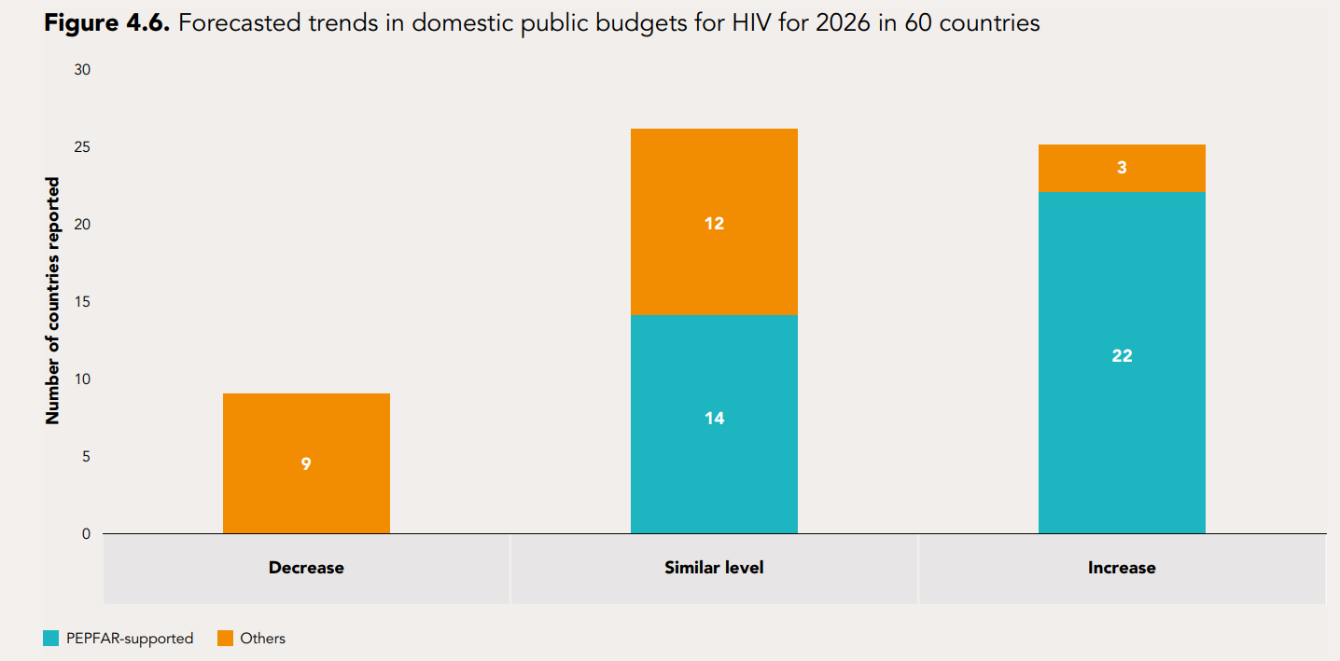
25 countries intend to increase their domestic funding for HIV in 2026
Twenty-five of the 60 countries reporting to Global AIDS Monitoring indicate increase in their Domestic budget for HIV in 2026.
More than half of reporting countries have increased their domestic HIV spending in the past five years.
Source: Global AIDS Monitoring 2025

Slide 51

Indonesia is making steady progress in domestic financing for its HIV response
Insert Text
Source: Indonesian national AIDS spending assessments (UNAIDS-supported), 2010–2022

Slide 52

From Progress to Pressure: Funding landscape 2010-2024 and 2025 Funding Crisis in HIV Response
US$ 18.7 billion was mobilized for the AIDS response in low- and middle-income countries by the end of 2024.
Since 2010, international HIV financing grew by 12%, while domestic contributions rose by 28%, reflecting stronger country ownership of the response.
Domestic funding increased by 2.2% in 2024, the first rise since the onset of the COVID-19 pandemic.
Source: UNAIDS financial and epidemiological estimates, July 2025.

Slide 53

HIV prevention, system strengthening and societal enabler programmes have relied
heavily on external funding
Data from 22-country analysis of data from National AIDS Spending Assessments(NASA):
60% of testing, 80% of prevention, 90% of research funded externally
Source: UNAIDS-supported National AIDS Spending Assessments (NASAs), covering the period 2019–2024

Slide 54

There are large variations in procurement prices for antiretroviral medicines
Insert text
Source: latest data reported to Global AIDS Monitoring 2024.

Slide 55

16 targets to end AIDS as a public health threat by 2030
Insert Text

Slide 56

Reaching the 2030 targets will save millions of lives
Achieving 2030 targets could avert 2.9 million new HIV infections and 1.3 million AIDS-related deaths (2025–2030)
Source: UNAIDS 2025 estimates and Projections from April 2025 using Avenir Health Goals Model.
Notes:
What the targets will achieve?
Ending AIDS as a public health threat, or “ending AIDS” in short, is defined as a 90% reduction in both the number of people newly acquiring HIV and the number dying of an AIDS-related cause from the 2010 estimates. Achieving the proposed 2030 HIV targets will bring most countries in reach of this goal.
This means bridging current gaps in services and enabling environments, which will avert 2.9 million infections and 1.3 million AIDS-related deaths between 2025 and 2030.

Slide 57

Estimated HIV resources available and needed to end AIDS by 2030
If countries meet proposed domestic financing targets, the domestic share could rise from 52% in 2024 to two-thirds of the global resource need by 2030
Source: UNAIDS financial estimates and projection of resource needs for 2026–2030, July 2025.
Notes:
Note: the domestic financing targets reflect the average share of domestic resources across different income groups by 2030. Within each group—particularly among lower-middle-income and
low-income countries—there is significant variation in disease burden and fiscal capacity across countries. These targets aim to encourage greater domestic ownership at the national level for a
collective increase across each of the income groups.

Slide 58

How much does it cost to achieve 2030 targets ?
Distribution of estimated resource needs by intervention and by region by 2030
UNAIDS estimates that US$ 21.9 billion will be needed annually in 2030 to achieve global HIV targets in low- and middle-income countries—down from the earlier 2021 estimate of US$ 29.3 billion to reach 2025 targets
Majority of annual resource needs in 2030 will be in upper-middle-income countries(46%) , 34% in lower-middle-income, and 20% in low-income.
Source: UNAIDS financial estimates and projection of resource needs for 2026–2030, July 2025.

