Slide 1
THE URGENCY OF NOW
2024 Global AIDS Update Report
Slide deck
AIDS AT A CROSSROADS

Slide 2
EXECUTIVE SUMMARY

Slide 3
Number of new HIV infections and AIDS-related deaths, global, 1990–2023, and 2025 target
Source: UNAIDS epidemiological estimates, 2024 (https://aidsinfo.unaids.org/).

Slide 4
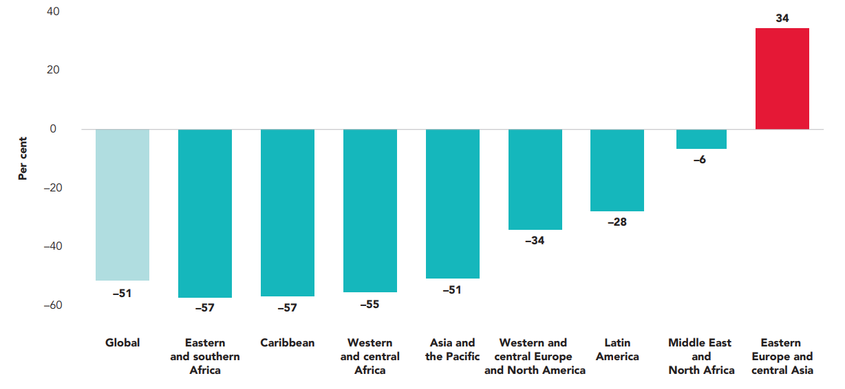
Percentage change in annual number of AIDS-related deaths between 2010 and 2023, global and by region
Source: UNAIDS epidemiological estimates, 2024 (https://aidsinfo.unaids.org/).

Slide 5
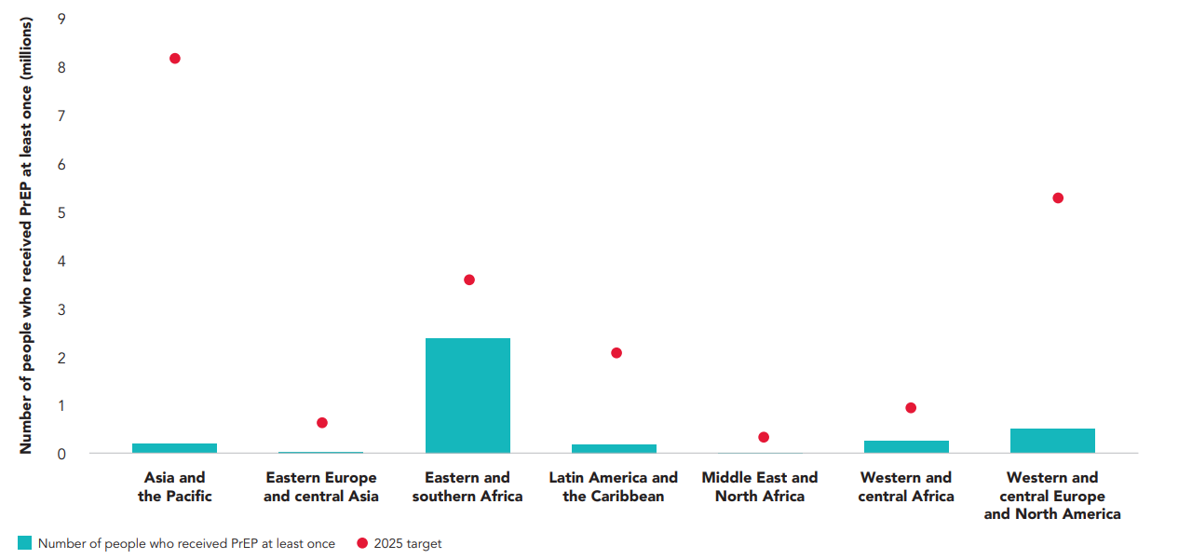
Number of people who used pre-exposure prophylaxis (PrEP) at least once in 2023, by region, and 2025 target
Source: Global AIDS Monitoring, 2024 (https://aidsinfo.unaids.org/).

Slide 6
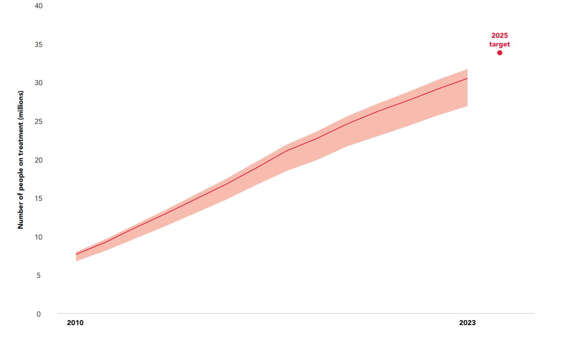
Number of people receiving antiretroviral therapy, 2010–2023, global, and 2025 target
Source: UNAIDS epidemiological estimates, 2024 (https://aidsinfo.unaids.org/).

Slide 7
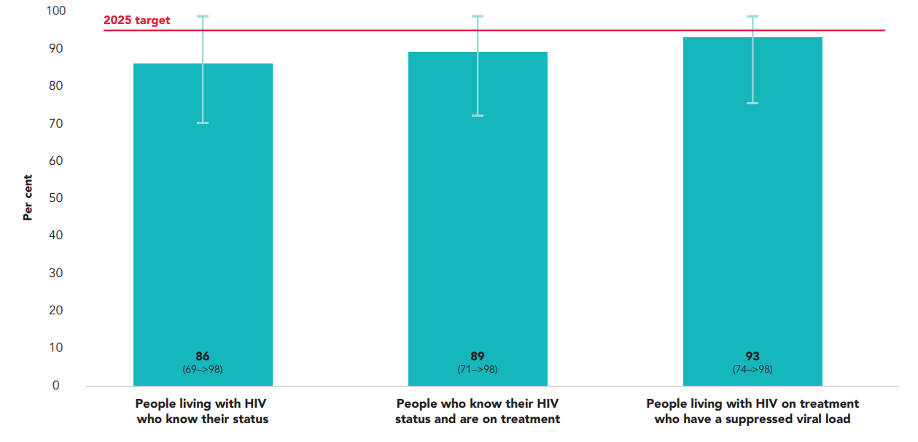
Percentage of people living with HIV who know their HIV status, of people who know their HIV status and are receiving antiretroviral therapy, and of people on HIV treatment who have suppressed viral load, global, 2023
Source: Further analysis of UNAIDS epidemiological estimates, 2024.

Slide 8
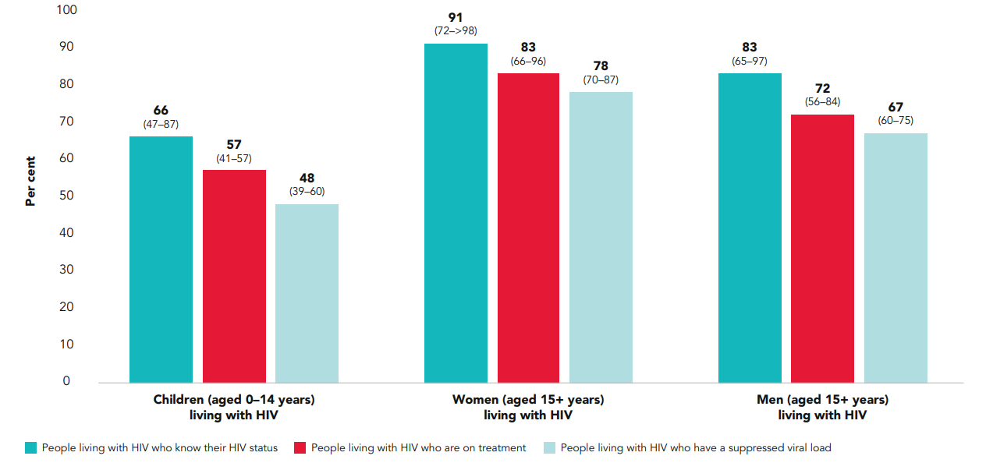
Testing and treatment cascade among children, women and men, global, 2023
Source: Further analysis of UNAIDS epidemiological estimates, 2024.

Slide 9
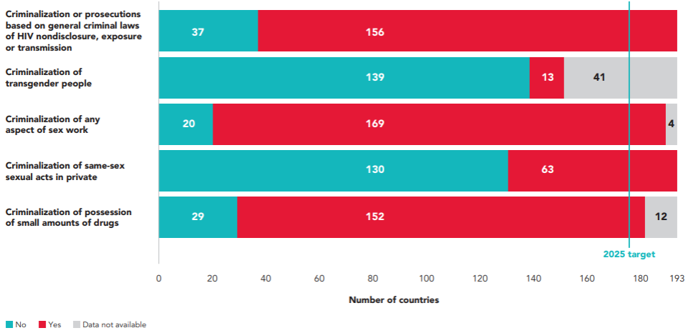
Number of countries with discriminatory and punitive HIV-related laws, global, 2024
Source: National Commitments and Policy Instrument, 2017–2024, supplemented by additional sources; 2024 (see references in regional factsheets and http://lawsandpolicies.unaids.org/).
Note: this figure does not capture where key populations may be de facto criminalized through other laws, such as vagrancy or public morality laws, or the use of the above laws for different populations.

Slide 10
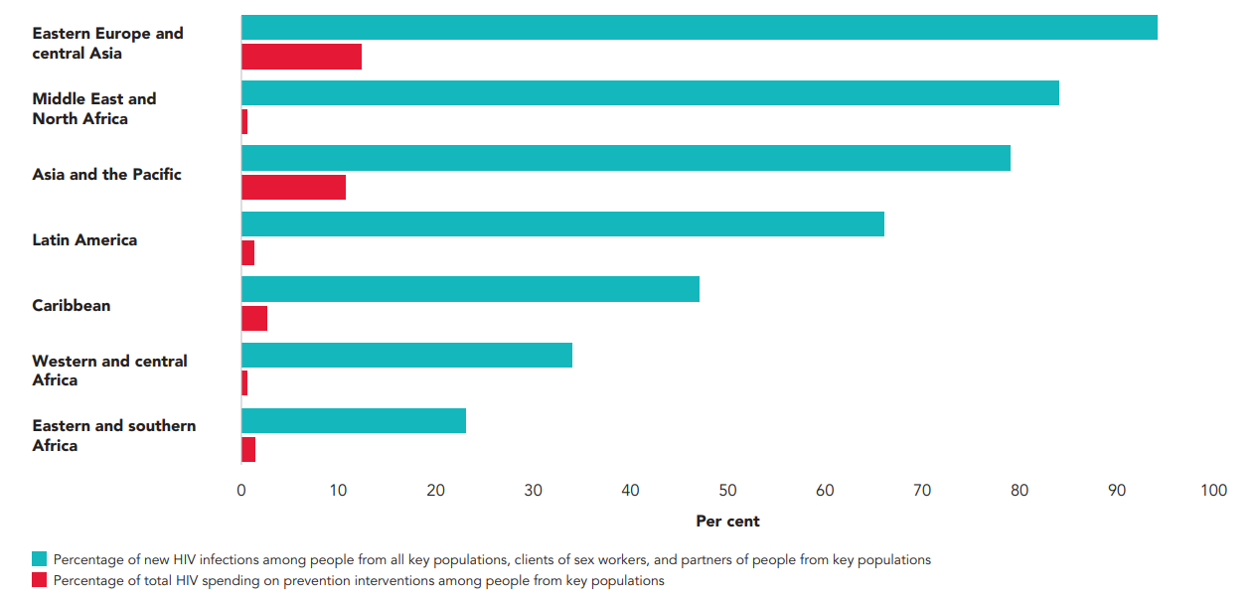
Percentage of total HIV resources spent on programmes for people from key populations and percentage of new HIV infections occurring among people from key populations and their sex partners, by region, 2023
Source: Korenromp EL, Sabin K, Stover J, Brown T, Johnson LF, Martin-Hughes R, et al. New HIV infections among key populations and their partners in 2010 and 2022, by world region: a multisources estimation. J Acquir Immune Defic Syndr. 2024;95(1S):e34–e45.

Slide 11
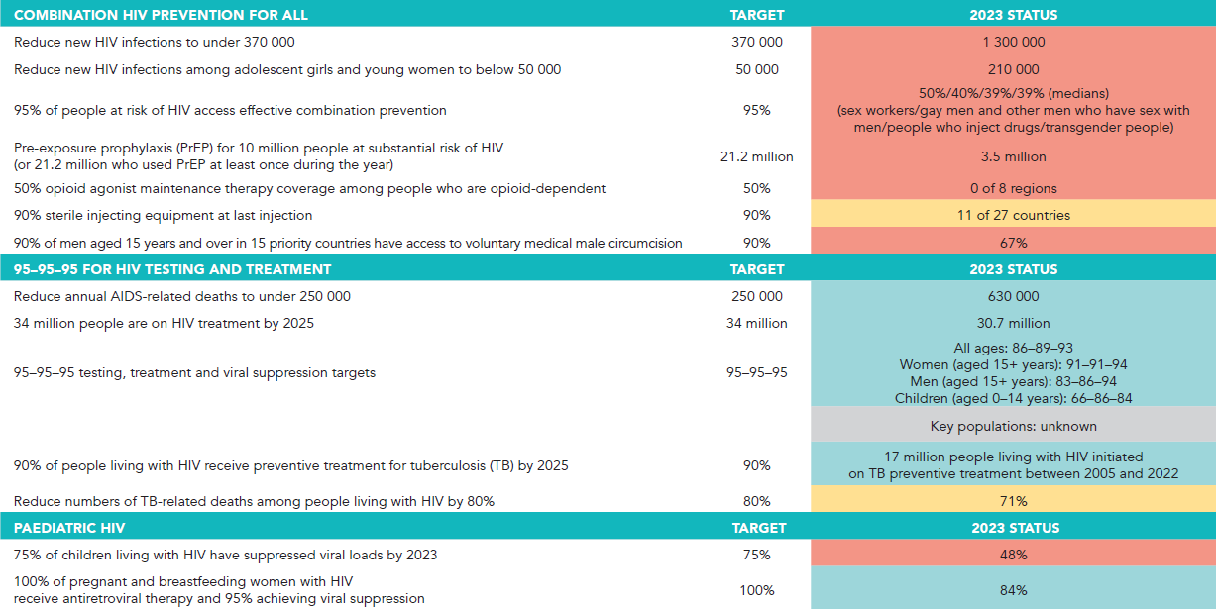
1/3
Summary of progress against the 2025 targets

Slide 12
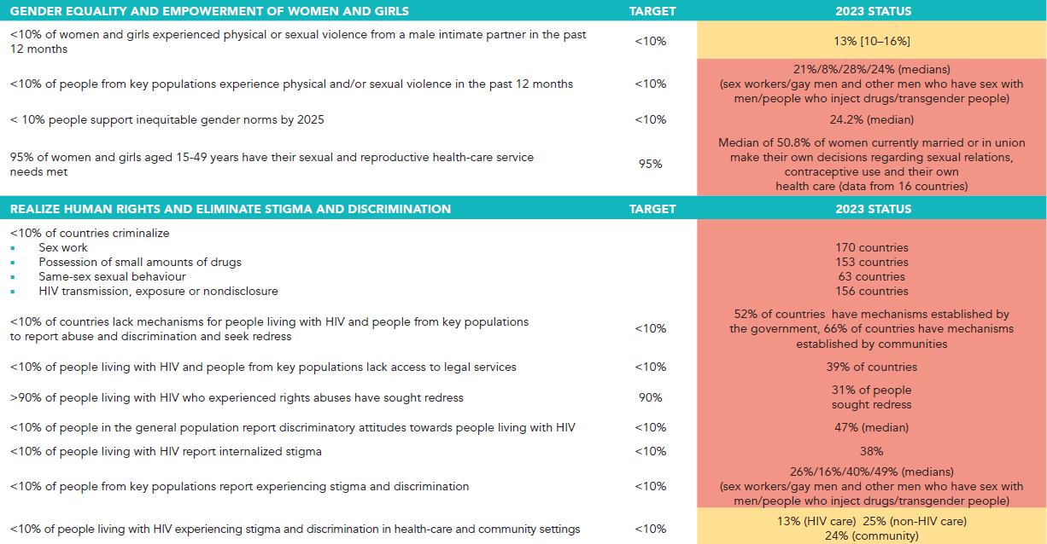
2/3
Summary of progress against the 2025 targets

Slide 13
3/3
Summary of progress against the 2025 targets

Slide 14
PROGRESS AT THE HALFWAY MARK TO THE 2025 MILESTONES

Slide 15
OVERVIEW: THE STATE OF THE HIV PANDEMIC

Slide 16
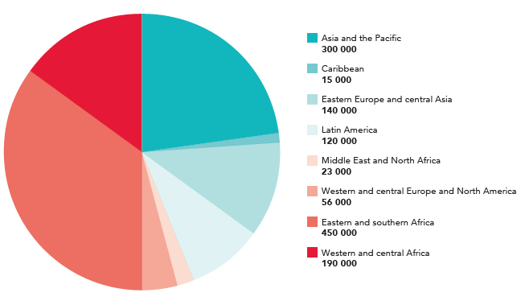
Distribution of new HIV infections, by region, 2023
Source: UNAIDS epidemiological estimates, 2024 (https://aidsinfo.unaids.org/).

Slide 17
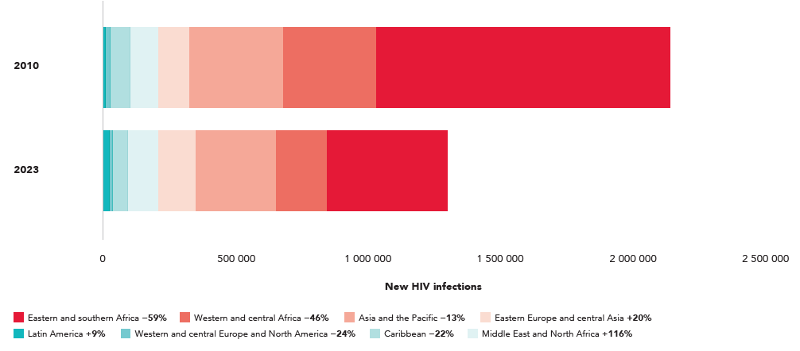
Distribution of new HIV infections and percent change between 2010 and 2023, total population, by region
Source: UNAIDS epidemiological estimates, 2024 (https://aidsinfo.unaids.org/).

Slide 18
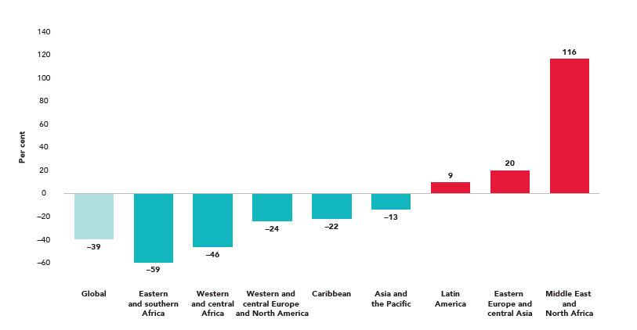
Change in new HIV infections between 2010 and 2023, total population, by region
Source: UNAIDS epidemiological estimates, 2024 (https://aidsinfo.unaids.org/).

Slide 19
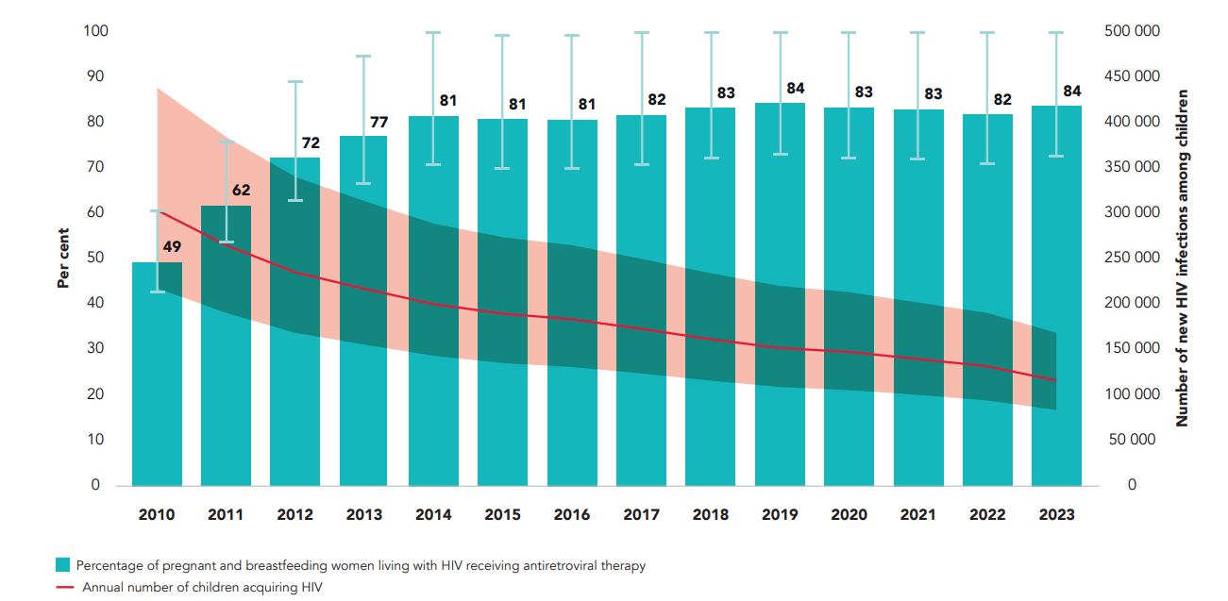
Annual number of children (aged 0–14 years) acquiring HIV and percentage of pregnant and breastfeeding women living with HIV receiving antiretroviral therapy, global, 2010–2023
Source: UNAIDS epidemiological estimates, 2024 (https://aidsinfo.unaids.org/).

Slide 20
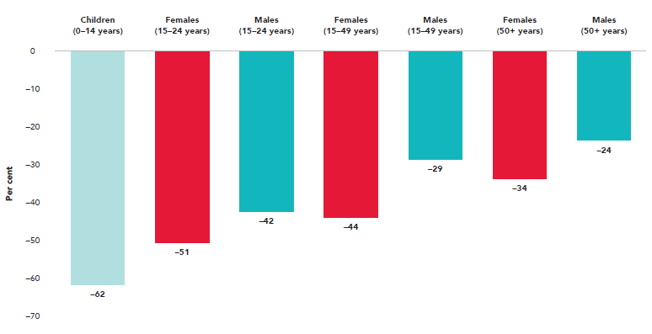
Percentage change in annual new HIV infections between 2010 and 2023 by age group and sex, global
Source: UNAIDS epidemiological estimates, 2024 (https://aidsinfo.unaids.org/).

Slide 21
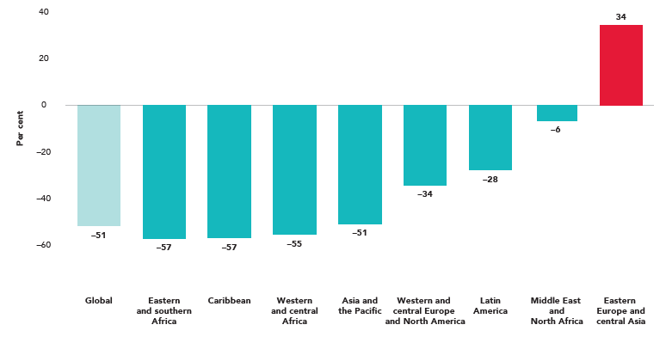
Percentage change in annual number of AIDS-related deaths between 2010 and 2023, global and by region
Source: UNAIDS epidemiological estimates, 2024 (https://aidsinfo.unaids.org/).

Slide 22
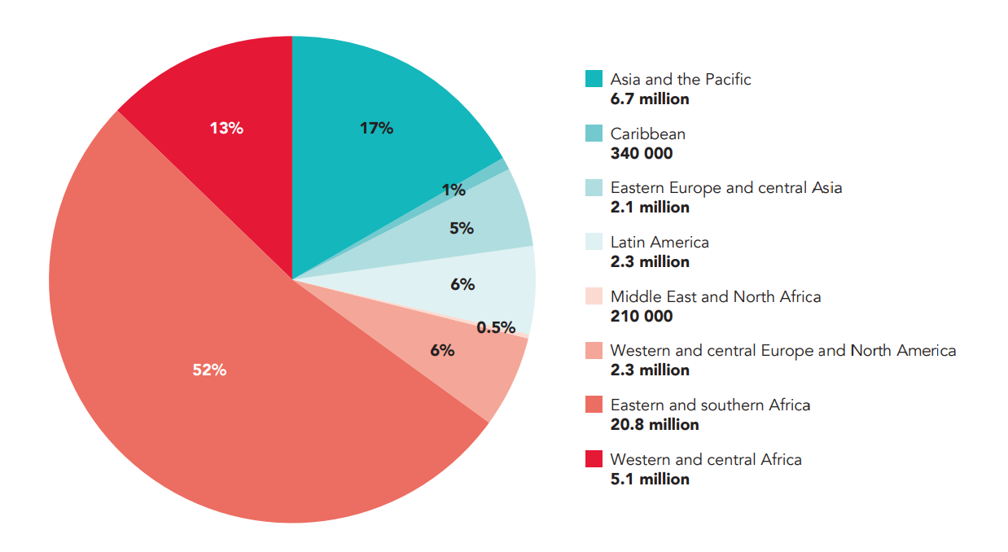
Number of people living with HIV, by region, 2023
Source: UNAIDS epidemiological estimates, 2024 (https://aidsinfo.unaids.org/).

Slide 23
ACCESSING HIV SERVICES AND SOLUTIONS
HIV PREVENTION

Slide 24
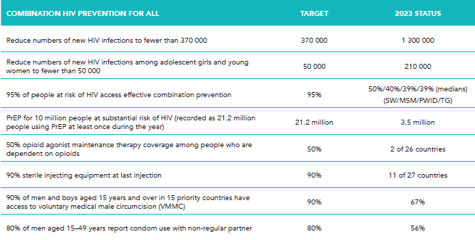
Overview of progress across priority elements of HIV prevention, 2023
Source: Global AIDS Monitoring, 2024 (https://aidsinfo.unaids.org/).
Global 2025 targets for condom use vary by level of HIV incidence in a geographical area and by individual risk. They are set at 95% for people at highest risk and 70% and 50% for people at moderate and low risk. Since data presented here are for a population at high risk (people with non-regular partners) in an entire country, a benchmark of 80% is used as a proxy for the targets. The benchmark of 21.2 million people who use PrEP is based on the global PrEP targets, which translates into 10.6 million person-years of PrEP. An assumed average duration of PrEP use of six months per year yields the benchmark of 21.2 million people who use PrEP.

Slide 25
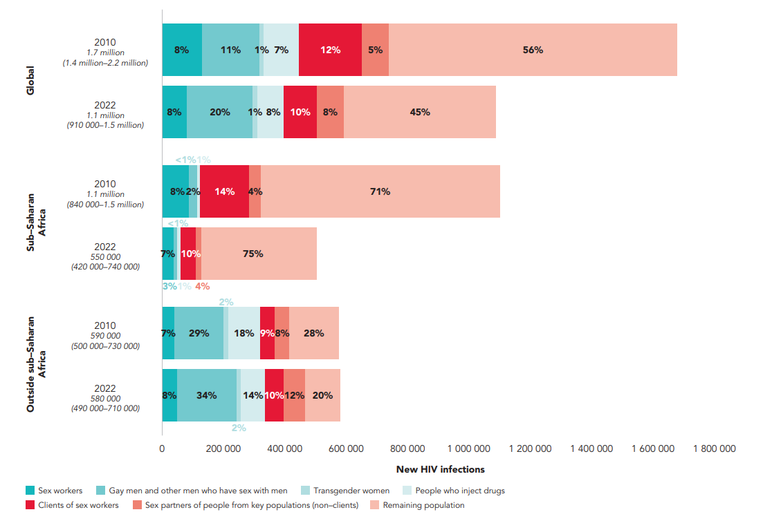
Distribution of adult (15-49 years) new HIV infections, by key population and region, 2010 and 2022
Source: Korenromp EL, Sabin K, Stover J, Brown T, Johnson LF, Martin-Hughes R, et al. New HIV infections among key populations and their partners in 2010 and 2022, by world region: a multisources estimation. J Acquir Immune Defic Syndr. 2024;95(1S):e34–e45. doi:10.1097/QAI.0000000000003340.
Note: the number below year is the number of new HIV infections.

Slide 26
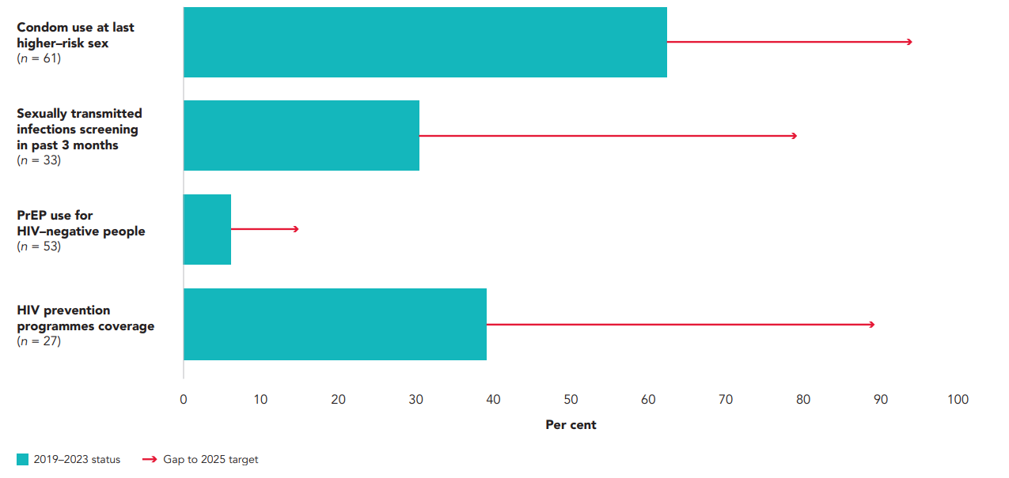
Gap to achieve combination prevention targets among gay men and other men who have sex with men, by intervention, global, 2019–2023
Source: Global AIDS Monitoring, 2020–2024 (https://aidsinfo.unaids.org/); UNAIDS special analysis 2024.
Note: the graph shows median coverage among countries reporting, except for PrEP use. For PrEP, the methods used are described in the section “Calculation of pre-exposure prophylaxis (PrEP) coverage for HIV-negative people” in Annex 2. 2025 targets are global. Coverage of interventions can be underestimated due to the lack of reporting from some countries. n = number of countries reporting. “HIV prevention programmes coverage” refers to people from key populations who reported receiving at least two prevention services in the previous three months. Possible prevention services received include condoms and lubricants, counselling on condom use and safer sex, and testing for sexually transmitted infections. Condom use at last higher-risk sex does not take into account people taking PrEP and therefore may be underestimated. PrEP targets were calculated based on the number of people who would most benefit from PrEP use, those with greatest vulnerability to HIV exposure within each key population. Reported numbers of PrEP users include all users regardless of vulnerability.

Slide 27
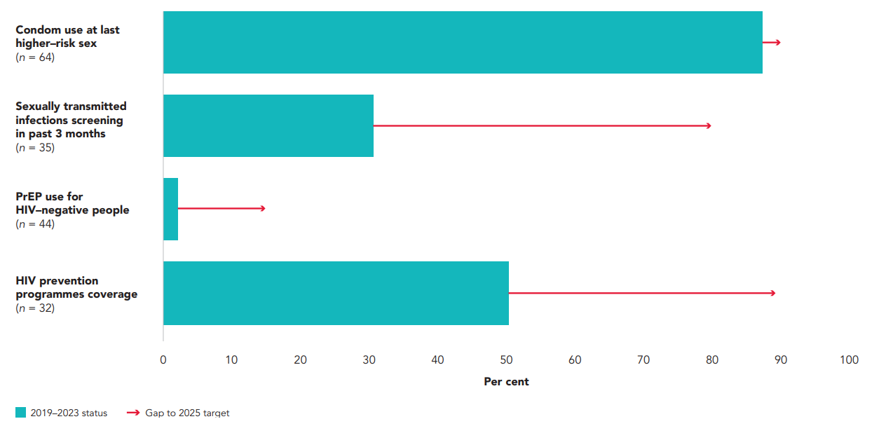
Gap to achieve combination prevention targets among sex workers, by intervention, global, 2019–2023
Source: Global AIDS Monitoring, 2020–2024 (https://aidsinfo.unaids.org/); UNAIDS special analysis, 2024.
Note: the graph shows median coverage among countries reporting, except for PrEP use. For PrEP, the methods used are described in the section “Calculation of pre-exposure prophylaxis (PrEP) coverage for HIV-negative people” in Annex 2. 2025 targets are global. Coverage of interventions can be underestimated due to the lack of reporting from some countries. n = number of countries reporting. HIV prevention programmes coverage refers to people from key populations who reported receiving at least two prevention services in the past three months. Possible prevention services received for sex workers include condoms and lubricants, counselling on condom use and safer sex, and testing for sexually transmitted infections. Condom use at last higher-risk sex does not take into account people taking PrEP and therefore may be underestimated. PrEP targets were calculated based on the number of people who would most benefit from PrEP use, those with greatest vulnerability to HIV exposure within each key population. Reported numbers of PrEP users include all users regardless of vulnerability.

Slide 28
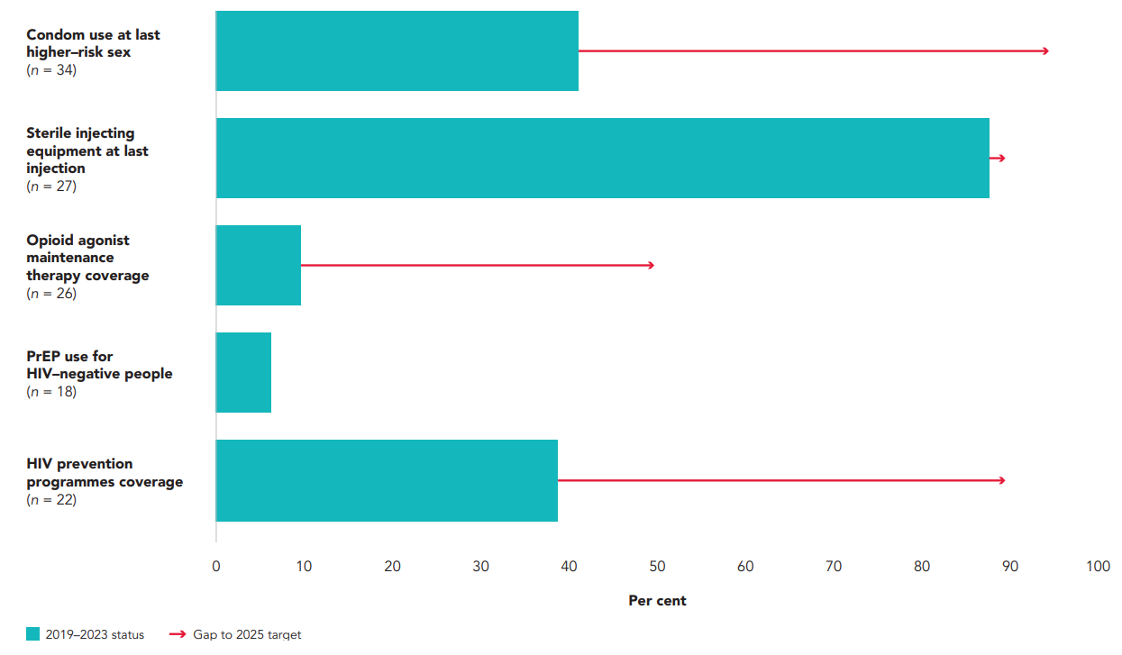
Gap to achieve combination prevention targets among people who inject drugs, by intervention, global, 2019–2023
Source: Global AIDS Monitoring, 2020–2024 (https://aidsinfo.unaids.org/); UNAIDS special analysis, 2024.
Note: the graph shows median coverage among countries reporting, except for PrEP use. For PrEP, the methods used are described in the section “Calculation of pre-exposure prophylaxis (PrEP) coverage for HIV-negative people” in the Annex. 2025 targets are global. Coverage of interventions can be underestimated due to the lack of reporting from some countries. n = number of countries reporting. HIV prevention programmes coverage refers to people from key populations who reported receiving at least two prevention services in the previous three months. Possible prevention services received include condoms and lubricants, counselling on condom use and safer sex, and sterile injecting equipment. Condom use at last higher-risk sex does not take into account people taking PrEP and therefore may be underestimated. The use of a clean needle the last time a person has injected tends to come from surveys, which are typically conducted in areas that have services available and thus may not be nationally representative.

Slide 29
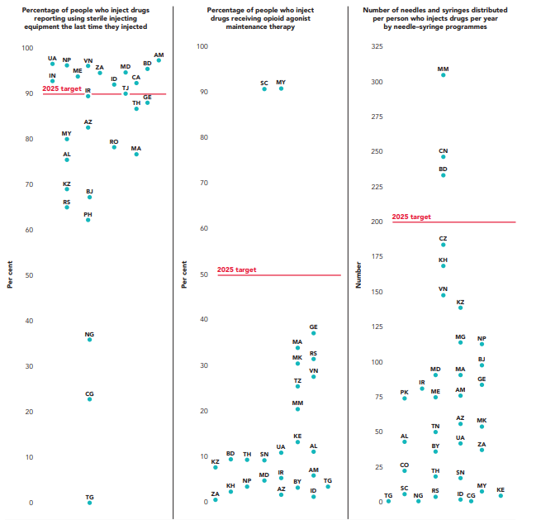
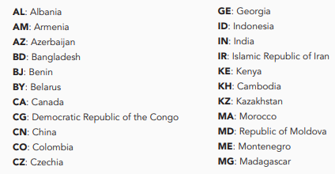
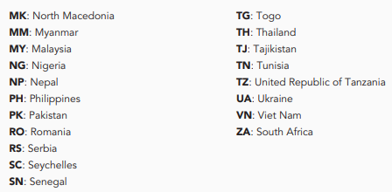
Progress towards the harm reduction 2025 targets, by country, 2019–2023
Source: Global AIDS Monitoring, 2020–2024 (https://aidsinfo.unaids.org/)

Slide 30
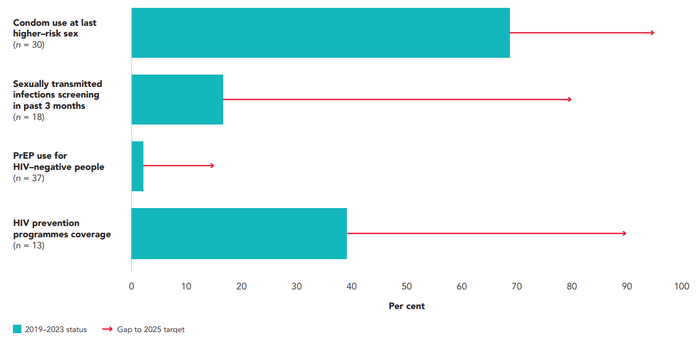
Gap to achieve combination prevention targets among transgender people, by intervention, global, 2019–2023
Source: Global AIDS Monitoring, 2024 (https://aidsinfo.unaids.org/); UNAIDS special analysis, 2024.
Note: the graph shows median coverage among countries reporting, except for PrEP use. For PrEP, the methods used are described in the section “Calculation of pre-exposure prophylaxis (PrEP) coverage for HIV-negative people” in Annex 2. 2025 targets are global. Coverage of interventions can be underestimated due to the lack of reporting from some countries. n = number of countries reporting. HIV prevention programmes coverage refers to people from key populations who reported receiving at least two prevention services in the previous three months. Possible prevention services received include condoms and lubricants, counselling on condom use and safer sex, and testing for sexually transmitted infections. Condom use at last high-risk sex does not take into account people taking PrEP and therefore can be underestimated. PrEP targets were calculated based on the number of people who would most benefit from PrEP use— those with greatest vulnerability to HIV exposure within each key population. Reported numbers of users of PrEP include all users regardless of vulnerability.

Slide 31
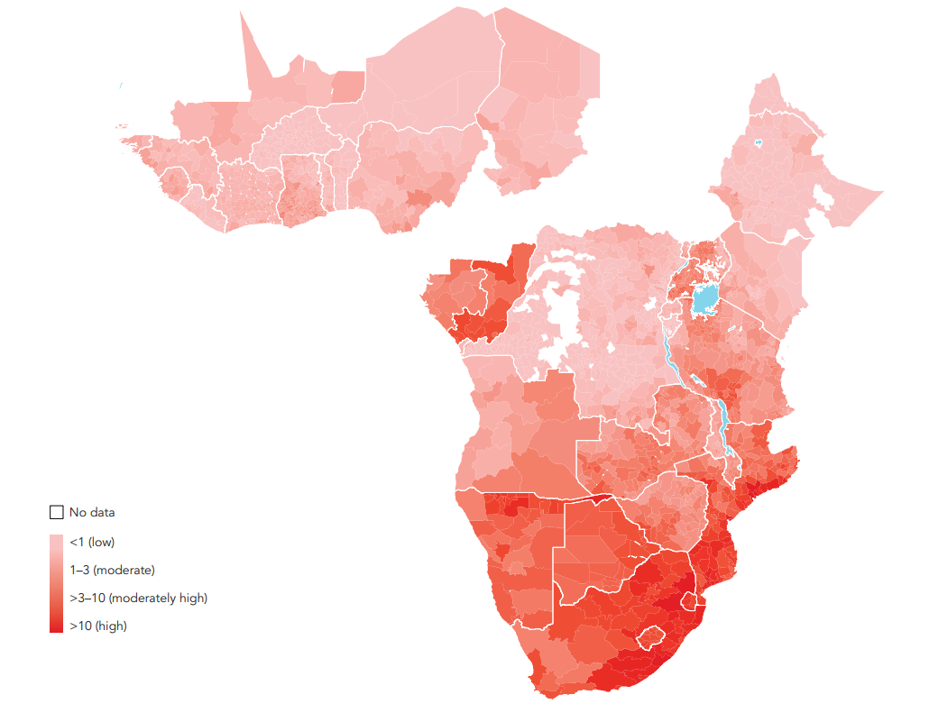
HIV incidence among all adolescent girls and young women (aged 15–24 years), subnational levels, sub–Saharan Africa, 2024
Source: UNAIDS epidemiological estimates, 2024 (https://aidsinfo.unaids.org/).
Note: HIV incidence estimated as new HIV infections per 1000 uninfected population.

Slide 32
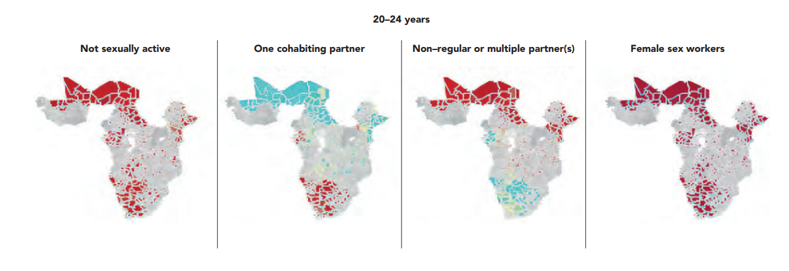
Spatial distribution of age and behavioural HIV-related risk factors among adolescent girls and young women in sub-Saharan Africa, 2022
Source: Howes A, Risher KA, Nguyen VK, Stevens O, Jia KM, Wolock TM, et al. Spatio-temporal estimates of HIV risk group proportions for adolescent girls and young women across 13 priority countries in sub-Saharan Africa. PLOS Glob Public Health. 2023;3(4):e0001731.

Slide 33
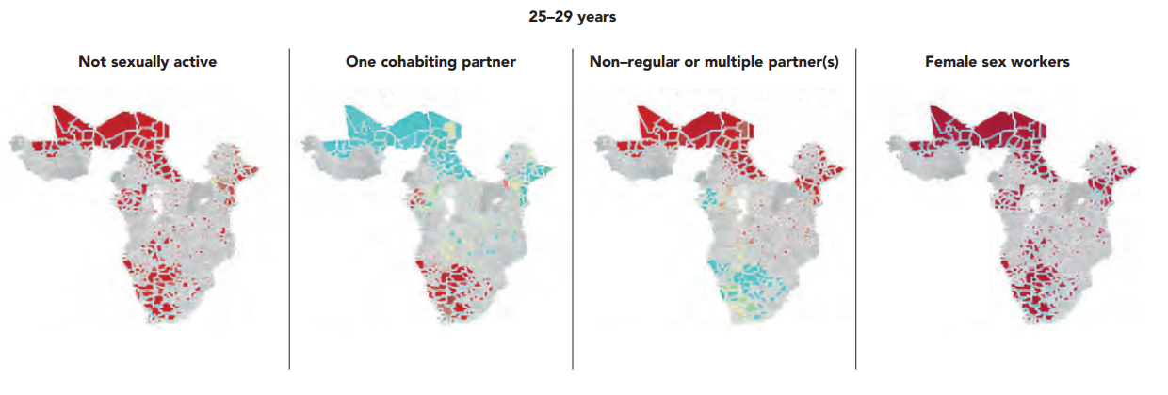
Spatial distribution of age and behavioural HIV-related risk factors among adolescent girls and young women in sub-Saharan Africa, 2022
Source: Howes A, Risher KA, Nguyen VK, Stevens O, Jia KM, Wolock TM, et al. Spatio-temporal estimates of HIV risk group proportions for adolescent girls and young women across 13 priority countries in sub-Saharan Africa. PLOS Glob Public Health. 2023;3(4):e0001731.

Slide 34
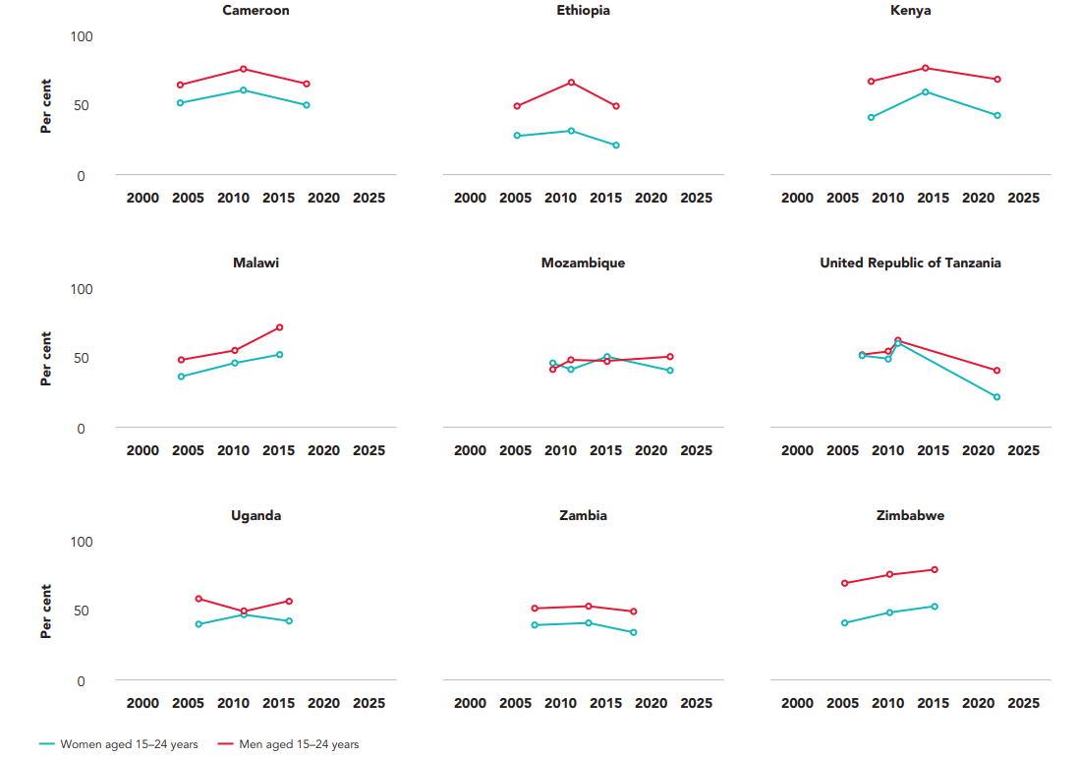
Percentage of adolescents and young people (aged 15–24 years) who used a condom at last higher-risk sex, selected countries, 2000–2022
Source: Demographic and Health Surveys 2002–2022.
Note: condom use at last higher-risk sex (with a non-marital, non-cohabiting partner) [women] = percentage of women who say they used a condom the last time they had sex with a nonmarital, non-cohabiting partner, of those who have had sex with such a partner in the past 12 months. Condom use at last higher-risk sex (with a non-marital, non-cohabiting partner) [men] = percentage of men who say they used a condom the last time they had sex with a non-marital, non-cohabiting partner, of those who have had sex with such a partner in the past 12 months.

Slide 35
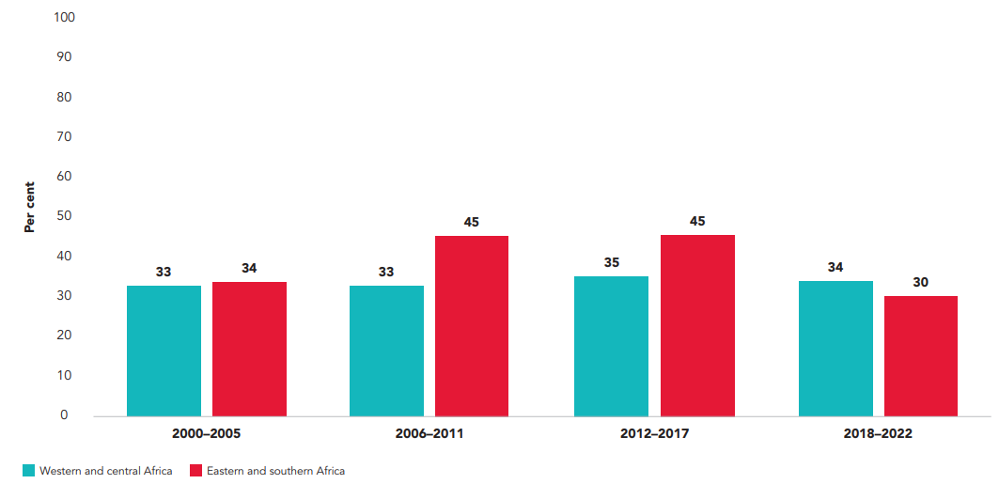
Condom use by adolescent girls and young women (aged 15–24 years) at last sex with a non-regular, non-cohabiting partner, eastern and southern Africa and western and central Africa, 2000–2022
Source: Demographic and Health Surveys, 2000–2022.
Note: data are weighted averages based on the population size of countries with Demographic and Health Surveys during the time periods and may vary by time period; thus, differences may not necessarily represent actual trends in condom use.

Slide 36
Condom use at last sex with a non-regular partner, by sex and wealth quintile, selected countries in sub-Saharan Africa, 2015–2022
Source: Demographic and Health Surveys, 2015–2022.

Slide 37
Condom use at last sex with a non-regular partner, by sex and wealth quintile, selected countries in sub-Saharan Africa, 2015–2022
Source: Demographic and Health Surveys, 2015–2022.

Slide 38
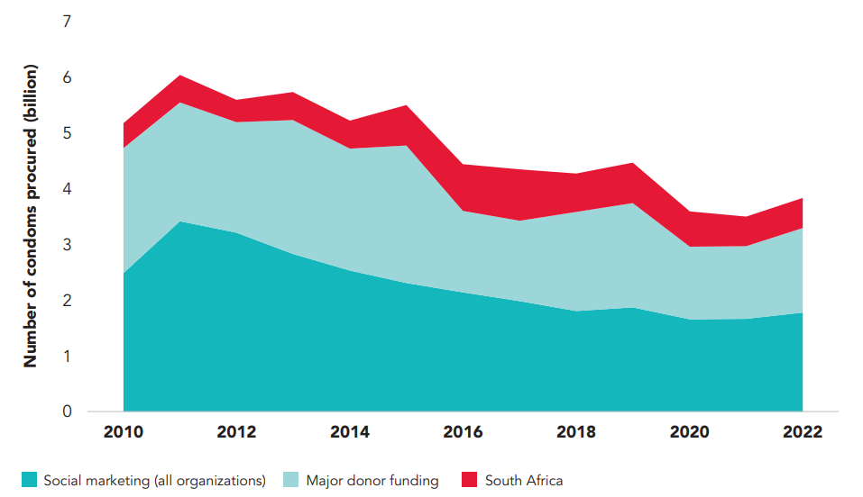
Condom distribution trends in low- and middle-income countries, 2010–2022
Source: Understanding the global condom landscape. Seattle, Geneva: Mann Global Health; 2024.
Note: donors include the United Nations Population Fund (UNFPA), UNFPA Third Party Procurement (TPP), the United States Agency for International Development (USAID) and the Global Fund to Fight AIDS, Tuberculosis and Malaria; data for donors reflect global procurement (condoms may not have been distributed in the same fiscal year); data for social marketing organizations are the reported distribution and per DKT International social marketing statistics report; data may be missing for domestically funded condoms not procured under TPP (aside from South Africa).

Slide 39
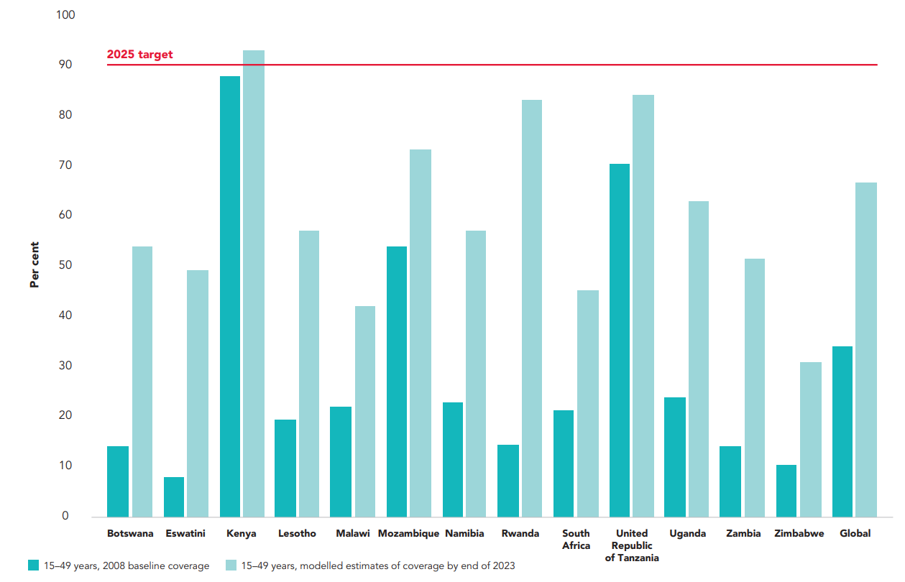
Modelled estimates of national coverage of voluntary medical male circumcision across 13 priority countries, 2008 and 2023, and 2025 coverage target
Source: VMMC 3MC Decision-makers’ Program Planning Toolkit, Version 2, 2024 version, data extracted on 29 March 2024 (http://www.vmmcipt.org/2024_3MC/).

Slide 40
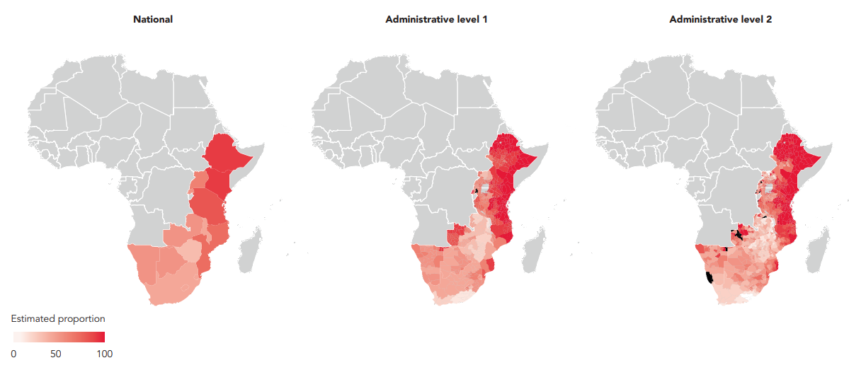
Coverage of voluntary medical male circumcision programmes among boys and men (aged 15– 29 years) at subnational levels in 15 priority countries, 2023
Source: Special analysis by Avenir Health using the 3MC Decision-makers’ Program Planning Toolkit, Version 2, 2024.
Note: data not available for Ethiopia, Rwanda or South Sudan.

Slide 41
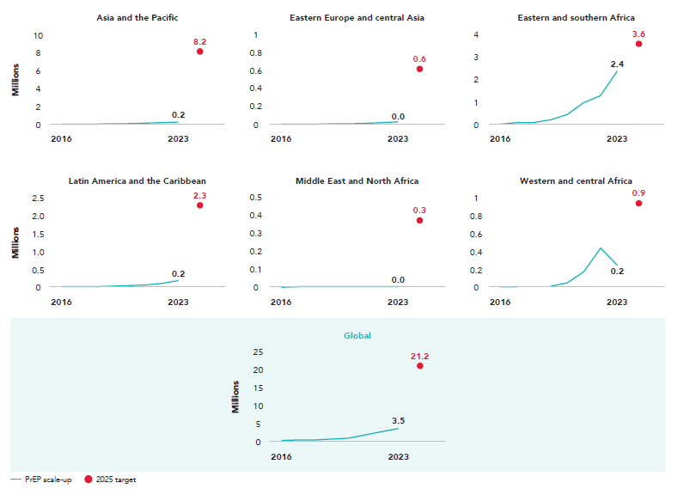
Trends in the number of people who received pre-exposure prophylaxis (PrEP) at least once during the reporting period, by region, 2016–2023, and 2025 target
Source: Global AIDS Monitoring, 2024 (https://aidsinfo.unaids.org/).
Note: in the global model to estimate PrEP need to achieve 2025 targets, PrEP need was defined as person-years of PrEP, meaning use for a period of 12 months. Country reporting, however, is done using the indicator people who used PrEP at least once in the past 12 months. For the purposes of this figure, it was assumed that average duration of PrEP use was six months. Based on this assumption, the global target of 10.6 million person-years of PrEP use was translated into an indicative estimated target of 21.2 million PrEP users. The same logic was applied to regional targets.

Slide 42
ACCESSING HIV SERVICES AND SOLUTIONS
TREATMENT AND CARE FOR PEOPLE LIVING WITH HIV

Slide 43
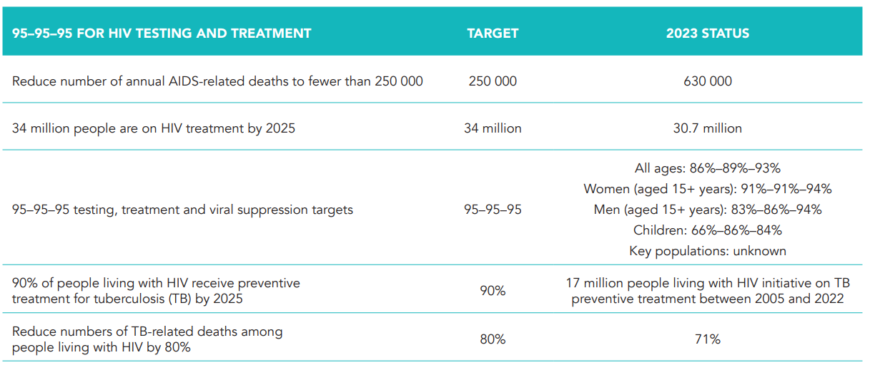
Overview of progress across priority elements of HIV treatment

Slide 44
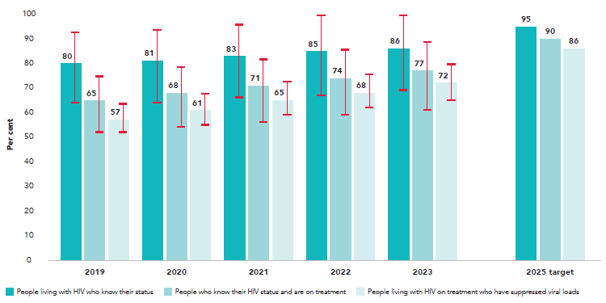
Testing and treatment cascade among people living with HIV, global, 2019–2023
Source: Further analysis of UNAIDS epidemiological estimates, 2024.

Slide 45
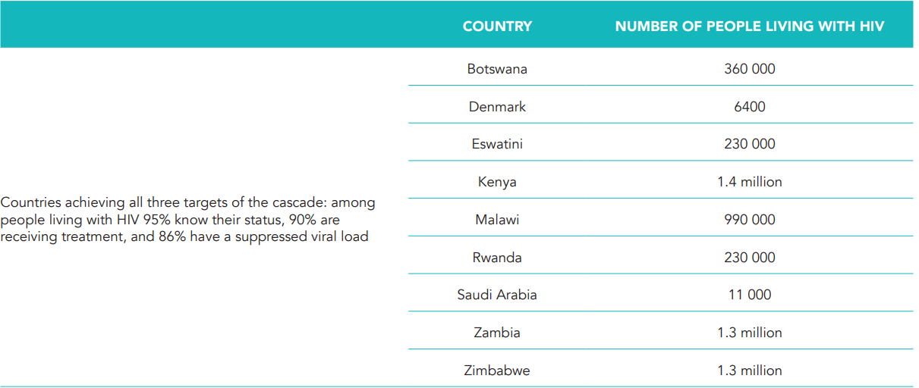
Countries reaching the treatment cascade and community-level viral suppression targets, and estimated numbers of people living with HIV, 2023
Source: UNAIDS epidemiological estimates, 2024 (https://aidsinfo.unaids.org/).
Note: the 2025 targets are for 95% of people living with HIV to know their HIV status, 95% of these people to be receiving HIV treatment, and 95% of these people to have viral suppression. In this table, the 95–95–95 targets are translated into a cascade using all people living with HIV as a denominator. For further explanation of the difference see https://www.unaids.org/sites/ default/files/media_asset/progress-towards-95-95-95_en.pdf

Slide 46
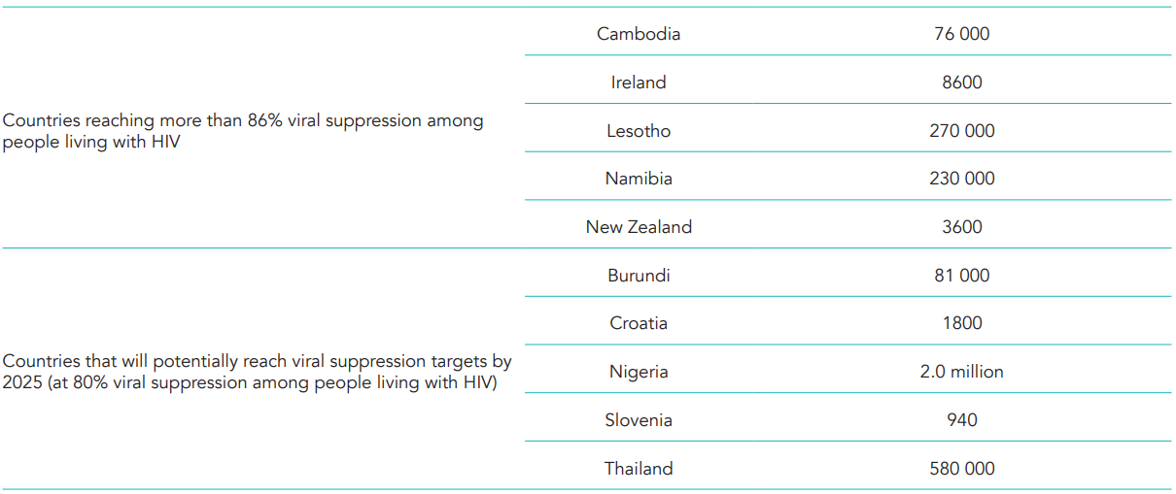
Countries reaching the treatment cascade and community-level viral suppression targets, and estimated numbers of people living with HIV, 2023
Source: UNAIDS epidemiological estimates, 2024 (https://aidsinfo.unaids.org/).
Note: the 2025 targets are for 95% of people living with HIV to know their HIV status, 95% of these people to be receiving HIV treatment, and 95% of these people to have viral suppression. In this table, the 95–95–95 targets are translated into a cascade using all people living with HIV as a denominator. For further explanation of the difference see https://www.unaids.org/sites/ default/files/media_asset/progress-towards-95-95-95_en.pdf

Slide 47
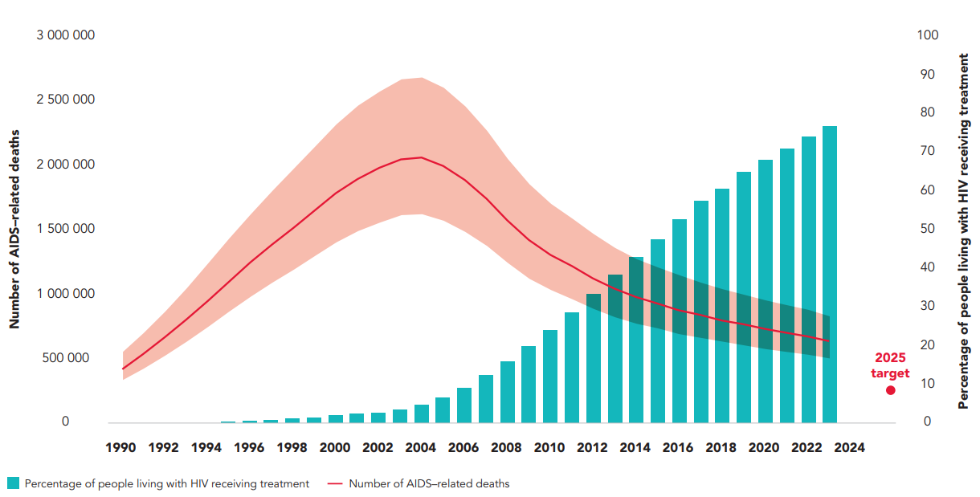
AIDS-related deaths, 2025 target and percentage of people living with HIV receiving treatment, global, 1990–2023
Source: UNAIDS epidemiological estimates 2024 (https//:aidsinfo.unaids.org/).

Slide 48
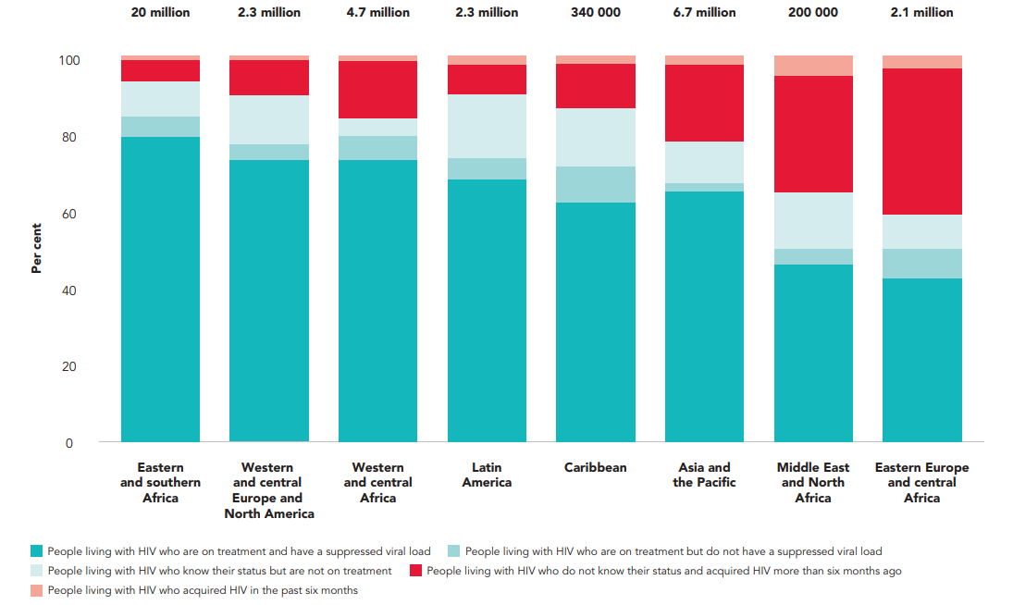
Distribution of people living with HIV by recent HIV infection, knowledge of status, treatment coverage and viral load suppression levels, aged 15 years and older, by region, 2023
Source: Further analysis of UNAIDS epidemiological estimates, 2024.
Note: the value shown at the top of each bar is the estimated number of people living with HIV in 2023.

Slide 49
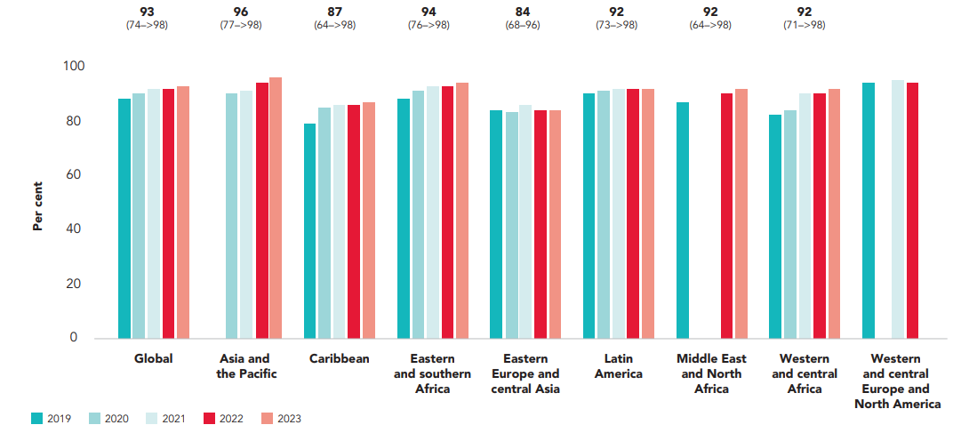
Viral load suppression among people on antiretroviral therapy, by region, 2019–2023
Source: Further analysis of UNAIDS epidemiological estimates, 2024.
Note: gaps indicate that data were unavailable for those years. Values in parentheses reflect uncertainty bounds.

Slide 50
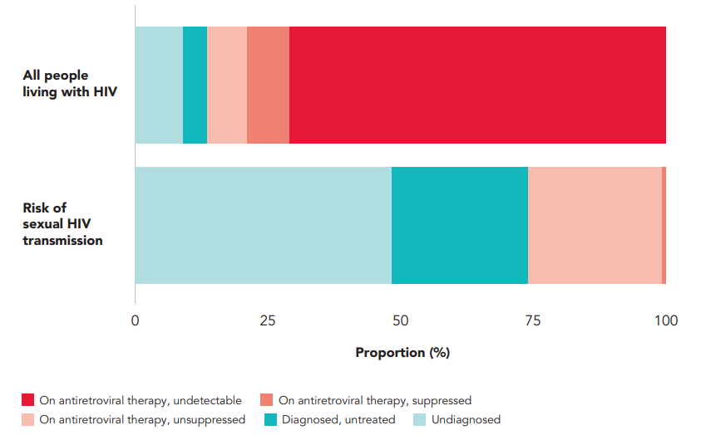
People living with HIV along the testing and treatment cascade, and their respective contribution to sexual HIV transmission, 2020
Source: Edun O, Okell L, Chun H, Bissek ACZ, Ndongmo CB, et al. HIV risk behaviour, viraemia, and transmission across HIV cascade stages including low-level viremia: analysis of 14 cross-sectional population-based HIV impact assessment surveys in sub-Saharan Africa. PLOS Glob Public Health. 2024;4(4):e0003030.

Slide 51
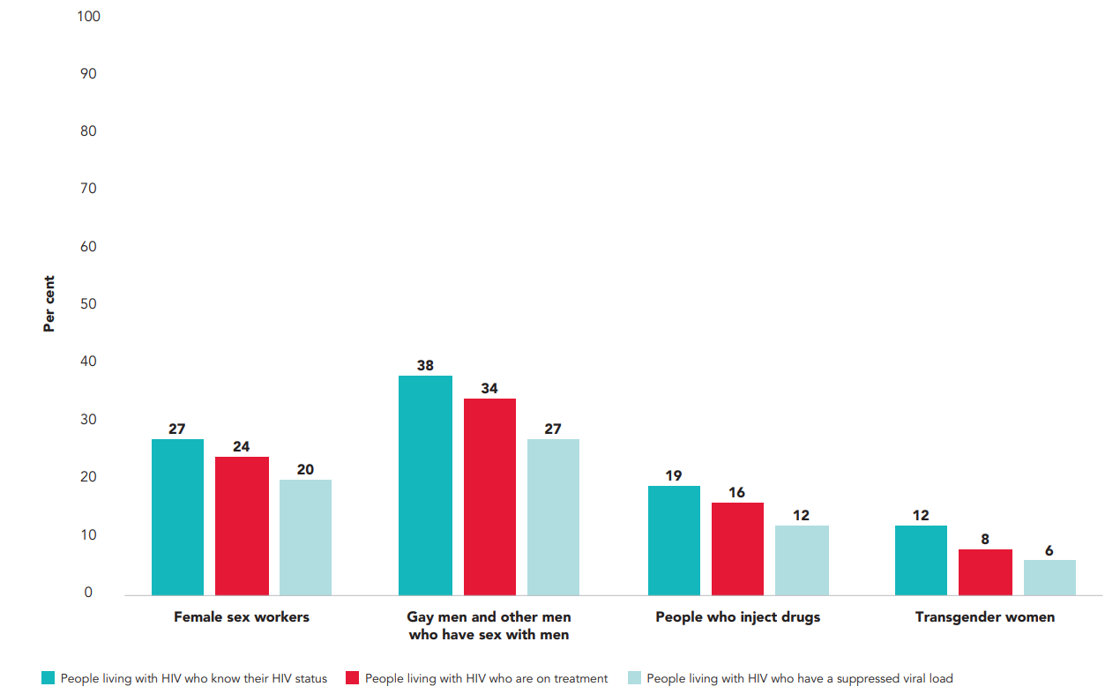
Treatment cascade among key populations, 12 states, Nigeria, 2020
Source: Aguolu R, Ejeckam C, Green K, Ashefor G. Did Nigeria achieve the UNAIDS 90–90–90 treatment target among key populations? An analysis of the national HIV treatment cascade. Presented at the 24th International AIDS Conference, 29 July–2 August 2022, Montreal, Canada (https://programme.aids2022.org/Abstract/Abstract/?abstractid=12068).

Slide 52
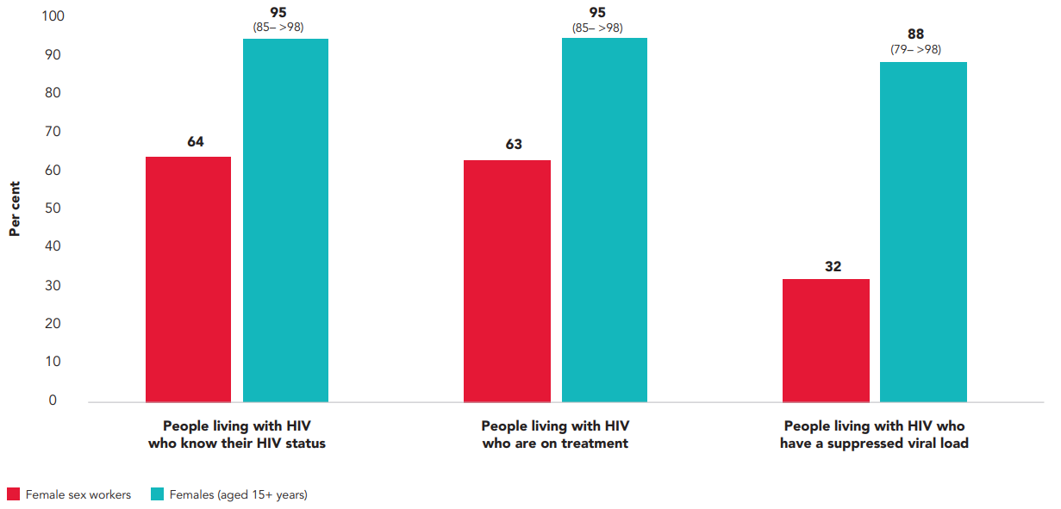
HIV testing and treatment cascade, Burundi, 2021
Source: UNAIDS epidemiological estimates, 2024 (https://aidsinfo.unaids.org/); Enquête nationale de seroprevalence et de surveillance des comportements face au VIH au Burundi chez les professionnelles de sexe, 2021.
Note: female sex worker data are retrieved from surveys and do not require uncertainty bounds.

Slide 53
ACCESSING HIV SERVICES AND SOLUTIONS
ENDING PAEDIATRIC AIDS

Slide 54
Overview of progress across priority elements of paediatric HIV

Slide 55
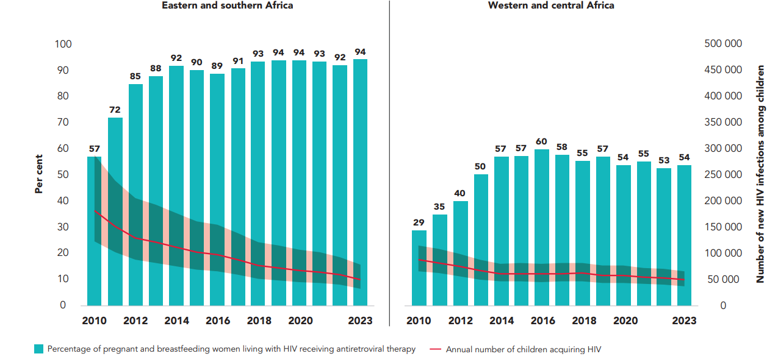
Annual number of children (aged 0–14 years) acquiring HIV and percentage of pregnant and breastfeeding women living with HIV receiving antiretroviral therapy, in eastern and southern Africa, and in western and central Africa, 2010–2023
Source: UNAIDS epidemiological estimates, 2024 (https://aidsinfo.unaids.org/).

Slide 56
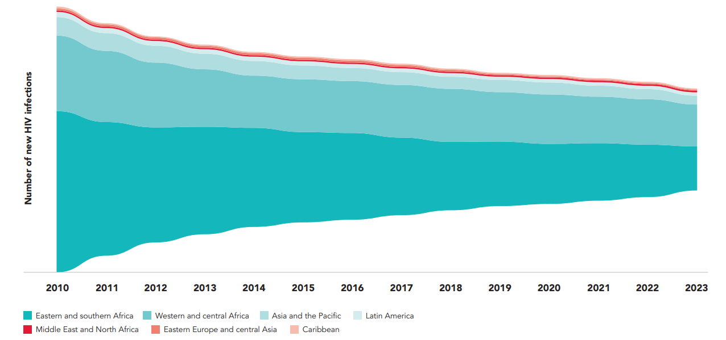
Estimated annual number of children acquiring HIV, by region, 2010–2023
Source: UNAIDS epidemiological estimates, 2024 (https://aidsinfo.unaids.org/).

Slide 57
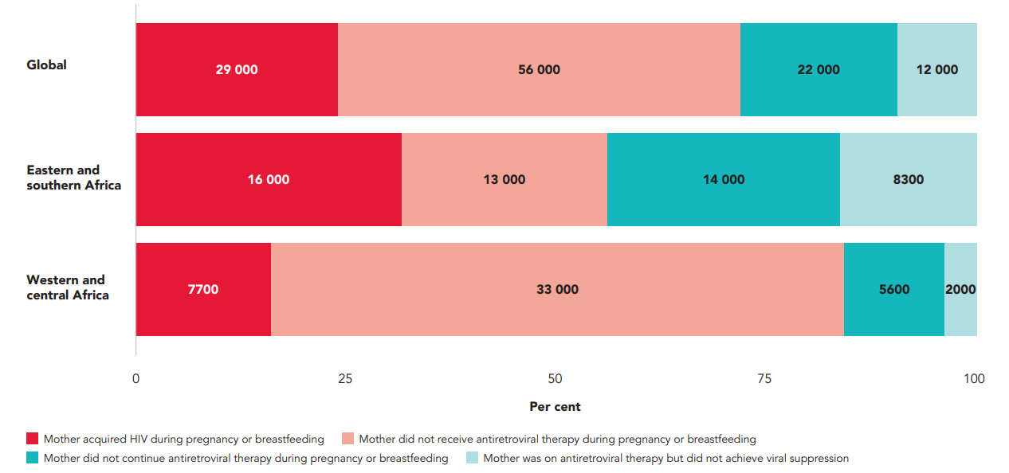
Percentage of new vertical HIV infections by cause of transmission, global and selected regions, 2023
Source: UNAIDS epidemiological estimates, 2024 (https://aidsinfo.unaids.org/).

Slide 58
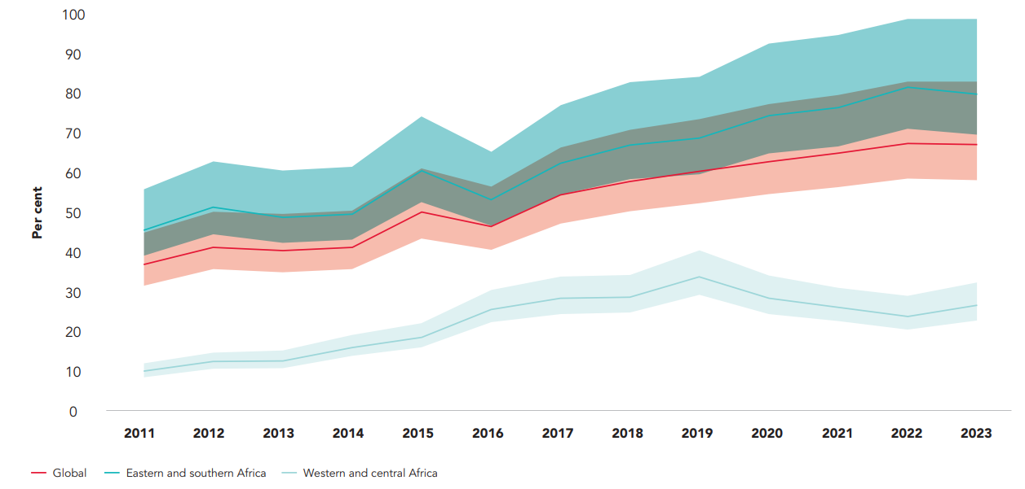
Percentage of children exposed to HIV who were tested for HIV by two months of age, global and selected regions, 2011–2023
Source: UNAIDS epidemiological estimates, 2024 (https://aidsinfo.unaids.org/).

Slide 59
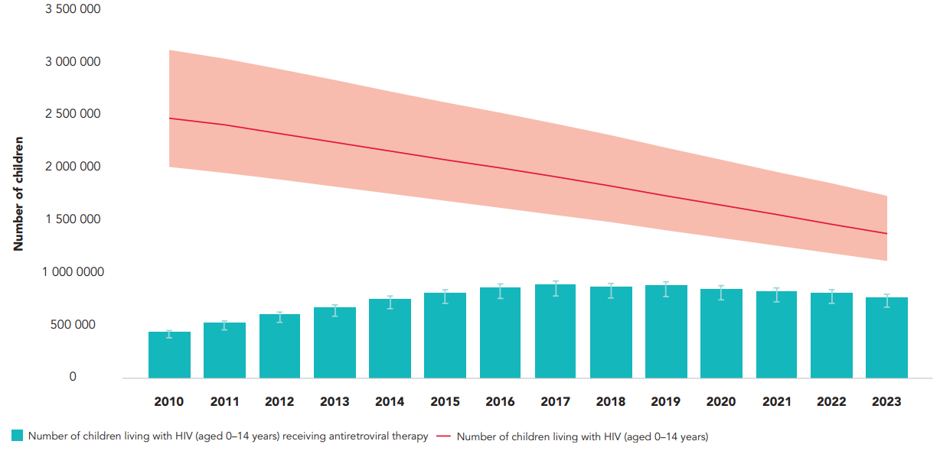
Gap analysis of paediatric HIV treatment, globally, 2010–2023
Source: UNAIDS epidemiological estimates, 2024 (https://aidsinfo.unaids.org/).

Slide 60
Breaking down barriers:
reaching THE 10-10-10
AND 30-80-60 TARGETS
ENDING HIV-RELATED STIGMA AND DISCRIMINATION, GENDER-BASED VIOLENCE AND CRIMINALIZING LAWS

Slide 61
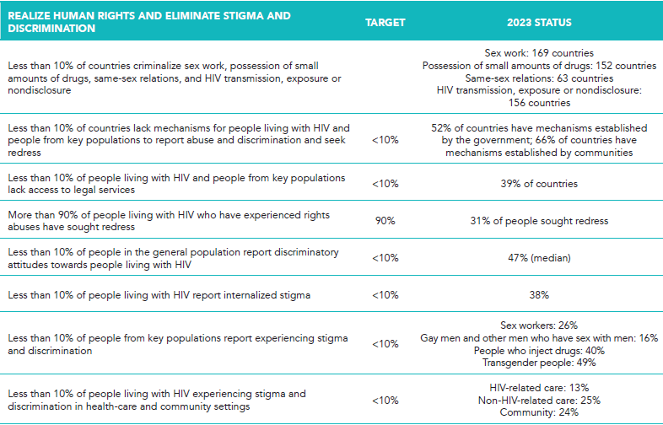
Overview of progress across societal enabler targets

Slide 62
Overview of progress across societal enabler targets

Slide 63
Number of countries with HIV-related discriminatory and punitive laws, global, 2024
Source: National Commitments and Policy Instrument, 2017–2024, supplemented by additional sources; 2024 (see references in regional factsheets and http://lawsandpolicies.unaids.org/).
Note: this figure does not capture where key populations may be de facto criminalized through other laws, such as vagrancy or public morality laws, or the use of the above laws for different populations.

Slide 64
Countries criminalizing HIV nondisclosure, exposure and transmission, global, July 2024
Source: National Commitments and Policy Instrument, 2017–2024, supplemented by additional sources
(see references in regional factsheets and http://lawsandpolicies.unaids.org/).

Slide 65
Countries with laws that criminalize at least some aspect of sex work, global, July 2024
Source: National Commitments and Policy Instrument, 2017–2024, supplemented by additional sources
(see references in regional factsheets and http://lawsandpolicies.unaids.org/).

Slide 66
Countries with laws that criminalize same-sex sexual acts, global, July 2024
Source: National Commitments and Policy Instrument, 2017–2024, supplemented by additional sources
(see references in regional factsheets and http://lawsandpolicies.unaids.org/).

Slide 67
Countries with laws that criminalize the possession of small amounts of drugs, global, July 2024
Source: National Commitments and Policy Instrument, 2017–2024, supplemented by additional sources
(see references in regional factsheets and http://lawsandpolicies.unaids.org/).

Slide 68
Countries with laws that criminalize transgender people, global, July 2024
Source: National Commitments and Policy Instrument, 2017–2024, supplemented by additional sources
(see references in regional factsheets and http://lawsandpolicies.unaids.org/).

Slide 69
Association between recent experience of sexual and/or physical violence and HIV infection among female sex workers, systematic review, 2010–2024
Source: Dawe J, Mazhar KA, Saher AK, Artenie A, Stone J, Hickman M, et al. Impact of societal enablers and barriers on HIV outcomes among female sex workers: a systematic review and metaanalysis (unpublished). Bristol: Population Health Science, University of Bristol; 2024.
Note: n is the number of studies included in pooled and adjusted estimates.

Slide 70
Percentage of women and men (aged 15–49 years) who report accepting attitudes towards violence against women, countries with available data, 2019–2023
Source: Population-based surveys, 2019–2023.
Note: * denotes women only. Accepting attitudes towards violence were defined as agreement with statements on whether a husband is justified in hitting or beating his wife in the following situations: goes out without telling him, neglects the children, argues with him, refuses to have sex with him, burns the food.

Slide 71
Percentage of women and men (aged 15–49 years) who report discriminatory attitudes towards people living with HIV, countries with available data, 2019–2023
Source: Population-based surveys, 2019–2023.
Note: * denotes data for women only. Discriminatory attitudes towards people living with HIV are measured as disagreement with two statements on whether the respondent would buy fresh vegetables from a shopkeeper if they knew the person was living with HIV and whether children living with HIV should be allowed to attend school with children who are HIV-negative.

Slide 72
Percentage of women and men (aged 15–49 years) who report discriminatory attitudes towards people living with HIV, countries with available data, 2000–2023
1/4
Source: Population-based surveys, 2000–2023.
Note: discriminatory attitudes towards people living with HIV are measured as disagreement with two statements on whether the respondent would buy fresh vegetables from a shopkeeper if they knew the person was living with HIV and whether children living with HIV should be allowed to attend school with children who are HIV-negative. The second question was introduced in survey questionnaires more recently, and therefore data for some countries reflect responses only to the first question. Data are for women respondents only for some countries or years.

Slide 73
Percentage of women and men (aged 15–49 years) who report discriminatory attitudes towards people living with HIV, countries with available data, 2000–2023
2/4
Source: Population-based surveys, 2000–2023.
Note: discriminatory attitudes towards people living with HIV are measured as disagreement with two statements on whether the respondent would buy fresh vegetables from a shopkeeper if they knew the person was living with HIV and whether children living with HIV should be allowed to attend school with children who are HIV-negative. The second question was introduced in survey questionnaires more recently, and therefore data for some countries reflect responses only to the first question. Data are for women respondents only for some countries or years.

Slide 74
Percentage of women and men (aged 15–49 years) who report discriminatory attitudes towards people living with HIV, countries with available data, 2000–2023
3/4
Source: Population-based surveys, 2000–2023.
Note: discriminatory attitudes towards people living with HIV are measured as disagreement with two statements on whether the respondent would buy fresh vegetables from a shopkeeper if they knew the person was living with HIV and whether children living with HIV should be allowed to attend school with children who are HIV-negative. The second question was introduced in survey questionnaires more recently, and therefore data for some countries reflect responses only to the first question. Data are for women respondents only for some countries or years.

Slide 75
Percentage of women and men (aged 15–49 years) who report discriminatory attitudes towards people living with HIV, countries with available data, 2000–2023
4/4
Source: Population-based surveys, 2000–2023.
Note: discriminatory attitudes towards people living with HIV are measured as disagreement with two statements on whether the respondent would buy fresh vegetables from a shopkeeper if they knew the person was living with HIV and whether children living with HIV should be allowed to attend school with children who are HIV-negative. The second question was introduced in survey questionnaires more recently, and therefore data for some countries reflect responses only to the first question. Data are for women respondents only for some countries or years.

Slide 76
Experiences of sexual and/or physical violence, stigma and discrimination, and avoidance of health care among people from key populations, reporting countries, 2019–2023
1/4
Source: Global AIDS Monitoring, 2020–2024 (https://aidsinfo.unaids.org/).
ª In the past six months. ^{b} In the past 12 months. ^{c} Ever.

Slide 77
Experiences of sexual and/or physical violence, stigma and discrimination, and avoidance of health care among people from key populations, reporting countries, 2019–2023
2/4
Source: Global AIDS Monitoring, 2020–2024 (https://aidsinfo.unaids.org/).
ª In the past six months. ^{b} In the past 12 months. ^{c} Ever.

Slide 78
Experiences of sexual and/or physical violence, stigma and discrimination, and avoidance of health care among people from key populations, reporting countries, 2019–2023
3/4
Source: Global AIDS Monitoring, 2020–2024 (https://aidsinfo.unaids.org/).
ª In the past six months. ^{b} In the past 12 months. ^{c} Ever.

Slide 79
Experiences of sexual and/or physical violence, stigma and discrimination, and avoidance of health care among people from key populations, reporting countries, 2019–2023
4/4
Source: Global AIDS Monitoring, 2020–2024 (https://aidsinfo.unaids.org/).
ª In the past six months. ^{b} In the past 12 months. ^{c} Ever.

Slide 80
Percentage of people living with HIV who experienced stigma or discrimination due to their HIV status when seeking HIV or other health-care services in the previous 12 months, 25 countries, 2020–2023
Source: People Living with HIV Stigma Index 2.0: global report 2023. Hear us out: community measuring HIV-related stigma and discrimination. Amsterdam: Global Network of People Living with HIV; 2023.

Slide 81
Countries with mechanisms in place to record and address HIV-related discrimination cases and for accessing affordable legal services, 2017–2024
Source: National Commitments and Policy Instrument, 2017–2024.
Note: countries are considered to have mechanisms in place to access legal services if they reported having legal aid systems applicable to HIV casework and at least one of the following: pro bono legal services provided by private law firms, legal services provided by legal clinics, community paralegals or other.

Slide 82
Percentage of people living with HIV who experienced human rights abuses during the past 12 months and sought redress, 25 countries, 2020–2023
Source: People Living with HIV Stigma Index 2.0: global report 2023. Hear us out: community measuring HIV-related stigma and discrimination. Amsterdam: Global Network of People Living with HIV; 2023.

Slide 83
Breaking down barriers:
reaching THE 10-10-10
AND 30-80-60 TARGETS
COMMUNITY-LED INTERVENTIONS DELIVER RESULTS

Slide 84
Countries with laws, regulations or policies providing for the registration of community-led organizations, by regions, 2022‒2024
Source: National Commitments and Policy Instrument, 2022‒2024.

Slide 85
Services that can be legally provided by community-led organizations, by region, 2024
Source: National Commitments and Policy Instrument, 2024.

Slide 86
Countries with laws, regulations or policies enabling access to funding for community-led organizations, by regions, 2022–2024
Source: National Commitments and Policy Instrument, 2022–2024.

Slide 87
Participation of people living with HIV, people from key populations and young people in the development of policies, guidelines or strategies related to their health, global, 2017–2024
Source: National Commitments and Policy Instrument, 2017–2024.
Note: participation of women living with HIV refers specifically to development of policies, guidelines or strategies related to prevention of vertical transmission.

Slide 88
Distribution of the reported number of people from key populations reached with HIV prevention interventions by type of provider, 2019–2023
Source: Global AIDS Monitoring, 2020–2024 (https://aidsinfo.unaids.org/).
Note: n = number of countries.

Slide 89
Distribution of reported services for people from key populations by type of provider, 2019–2023
Source: Global AIDS Monitoring, 2020–2024 (https://aidsinfo.unaids.org/).
Note: n = number of countries.

Slide 90
INTEGRATING
AND RESOURCING
HIV RESPONSES
INTEGRATION OF STRATEGIES, SERVICES AND SYSTEMS

Slide 91
Estimated number of tuberculosis (TB)-related deaths among people living with HIV, global, 2000–2022
Source: Global tuberculosis report 2023. Geneva: World Health Organization; 2023.

Slide 92
Estimated number of incident cases of tuberculosis (TB) among people living with HIV, number of people notified with a new or relapse episode of TB who were known to be living with HIV, and number of people living with HIV with TB on antiretroviral therapy, 2010–2022
Source: Global tuberculosis report 2023. Geneva: World Health Organization; 2023.

Slide 93
Number of people living with HIV and enrolled on antiretroviral therapy who started tuberculosis (TB) preventive treatment, global, 2022–2022
Source: Global AIDS Monitoring 2011–2023 (https://aidsinfo.unaids.org/); Global tuberculosis report 2023. Geneva: World Health Organization; 2023.
Note: before 2017, countries reported the number of people who received TB preventive treatment among people living with HIV newly enrolled on antiretroviral therapy. From 2017 onwards, countries had the option to also report on the number of people that received TB preventive treatment among all people currently on antiretroviral therapy, including those who had started antiretroviral therapy before the previous year/reporting period.

Slide 94
Gaps in tuberculosis (TB) detection and prevention among people newly enrolled on antiretroviral therapy, high TB/HIV burden countries with available data, 2022
Source: Global AIDS Monitoring 2023 (https://aidsinfo.uniads.org/); Global tuberculosis report 2023. Geneva: World Health Organization; 2023.
Note: data are shown for the 30 high TB/HIV burden countries with available data on the number of people newly initiated on antiretroviral therapy, started on TB preventive treatment, and detected and notified with TB.

Slide 95
Status of integration of HIV and tuberculosis services, countries with available data, 2020–2024
Source: National Commitments and Policy Instrument, 2020‒2024 (https://lawsandpolicies.unaids.org/).

Slide 96
Percentage of women and girls whose demand for family planning is satisfied by modern methods of contraception, by age, selected regions, 2015–2022
Source: The DHS Program STATcompiler. Funded by USAID. http://www.statcompiler.com. Accessed on July 8, 2024.
Note: Percentage of demand for family planning satisfied by modern methods of contraception is calculated as the number of all women using modern methods of family planning divided by the number of all women with demand for family planning (either with unmet need or currently using any family planning).

Slide 97
INTEGRATING
AND RESOURCING
HIV RESPONSES
RESOURCING THE HIV RESPONSE

Slide 98
Resource availability for HIV in low- and middle-income countries, by source, 2000–2023, and 2025 target
Source: UNAIDS financial estimates, July 2024 (http://hivfinancial.unaids.org/hivfinancialdashboards.html).

Slide 99
Amount and source of HIV prevention spending, by region, 2023
Source: UNAIDS financial estimates, July 2024 (http://hivfinancial.unaids.org/hivfinancialdashboards.html); Global AIDS Monitoring, 2024 (https://aidsinfo.unaids.org/).

Slide 100
Distribution of funding for societal enabler programmes, by region, 2023
Source: Global AIDS Monitoring, 2024 (https://aidsinfo.unaids.org).

Slide 101
Percentage shares of domestic and international resources for HIV prevention programmes, by key population, 2023
Source: UNAIDS HIV Financial dashboard; Global AIDS Monitoring, 2024 (https://aidsinfo.unaids.org/).

Slide 102
International and domestic resources as a percentage of total health spending, total HIV spending and HIV prevention spending, by country income group, 2021
Source: UNAIDS financial estimates, July 2024 (http://hivfinancial.unaids.org/hivfinancialdashboards.html); and WHO Health Expenditure Database, May 2024 (https://apps.who.int/nha/database/).

Slide 103
Annual change in domestic spending, by income groups of countries, 2015–2023
Source: UNAIDS financial estimates, July 2024 (http://hivfinancial.unaids.org/hivfinancialdashboards.html).

Slide 104
Change in domestic public spending, by country, 2018–2023
Source: UNAIDS HIV Financial Dashboard (https://hivfinancial.unaids.org/hivfinancialdashboards.html); Global AIDS Monitoring, 2024 (https://aidsinfo.unaids.org/).

Slide 105
Resource availability for HIV programmes from international sources in low- and middle-income countries, 2000–2023
Source: UNAIDS financial estimates, July 2024 (http://hivfinancial.unaids.org/hivfinancialdashboards.html).
Note: the resource estimates are presented in constant 2019 US$ billions.

Slide 106
Average procurement prices (US$ per person year) of antiretroviral medicines, by region, 2020–2022
Source: UNAIDS financial estimates using Global AIDS Monitoring, 2024 (https://aidsinfo.unaids.org/); government customs data (https://www.seair.co.in).
Note: procurement prices include freight costs and import duties.

Slide 107
Average procurement prices (US$ per person year) of antiretroviral medicines, by country income group, 2020–2022
Source: UNAIDS financial estimates using Global AIDS Monitoring, 2024 (https://aidsinfo.unaids.org/); government customs data (https://www.seair.co.in).

Slide 108
Main sources of funding for community-led organizations and their activities in Pakistan, 2022
Source: Pakistan National AIDS Spending Assessment report, 2024.

Slide 109
TAKING A SUSTAINABLE
HIV RESPONSE TO 2030
AND BEYOND

Slide 110
Projections of numbers of people living with HIV globally in 2030 and 2050 in status quo scenario and if the 2025 targets are met and maintained
Source: Special analysis by Avenir Health using Goals model, November 2023.

Slide 111
A continuum of milestones and targets
Source: Khawar L, Donovan B, Peeling RW, Guy RJ, McGregor S. Elimination and eradication goals for communicable diseases: a systematic review. Bull World Health Organ. 2023;101(10):649–665.

Slide 112
Projected age of people living with HIV and viral suppression in eastern and southern Africa in 2010, 2030 and 2050
Source: UNAIDS epidemiological estimates, 2023 (https://aidsinfo.unaids.org/); Eaton J, Stover J. Describing the end of AIDS as a public health threat. Technical consultation, 20–21 July 2023, Boston, MA (https://jointsiwg.unaids.org/publication/describing-the-end-of-aids-as-a-public-health-threat/).

Slide 113
ASIA AND
THE PACIFIC

Slide 114
Numbers of new HIV infections and AIDS-related deaths, Asia and the Pacific, 2000–2023
Source: UNAIDS epidemiological estimates, 2024 (https://aidsinfo.unaids.org/).

Slide 115
Distribution of new HIV infections and percentage change among adults, Asia and the Pacific, 2010 and 2022
Source: Korenromp EL, Sabin K, Stover J, Brown T, Johnson LF, Martin-Hughes R, et al. New HIV infections among key populations and their partners in 2010 and 2022, by world region: a multisources estimation. J Acquir Immune Defic Syndr. 2024;95(1S):e34–e45.

Slide 116
Proportion of spending on prevention programmes for people from key populations out of total HIV expenditure, selected countries in Asia and the Pacific where data are available, 2024
Source: UNAIDS financial estimates, July 2024 (http://hivfinancial.unaids.org/hivfinancialdashboards.html); Global AIDS Monitoring, 2024 (https://aidsinfo.unaids.org/).

Slide 117
CARIBBEAN

Slide 118
Numbers of new HIV infections and AIDS-related deaths, Caribbean, 2000–2023
Source: UNAIDS epidemiological estimates, 2024 (https://aidsinfo.unaids.org/).

Slide 119
Distribution of new HIV infections and percentage change among adults, the Caribbean, 2010 and 2022
Source: Korenromp EL, Sabin K, Stover J, Brown T, Johnson LF, Martin-Hughes R, et al. New HIV infections among key populations and their partners in 2010 and 2022, by world region: a multisources estimation. J Acquir Immune Defic Syndr. 2024;95(1S):e34–e45.

Slide 120
Resource availability for HIV, Caribbean, 2010–2023
Source: UNAIDS financial estimates, July 2024 (http://hivfinancial.unaids.org/hivfinancialdashboards.html).

Slide 121
EASTERN EUROPE
AND CENTRAL ASIA

Slide 122
Numbers of new HIV infections and AIDS-related deaths, eastern Europe and central Asia, 2000–2023
Source: UNAIDS epidemiological estimates, 2024 (https://aidsinfo.unaids.org/).

Slide 123
Distribution of new HIV infections and percentage change among adults, eastern Europe and central Asia, 2010 and 2022
Source: Korenromp EL, Sabin K, Stover J, Brown T, Johnson LF, Martin-Hughes R, et al. New HIV infections among key populations and their partners in 2010 and 2022, by world region: a multisources estimation. J Acquir Immune Defic Syndr. 2024;95(1S):e34–e45.

Slide 124
Countries with discriminatory and punitive laws, eastern Europe and central Asia, 2024
Source: National Commitments and Policy Instrument, 2017–2024 (http://lawsandpolicies.unaids.org/), supplemented by additional sources (see references in regional factsheet and http://lawsandpolicies.unaids.org/).

Slide 125
EASTERN AND
SOUTHERN AFRICA

Slide 126
Numbers of new HIV infections and AIDS-related deaths, eastern and southern Africa, 2000–2023
Source: UNAIDS epidemiological estimates, 2024 (https://aidsinfo.unaids.org/).

Slide 127
Distribution of new HIV infections and percentage change among adults, eastern and southern Africa, 2010 and 2022
Source: Korenromp EL, Sabin K, Stover J, Brown T, Johnson LF, Martin-Hughes R, et al. New HIV infections among key populations and their partners in 2010 and 2022, by world region: a multisources estimation. J Acquir Immune Defic Syndr. 2024;95(1S):e34–e45.

Slide 128
Resource availability for HIV, eastern and southern Africa, 2010–2023
Source: UNAIDS financial estimates, July 2024 (http://hivfinancial.unaids.org/hivfinancialdashboards.html).

Slide 129
LATIN AMERICA

Slide 130
Numbers of new HIV infections and AIDS-related deaths, Latin America, 2000–2023
Source: UNAIDS epidemiological estimates, 2024 (https://aidsinfo.unaids.org/).

Slide 131
Distribution of new HIV infections and percentage change among adults, Latin America, 2010 and 2022
Source: Korenromp EL, Sabin K, Stover J, Brown T, Johnson LF, Martin-Hughes R, et al. New HIV infections among key populations and their partners in 2010 and 2022, by world region: a multisources estimation. J Acquir Immune Defic Syndr. 2024;95(1S):e34–e45.

Slide 132
Resource availability for HIV, Latin America, 2010–2023
Source: UNAIDS financial estimates, July 2024 (http://hivfinancial.unaids.org/hivfinancialdashboards.html).

Slide 133
MIDDLE EAST AND
NORTH AFRICA

Slide 134
Numbers of new HIV infections and AIDS-related deaths, Middle East and North Africa, 2000–2023
Source: UNAIDS epidemiological estimates, 2024 (https://aidsinfo.unaids.org/).

Slide 135
Distribution of new HIV infections and percentage change among adults, Middle East and North Africa, 2010 and 2022
Source: Korenromp EL, Sabin K, Stover J, Brown T, Johnson LF, Martin-Hughes R, et al. New HIV infections among key populations and their partners in 2010 and 2022, by world region: a multisources estimation. J Acquir Immune Defic Syndr. 2024;95(1S):e34–e45.

Slide 136
Resource availability for HIV, Middle East and North Africa, 2010–2023
Source: UNAIDS financial estimates, July 2024 (http://hivfinancial.unaids.org/hivfinancialdashboards.html).

Slide 137
WESTERN AND
CENTRAL AFRICA

Slide 138
Numbers of new HIV infections and AIDS-related deaths, western and central Africa, 2000–2023
Source: UNAIDS epidemiological estimates, 2024 (https://aidsinfo.unaids.org/).

Slide 139
Distribution of new HIV infections and percentage change among adults, western and central Africa, 2010 and 2022
Source: Korenromp EL, Sabin K, Stover J, Brown T, Johnson LF, Martin-Hughes R, et al. New HIV infections among key populations and their partners in 2010 and 2022, by world region: a multisources estimation. J Acquir Immune Defic Syndr. 2024;95(1S):e34–e45.

Slide 140
Resource availability for HIV, western and central Africa, 2010–2023
Source: UNAIDS financial estimates, July 2024 (http://hivfinancial.unaids.org/hivfinancialdashboards.html).

Slide 141
WESTERN AND CENTRAL EUROPE AND NORTH
AMERICA

Slide 142
Number of new HIV infections and AIDS-related deaths, western and central Europe and North America, 2000–2023
Source: UNAIDS epidemiological estimates, 2024 (https://aidsinfo.unaids.org/).

Slide 143
Distribution of new HIV infections and percentage change among adults, western and central Europe and North America, 2010 and 2022
Source: Korenromp EL, Sabin K, Stover J, Brown T, Johnson LF, Martin-Hughes R, et al. New HIV infections among key populations and their partners in 2010 and 2022, by world region: a multisources estimation. J Acquir Immune Defic Syndr. 2024;95(1S):e34–e45.

Slide 144
ANNEX 1
PROGRESS TOWARDS
THE 2025 TARGETS

Slide 145
Number of new HIV infections, global, 1990–2023, and 2025 target
Source: UNAIDS epidemiological estimates, 2024 (https://aidsinfo.unaids.org/).

Slide 146
Number of AIDS-related deaths, global, 1990–2023, and 2025 target
Source: UNAIDS epidemiological estimates, 2024 (https://aidsinfo.unaids.org/).

Slide 147
Progress towards the 95–95–95 testing, treatment and viral load suppression targets, total population, global, 2015 and 2023
Source: Further analysis of UNAIDS epidemiological estimates, 2024.

Slide 148
Number of countries with HIV-related discriminatory and punitive laws, global, 2024
Source: National Commitments and Policy Instrument, 2017–2024, supplemented by additional sources; 2024 (see references in regional factsheets and http://lawsandpolicies.unaids.org/).
Note: this figure does not capture where key populations may be de facto criminalized through other laws, such as vagrancy or public morality laws, or the use of the above laws for different populations.

Slide 149
Percentage of women and men (aged 15–49 years) who report discriminatory attitudes towards people living with HIV, countries with available data, 2019–2023
Source: Population-based surveys, 2019–2023.
Note: * denotes data for women only. Discriminatory attitudes towards people living with HIV are measured as disagreement with two statements on whether the respondent would buy fresh vegetables from a shopkeeper if they knew the person was living with HIV and whether children living with HIV should be allowed to attend school with children who are HIV-negative.

Slide 150
Resource availability for HIV in low- and middle-income countries, by source, 2010–2023, and 2025 target
Source: UNAIDS financial estimates, July 2024 (http://hivfinancial.unaids.org/hivfinancialdashboards.html).

Slide 151
ANNEX 2
METHODS

Slide 152
Incidence models used for national HIV estimates collated in the Spectrum software and UNAIDS 2024 estimates round

Slide 153
Comparison of 2023 and 2024 UNAIDS estimates: people living with HIV, new HIV infections, and AIDS-related deaths, global, 1990–2023
1/3
Source: UNAIDS epidemiological estimates, 2023 and 2024 rounds.

Slide 154
Comparison of 2023 and 2024 UNAIDS estimates: people living with HIV, new HIV infections, and AIDS-related deaths, global, 1990–2023
2/3
Source: UNAIDS epidemiological estimates, 2023 and 2024 rounds.

Slide 155
Comparison of 2023 and 2024 UNAIDS estimates: people living with HIV, new HIV infections, and AIDS-related deaths, global, 1990–2023
3/3
Source: UNAIDS epidemiological estimates, 2023 and 2024 rounds.

Slide 156
Data available for constructing UNAIDS measures of progress against the 95–95–95 targets, 2015–2023
1/3
Source: UNAIDS epidemiological estimates, 2015–2023.
Note: Not counting countries that published numbers of adults living with HIV who knew their status, were on treatment or virally suppressed but missing a corresponding estimate of numbers of adults living with HIV.

Slide 157
Data available for constructing UNAIDS measures of progress against the 95–95–95 targets, 2015–2023
2/3
Source: UNAIDS epidemiological estimates, 2015–2023.
Note: Not counting countries that published numbers of adults living with HIV who knew their status, were on treatment or virally suppressed but missing a corresponding estimate of numbers of adults living with HIV.

Slide 158
Data available for constructing UNAIDS measures of progress against the 95–95–95 targets, 2015–2023
3/3
Source: UNAIDS epidemiological estimates, 2015–2023.
Note: Not counting countries that published numbers of adults living with HIV who knew their status, were on treatment or virally suppressed but missing a corresponding estimate of numbers of adults living with HIV.

Slide 159
Proportion of estimated people living with HIV for whom knowledge of status was imputed, and proportion of estimated people on treatment for whom viral suppression was imputed, 2015–2023
Source: UNAIDS epidemiological estimates, 2016–2023.

Slide 160
Countries using the Naomi model to generate subnational estimates

Slide 161
Thanks to all UNAIDS colleagues, and cosponsors and partners for their contributions

