Slide 1
UNAIDS
2024 Global AIDS Monitoring
Notes:
This presentation gives you an overview of the Global AIDS Monitoring mechanism. It is focused on measuring progress towards the global AIDS targets set for 2025 and ending AIDS by 2030.

Slide 2
Components of 2024 GAM reports
Notes:
The Global AIDS Monitoring consists of several components.

Slide 3
2024 GAM reporting
Indicator data
Including disaggregations and sub-national data, where requested
National Commitments and Policy Instrument (NCPI)
Narrative report (optional)
AIDS Medicines and Diagnostics Survey
Link to the reporting platform:
https://aidsreportingtool.unaids.org/
Notes:
The indicators are over 70, and country responses include stating which indicators are relevant to their AIDS response, and if they have new data available.
Besides the indicators, the reporting platform includes a laws and policies questionnaire called National Commitments and Policy Instrument, which has separate components to be filled by government and civil society.
The reporting platform also supports the writing of a narrative report, in the form of summaries by commitment areas in the 2021 Political Declaration on HIV and AIDS. The narrative summaries can help in documenting the key observations on the AIDS response, and actions required to speed up progress.
The AIDS medicines and diagnostics survey is conducted in collaboration with WHO and is an important tool in monitoring whether the health system is equipping the response appropriately.

Slide 4
Changes to GAM indicators since 2023 reporting
Notes:
The Global AIDS Monitoring structure and numbering remains the same as in 2023 and is aligned to the Global AIDS Strategy and the political declaration of 2021. Several new indicators have been included in the GAM framework to monitor areas that were previously missing in the framework. Minor changes have been made to definitions of existing indicators.

Slide 5
Four new indicators related to the 10-10-10 targets on achieving gender equality, realizing human rights, and eliminating stigma and discrimination:
4.3 Gender-responsiveness of HIV services*
6.8 Discriminatory attitudes towards people living with HIV among health facility staff
6.9 Discriminatory attitudes towards people from key populations among health facility staff (A‒D)
6.10 Discriminatory attitudes towards people from key populations among police (A‒D)*
Three new indicators on management of advanced HIV disease and differentiated service delivery:
2.8 Management of cryptococcal infection
7.15 Coverage of differentiated service delivery antiretroviral therapy models among people living with HIV currently on antiretroviral therapy
7.16 Viral suppression among people living with HIV engaged in differentiated service delivery antiretroviral therapy models
*Indicators based on new data collection tools. Technical briefs with the tools and guidance for implementation will be available soon.

Slide 6
2.4 Late HIV diagnosis:
Indicator name updated to “Advanced HIV disease and late HIV diagnosis”
Focuses on people with a CD4 cell count <200cells/mm3 (or <15% for children)
New disaggregation by time of CD4 cell count (at initial diagnosis, at initiation/re-initiation of ART)
Data requested on the total number of people who received a CD4 test at initial diagnosis and at initiation/re-initiation of ART in four categories of CD4 cell count (>200, 200 to <350, 350 to <500, ≥500)
3.1 HIV testing in pregnant women: Countries with a population of more than 250 000 people will now report on this indicator within Spectrum.
6.6 Avoidance of health care among key populations because of stigma and discrimination (A–D): Modified to refer only to avoidance of health-care services among key populations. The other three sub-items previously included in the indicator definition have been removed.
8.2 Antiretroviral medicines: unit prices and volume: Expanded to include other HIV-related regimens beyond ARVs. See updated Annex 3 for full list.

Slide 7
Terminology updates:
“Prisoners” has been updated throughout the guidelines to “people in prisons and other closed settings”
1.4 HIV testing among key populations (A–D): The indicator name has been updated to “HIV testing and status awareness among key populations” to better reflect the purpose of this indicator
7.8 People living with HIV with active tuberculosis disease: “Active TB disease” has been updated throughout to “TB disease”
The NCPI for 2024 reporting consists of Part A (to be completed by national authorities) and Part B (to be completed by community and civil society representatives and other non-governmental partners). The wording of some of the questions has been further refined based on experiences in previous reporting rounds and to reflect developments in policy recommendations and available technologies. Some questions have also been added and others removed.
Notes:
The NCPI questionnaire is the full questionnaire. It consists of Part A (to be completed by national authorities) and Part B (to be completed by community and civil society representatives and other non-governmental partners). The wording of some of the questions has been further refined based on experiences in previous reporting rounds and to reflect developments in policy recommendations and available technologies. Some questions have also been added and others removed.

Slide 8
The reporting process
Notes:
In the following slides we illustrate the recommended steps in carrying out the annual national AIDS reporting, dividing it into three phases; 1) preparation; 2) the reporting; and 3) the follow-up.

Slide 9
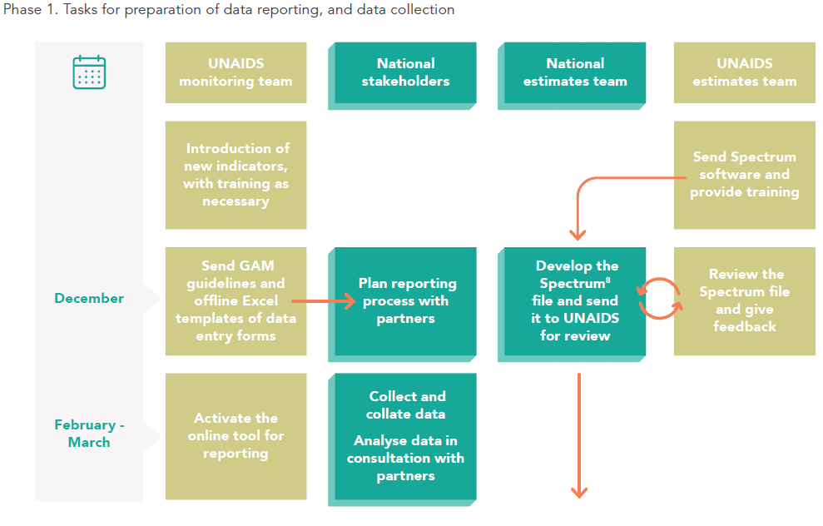
Global AIDS Monitoring reporting process
Notes:
In the preparation phase, from December to February, the national rapporteur receives a confirmation message from UNAIDS on the reporting process.
The preparatory steps are described in the guideline documents. They include identifying indicators and data sources, resource persons, and ensuring the participation of key stakeholders such as government and civil society leads and the HIV estimates team to the process.

Slide 10
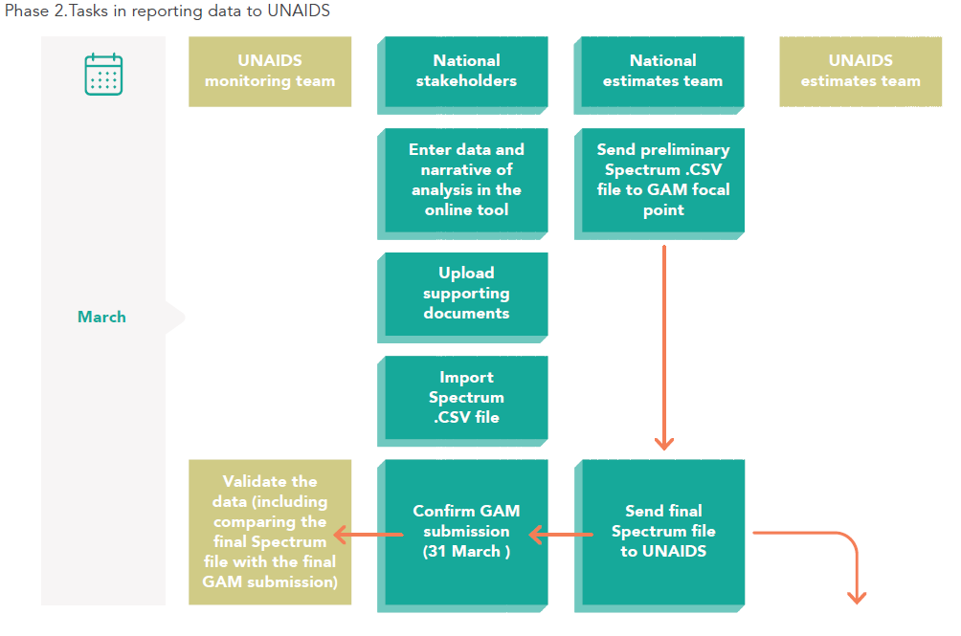
Global AIDS Monitoring reporting process - preparation
Notes:
In the second phase, in March, when conducting the reporting, the national rapporteur enters the relevant data and the narrative report in the online tool; uploads all supporting documents and confirms the GAM submission by the 31st of March.

Slide 11
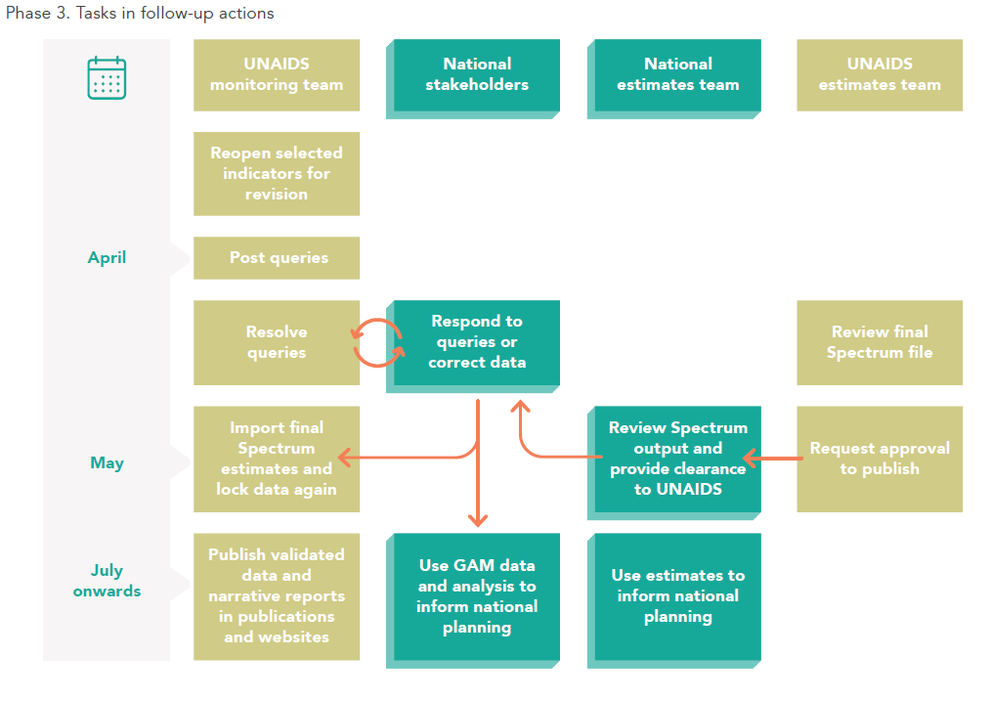
Global AIDS Monitoring reporting process – after submission
Notes:
In the last phase, April to June, the national rapporteur has still some follow-up tasks. UNAIDS may have data queries to the national rapporteurs, which are important to be addressed before the final data set is made public. The rapporteurs can also use extracts from the GAM online reporting tool to inform any public national events, forums or programme reviews on progress towards ending AIDS by 2030.
As part of the finalization process, reported data should be validated and reconciled between all partners in the country, including community-led organizations. The online reporting tool supports this process through the ability to share viewer credentials with national stakeholders.
Several countries have reported that this feature enabled community-led organizations and other partners to view and provide input during the reporting process, enabling wider and more rapid stakeholder consultation and validation.

Slide 12
Spectrum and Naomi estimates
One of the main tools that can be used to obtain denominators for reporting is the Spectrum software package.
Countries can select to use Spectrum estimates as the source for reporting on the following GAM indicators:
1.1. HIV incidence
2.1, 2.2 and 2.3. 95-95-95. HIV testing and treatment
2.7. AIDS mortality
3.1 HIV testing in pregnant women
3.2. Early infant diagnosis
3.3. Vertical transmission of HIV
3.4. Preventing the vertical transmission of HIV
Results will be obtained directly from the final national Spectrum file. Reporting on sub-national data for the indicator will be done in the Global AIDS Monitoring reporting tool
For indicators above where sub-national data are requested: if a country has sub-national estimates developed using Naomi, these data will be obtained directly from the final Naomi file.
Notes:
One of the main tools that can be used to obtain denominators for reporting is the Spectrum software package.
To reduce the manual data entry, countries can select to use Spectrum as the source. Results will be obtained directly by UNAIDS from the final national Spectrum file.

Slide 13
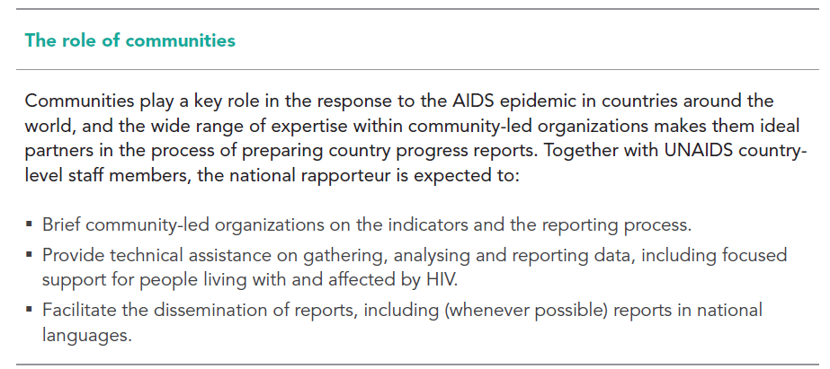
Multisectoral engagement
Countries are encouraged to engage a multisectoral group of stakeholders in the GAM reporting process, including from community-led organizations and appropriate civil society representatives
Notes:
Communities and civil society play important roles in the AIDS response. The reporting process benefits of the close participation of community and civil society representatives who can give insights on the status of the AIDS response, as well as help identify barriers to effective service delivery.

Slide 14
Support during the GAM reporting process
Notes:
In the following we summarize few resources available to you on the reporting process.

Slide 15
Support during the reporting process
Technical assistance is available from UNAIDS, UNICEF and/or WHO country offices
Support is also available from the UNAIDS Strategic Information Department (AIDSreporting@unaids.org)
Notes:
You may seek for support from UNAIDS, UNICEF or WHO offices present in your country, or email to AIDSreporting@unaids.org

Slide 16
Where to find previously reported data
Notes:
Data reported in previous reporting rounds that have been validated are available on the AIDSinfo.unaids.org web-site.

Slide 17
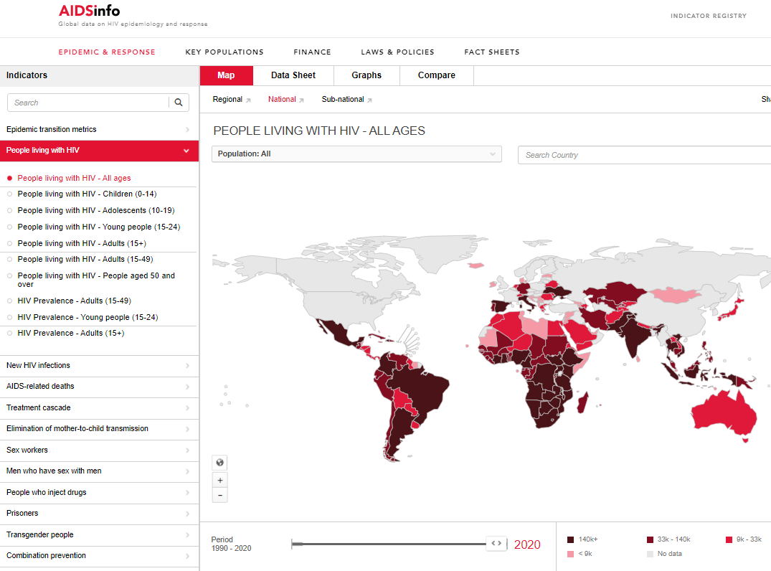
aidsinfo.unaids.org
Notes:
You can view the epidemiological and other indicator data from the main site; using maps, data sheets, graphs, or doing country comparisons.

Slide 18
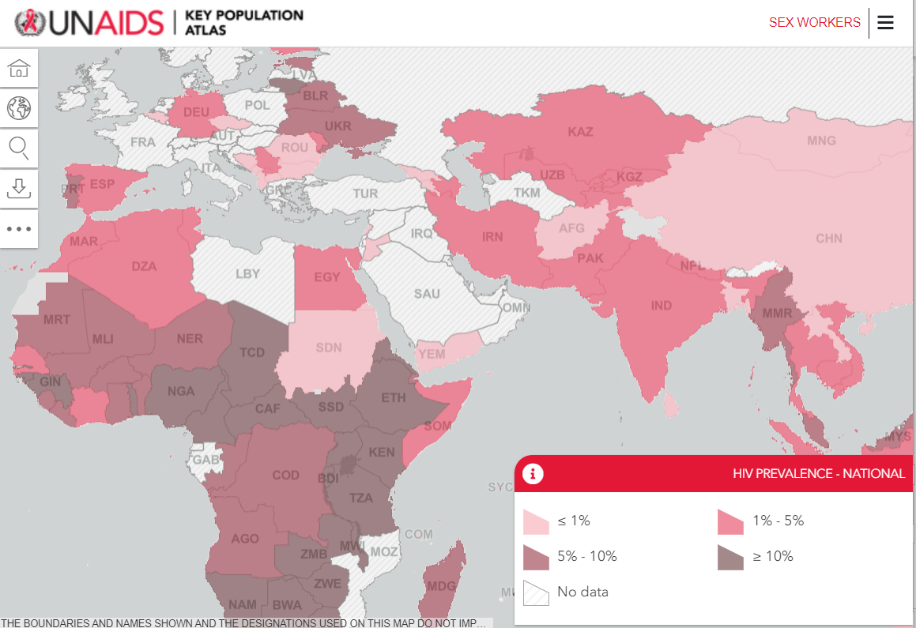
http://kpatlas.unaids.org/dashboard
Notes:
Key Population Atlas focuses on key populations data, covering SEX WORKERS, MEN WHO HAVE SEX WITH MEN, PEOPLE WHO INJECT DRUGS, TRANSGENDER PEOPLE, PRISONERS, and PEOPLE LIVING WITH HIV

Slide 19
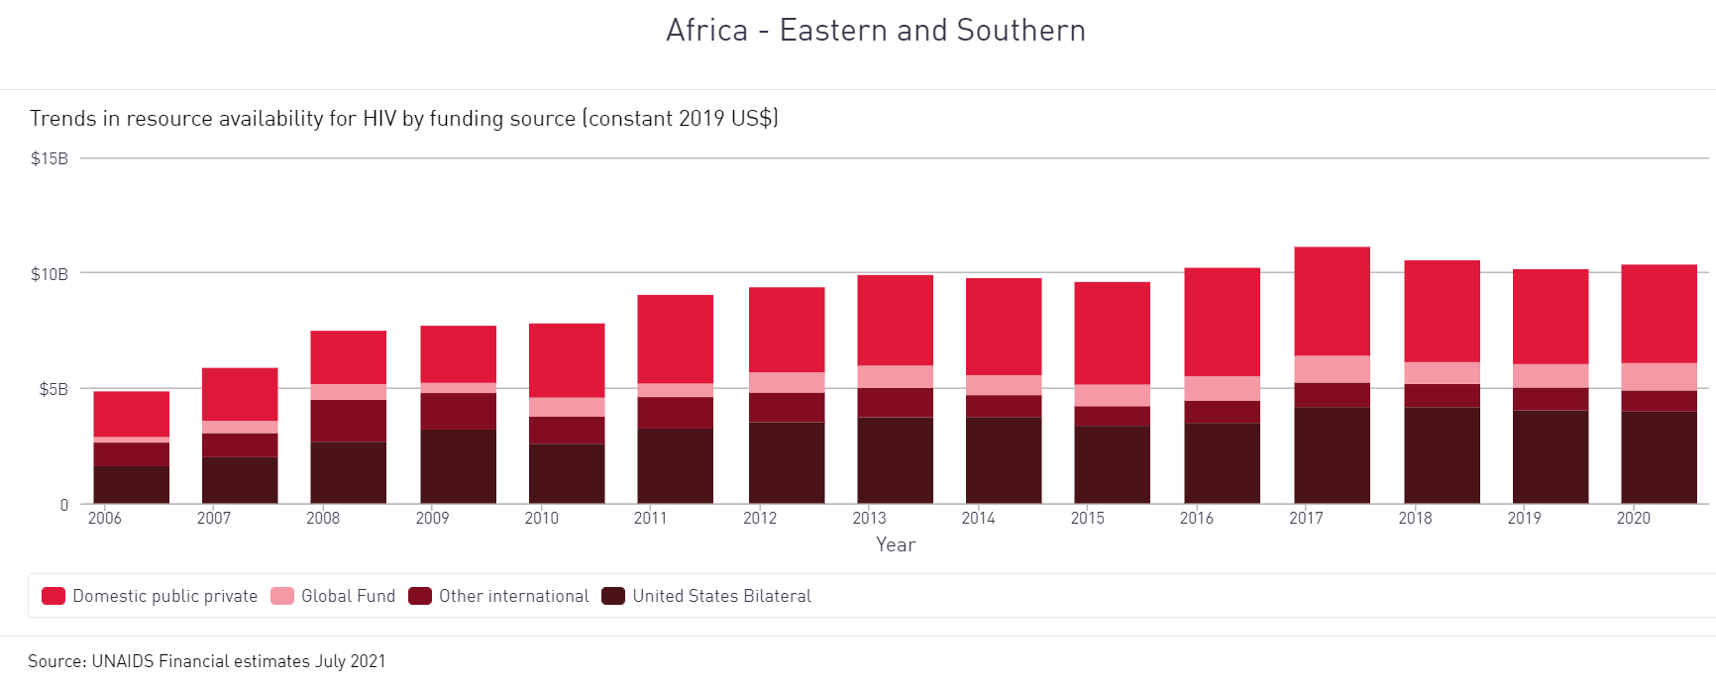
http://hivfinancial.unaids.org/hivfinancialdashboards.html
Notes:
The financial dashboards includes global, regional, and country by country data on the financing and spending of the AIDS response.

Slide 20
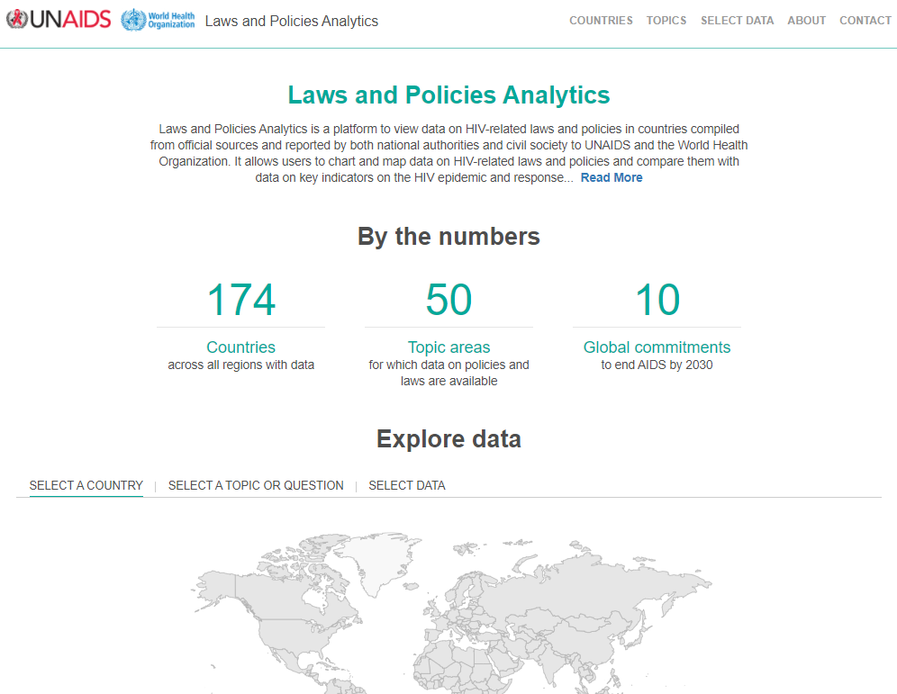
http://lawsandpolicies.unaids.org/
Notes:
In the laws and policies analytics you can look up policy and laws data reported through the NCPI and compiled by UNAIDS from other sources, including country documents and other global databases. Data can be searched by regions or specific countries, by topics and questions, and can be viewed in tables, graphs or maps.

Slide 21
For more information visit:
https://www.unaids.org/en/global-aids-monitoring

